Slide 1
Englısh Performance
Homework

Slide 2
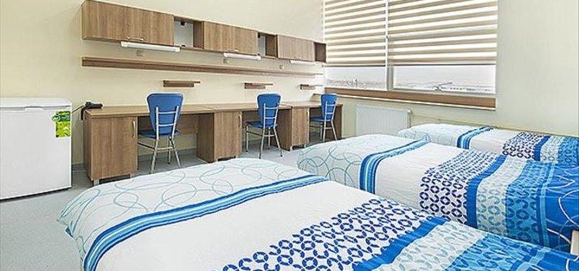
Dormitory
the place where a person was born, raised, lived, father's hearth.

Slide 3
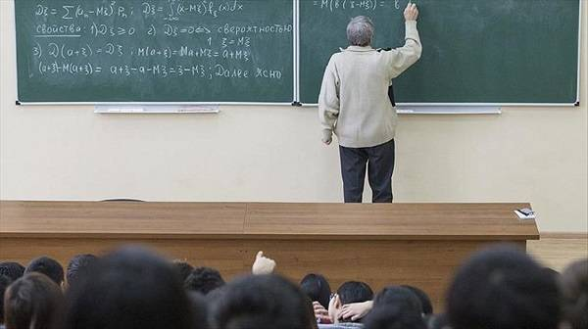
Compulsory
whose existence is clearly needed.

Slide 4
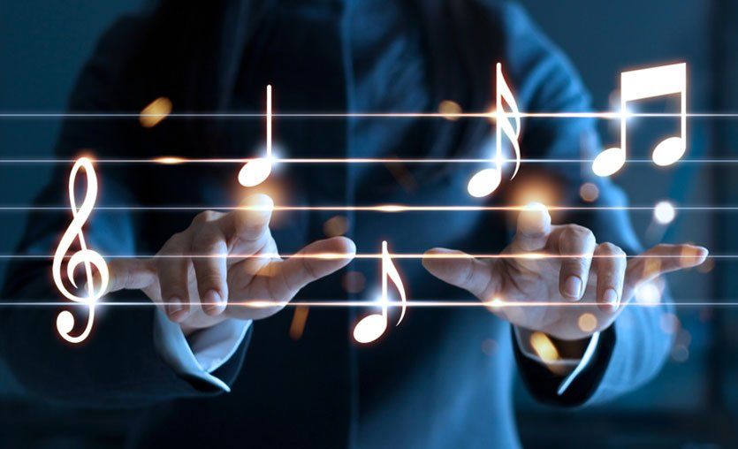
Elective
free to choose or not to do as she pleases.

Slide 5
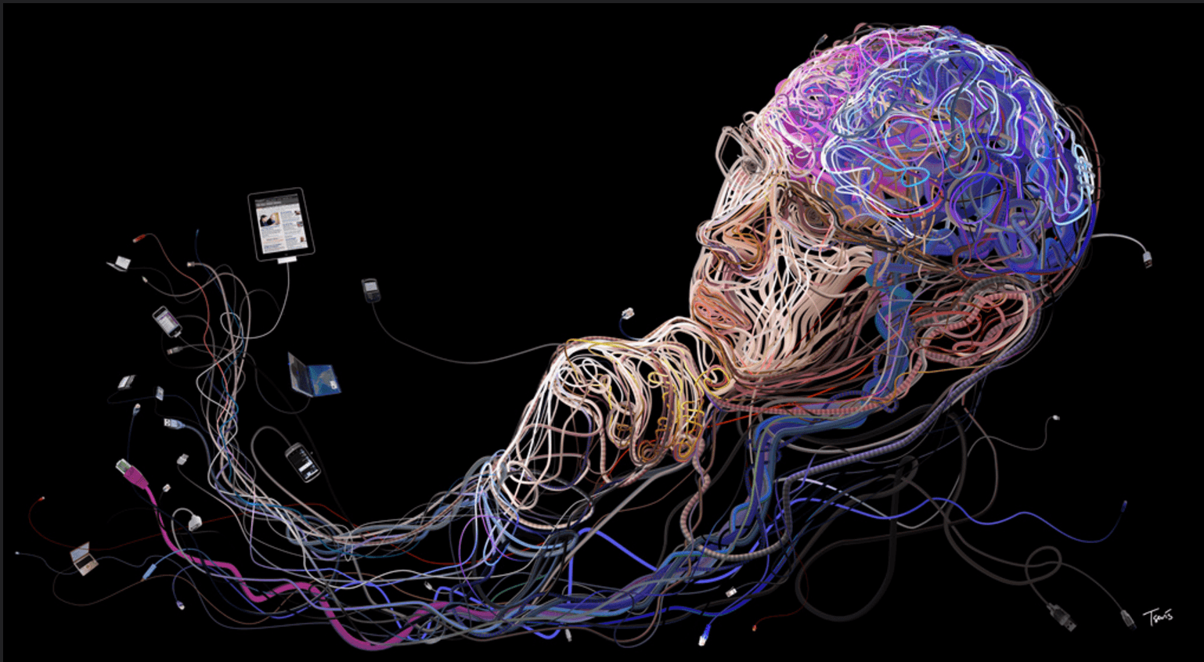
Informatıon
The name given to all the facts, facts and principles that the human mind can take.

Slide 6
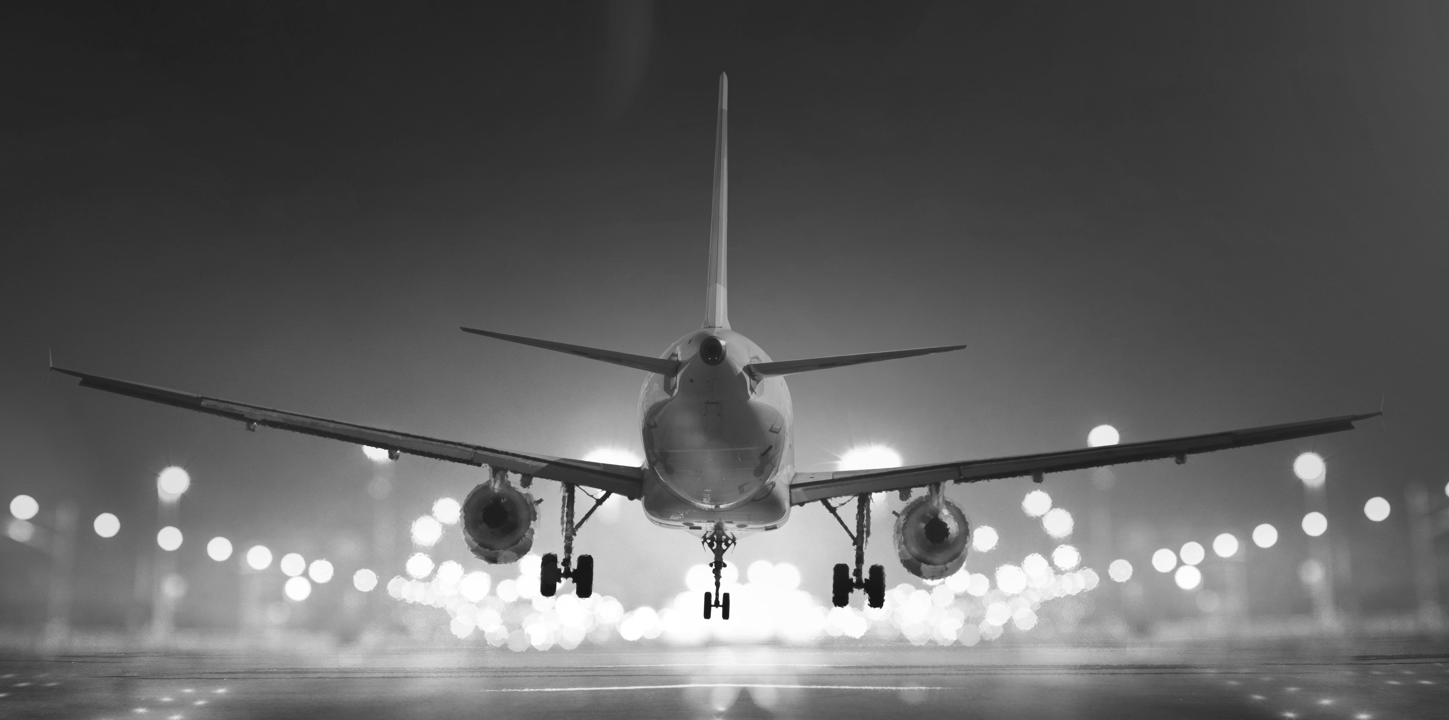
Aviation
work of the aviator.

Slide 7
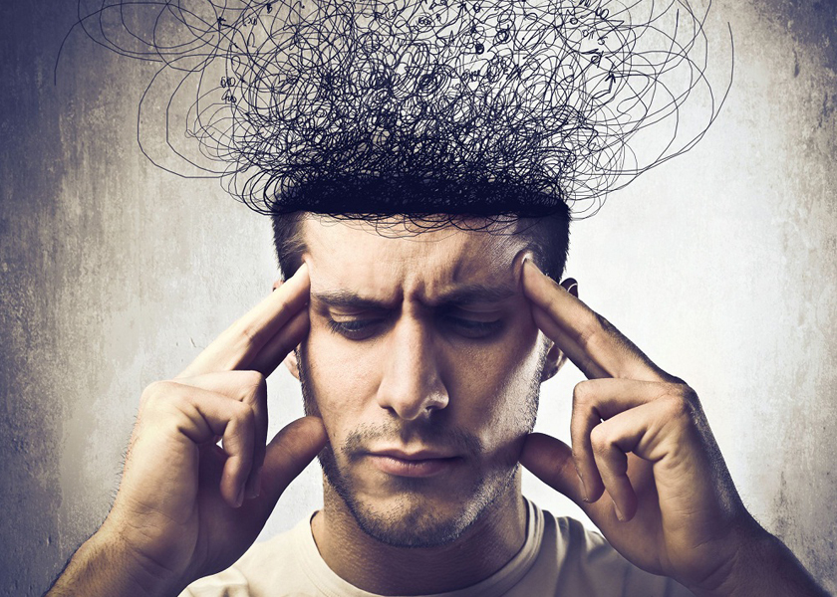
Consider
To examine and compare information with the aim of making a judgment and to generate ideas by making use of the connections between them, to form mental abilities.

Slide 8

Decision
conclusive judgment about a business or problem.

Slide 9
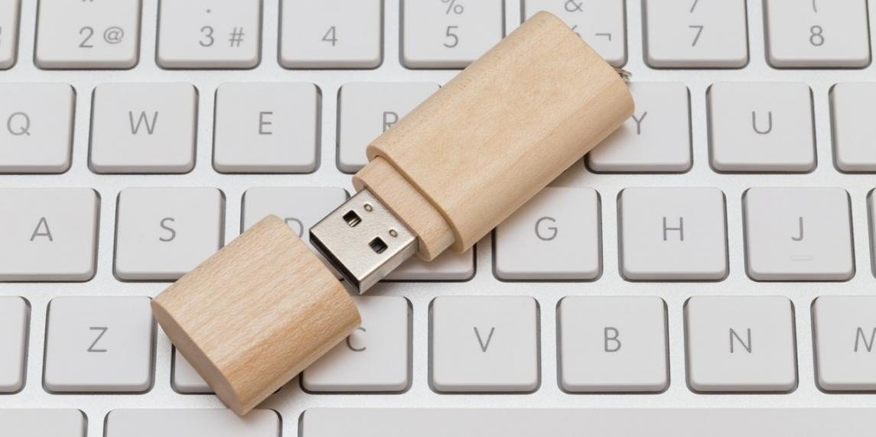
Memory
M
memory

Slide 10
Sensible
sensible, logical.

Slide 11
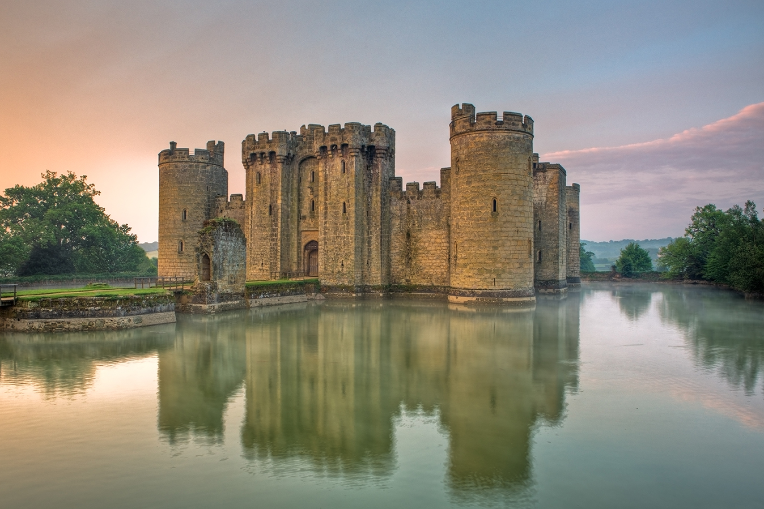
Fort
A thick and high walled, bastioned, crenellated structure built and used for defense and security purposes.

Slide 12
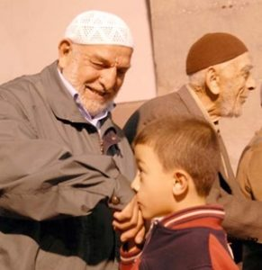
Respect
A feeling of devotion mixed with love and shyness towards elders, old people, people of high value, holy people, things.

Slide 13

Victory
head earned by a certain effort in a competition or occupation

Slide 14

Admire
find good and beautiful.

Slide 15
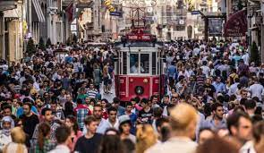
Community
crowd of people in the same place.

Slide 16

Innovation
The name given to all the facts, facts and principles that the human mind can take.

Slide 17
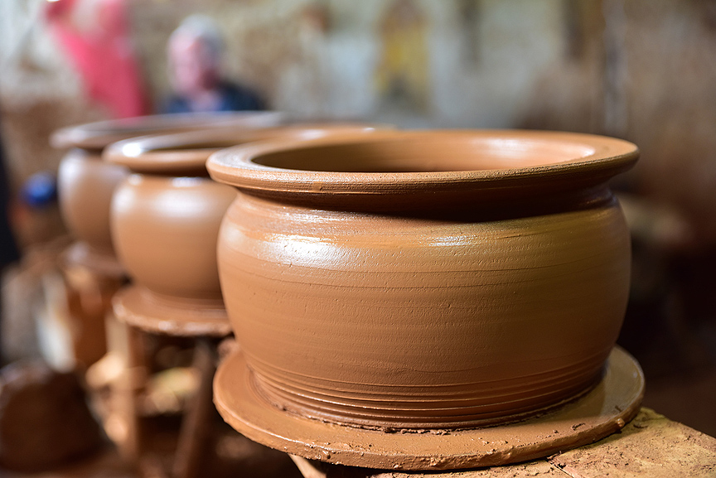
Pottery
earthenware pots.

Slide 18
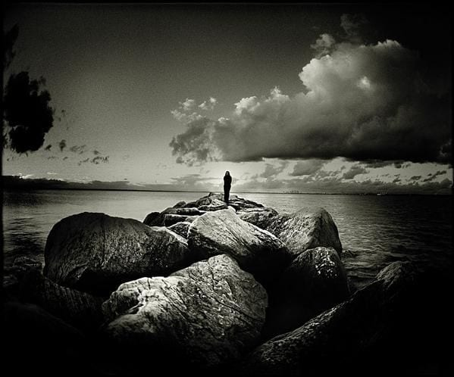
Vital
of great importance, important.

Slide 19

To ask
to ask for information on any subject by asking someone a question.

Slide 20
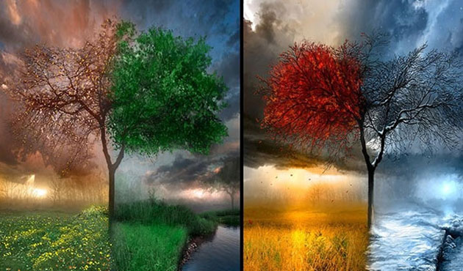
Climate
the long-term average of the effects of atmospheric events, collectively, anywhere on the earth's surface.

Slide 21
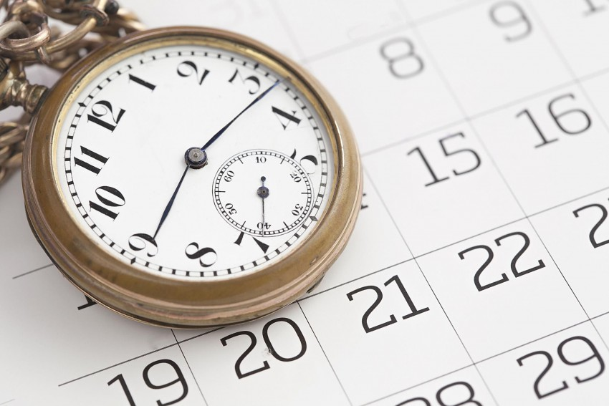
Duration
a certain period of time between the beginning and the end of an event, a certain time interval between the beginning and the end, a certain part in the flowing time.

Slide 22
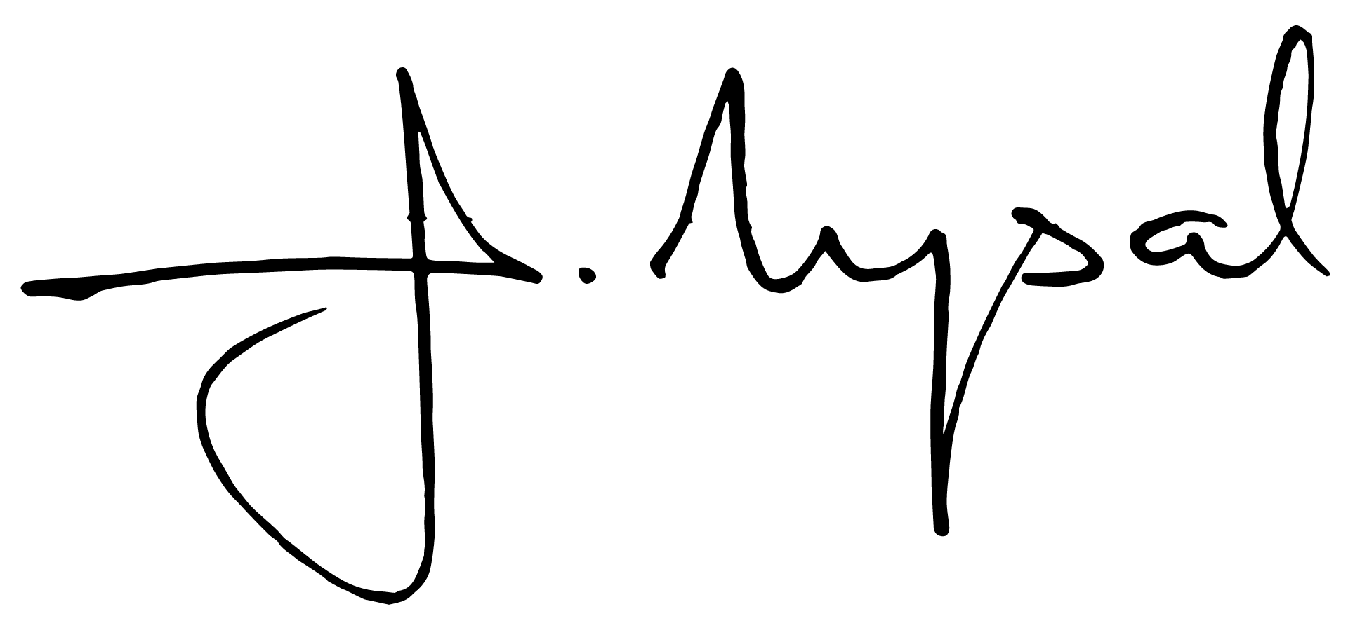
Sight
a person's own name or a bookmark, always written in the same form and by one's own hand, to indicate that he or she has written or approved that text

Slide 23
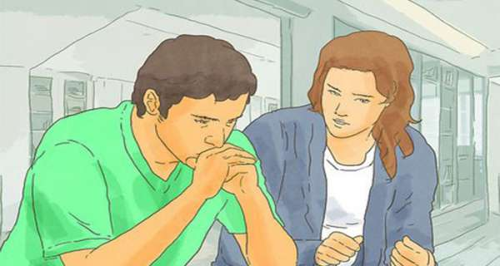
Advice
guiding, advising.

Slide 24

Fabric
any kind of fabric woven by machine from yarns of things such as wool, cotton, silk.

Slide 25
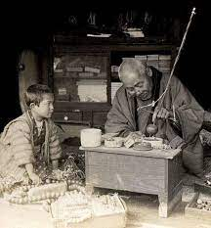
Handle
masterfully, skillfully.

Slide 26
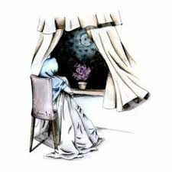
Infer
bir cümleden veya metinden yeni ve değişik bir anlam yakalamak.

Slide 27

Rule
Davranışlarımıza yön veren, uyulması gereken ilke

Slide 28

Announce
To announce

Slide 29
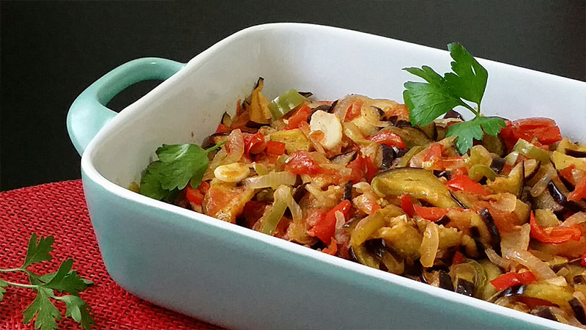
Diverse
Miscellaneous, diverse, diverse.

Slide 30
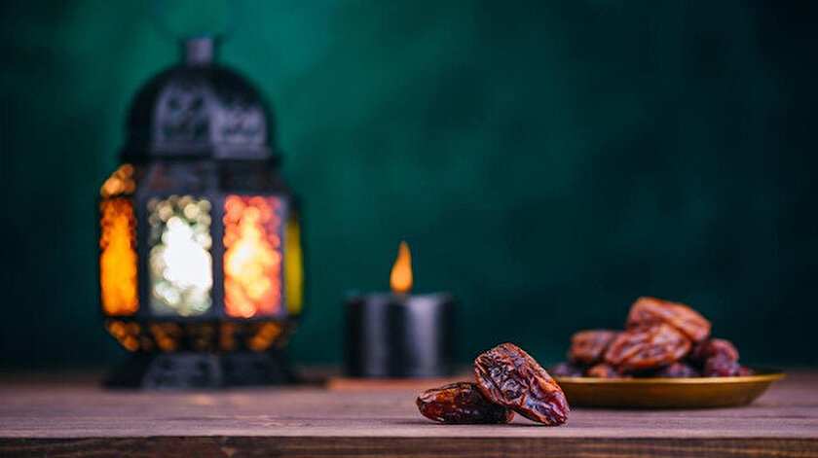
Feast
a day that has national or religious significance, is considered sacred, and is celebrated nationally.

Slide 31

Universal
concerning all humanity.

Slide 32
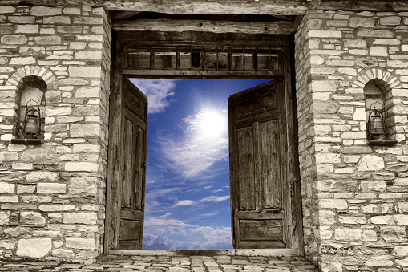
Access
a place through which one enters and passes through a building.

Slide 33
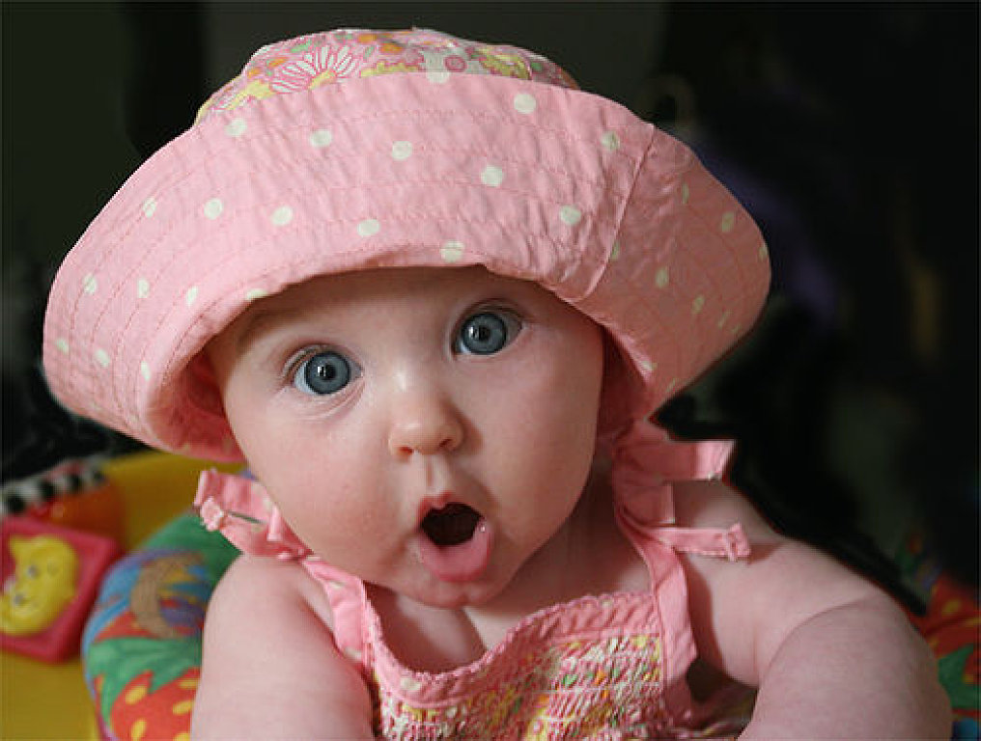
Cause
to create, to make way.

Slide 34
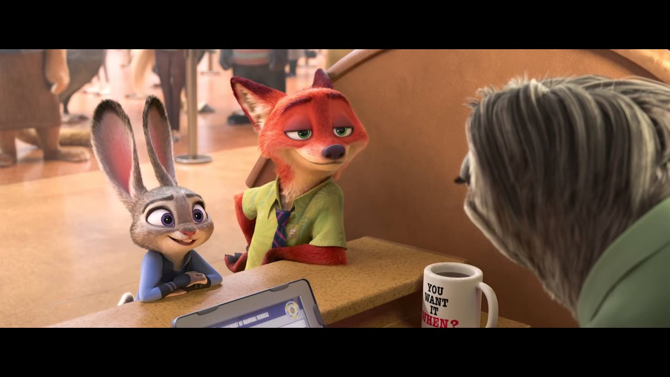
Comment
evaluation of an event according to a certain view, explanation.

Slide 35

Effect
It should be used in radio and television broadcasts, theater plays, film interpretations, as a matter of subject, the sounds that should be found are optical, mechanical, chemical, etc., apart from natural resources. by artificial means.

Slide 36

Store
widely described event.

Slide 37

Dedicate
To have an intention to God or a divine power, usually to perform a sacrifice or similar benevolent act, when a wish is granted.

Slide 38

Fail
failed, unsuccessful, unsuccessful, unsuccessful (person).

Slide 39
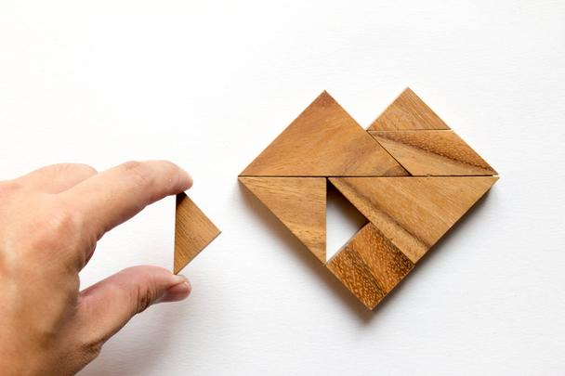
Fulfill
to ensure its fulfillment, to do what is necessary, to realize, to implement.

Slide 40

Image
objects, nature appearances with tools such as pencils, brushes and paints, cloth, paper, etc. format made on it.

Slide 41
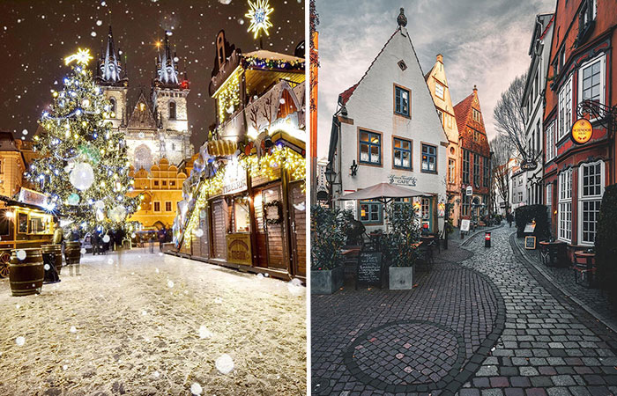
Ordinary
without any feature and value, ordinary, vulgar, worthless, unqualified.

Slide 42
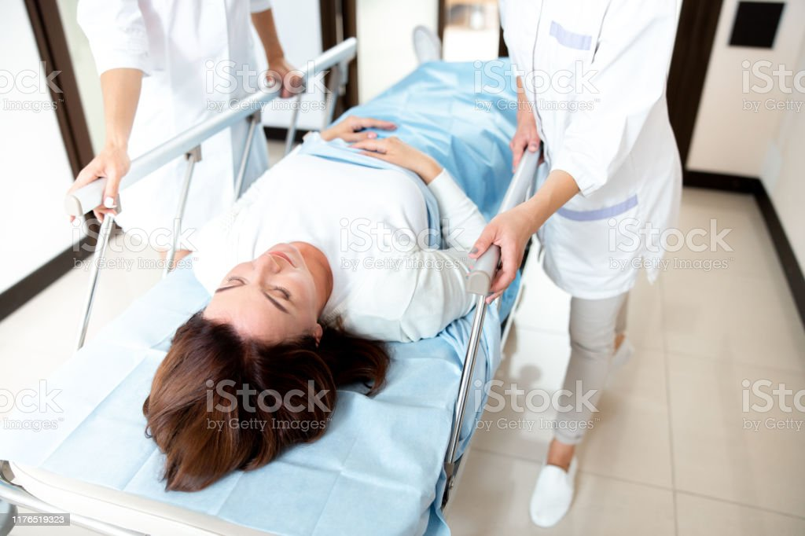
Cure
(disease) cure, cure, cure.

Slide 43

Casual
everyday, everyday, daily

Slide 44
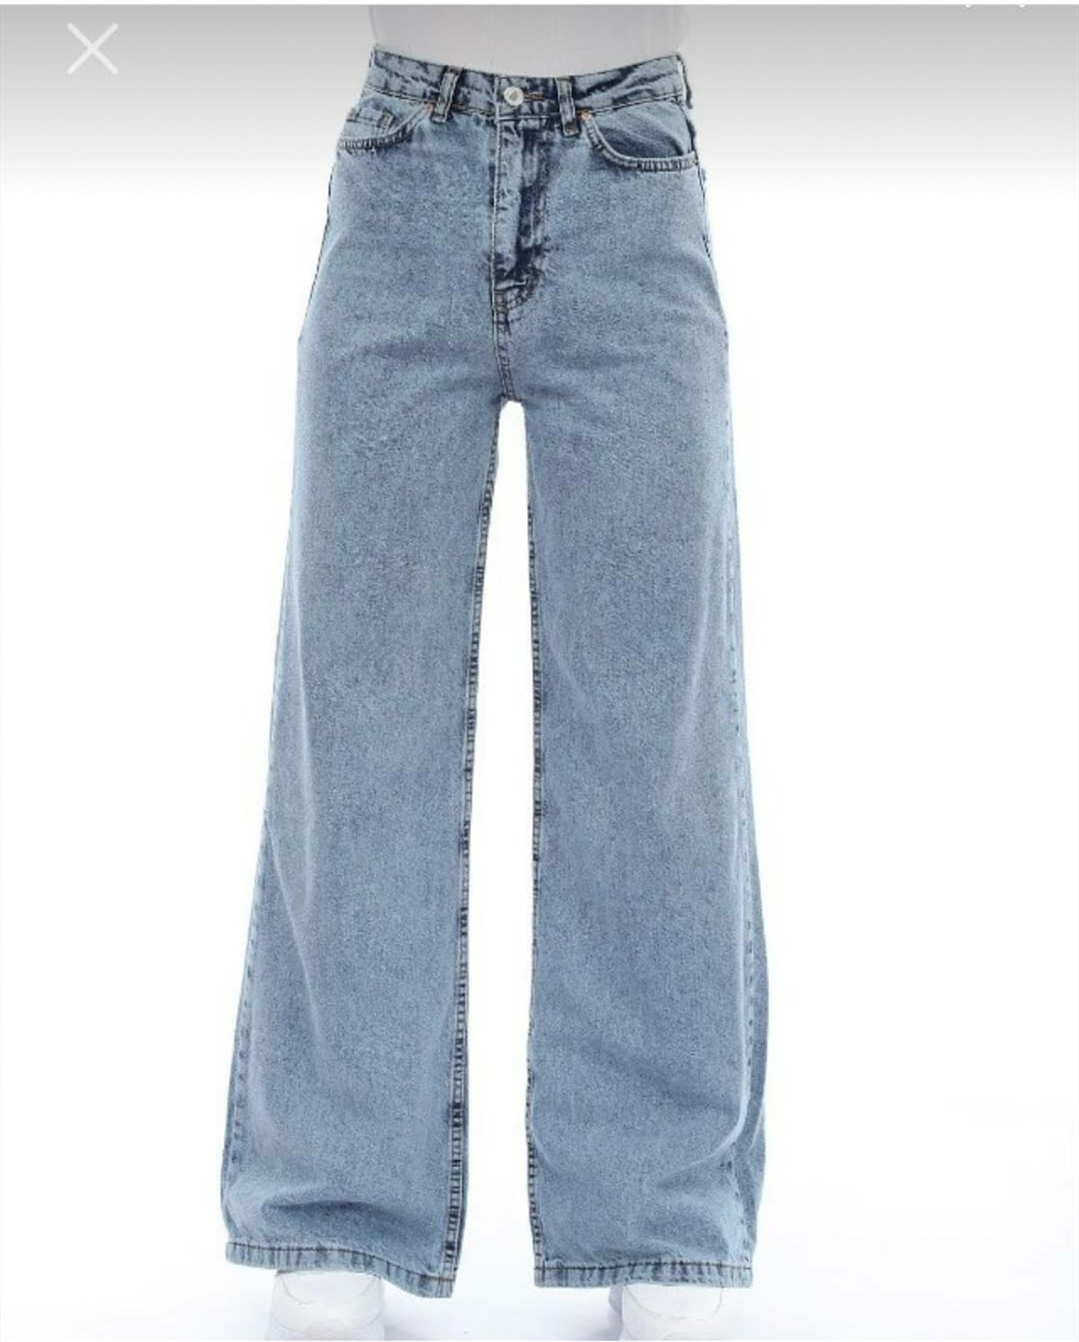
Denim
Blue, coarse cotton, patterned hard fabric used in jeans, blouses, and pocketed trousers, coats, etc. made of this fabric. clothes

Slide 45

Dress
all kinds of articles of clothing worn over the underwear.

Slide 46
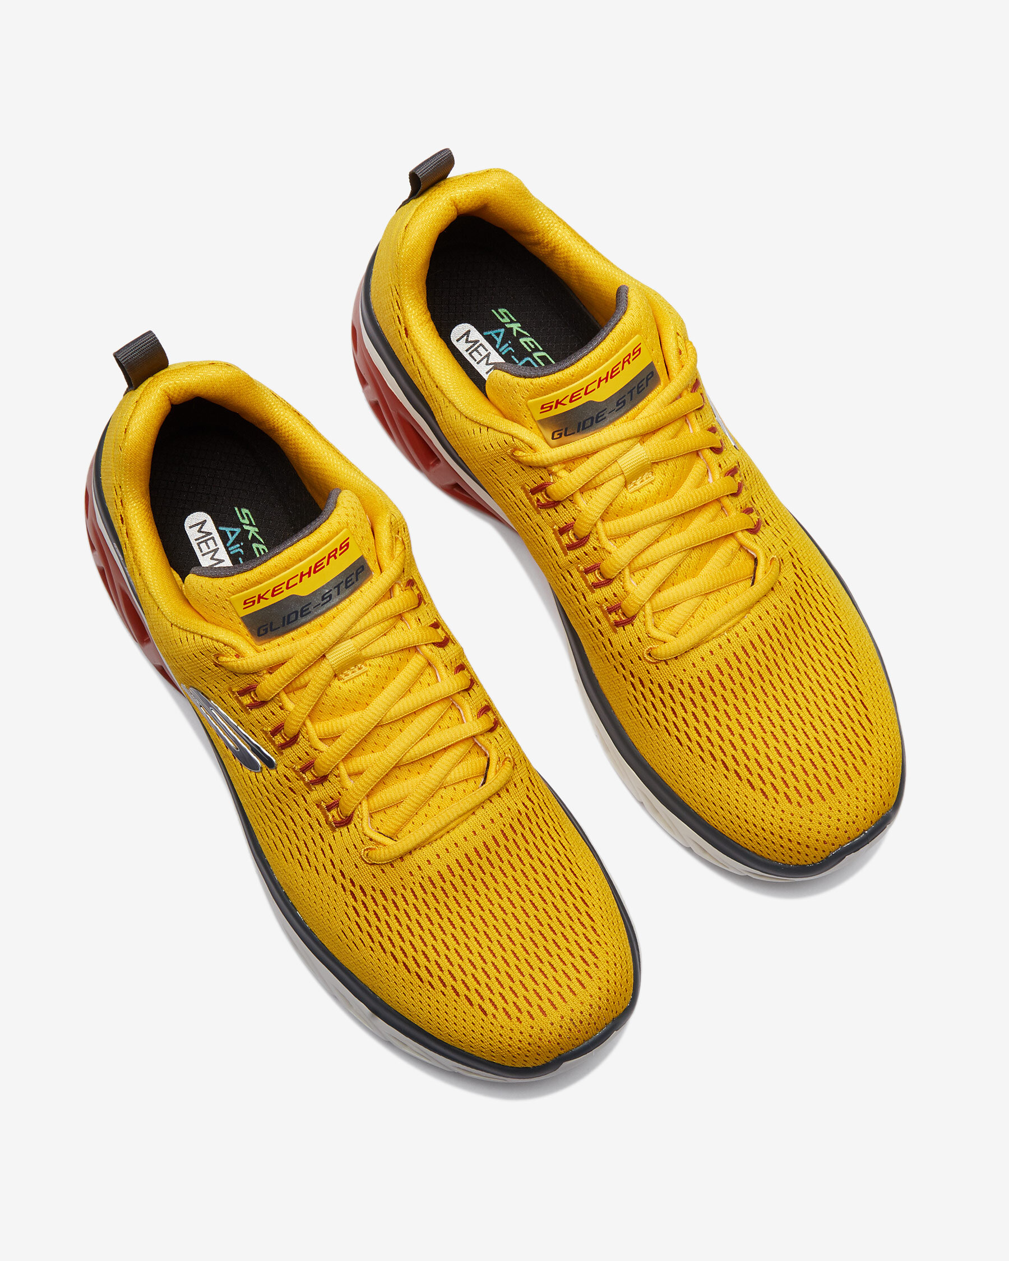
Shoe
Footwear, the upper of which is usually made of leather and similar materials, the sole is made of durable materials such as leather, rubber, and is worn to protect the foot from all kinds of effects, especially on the street.

Slide 47
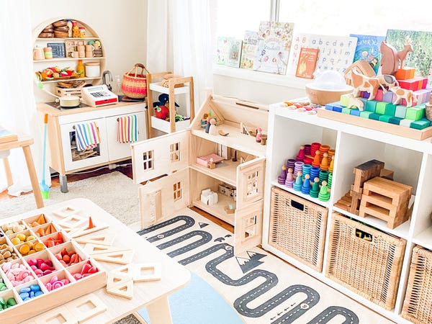
Neat
everything in its place, in order, in order, neat, in its place, not messy, orderly.

Slide 48
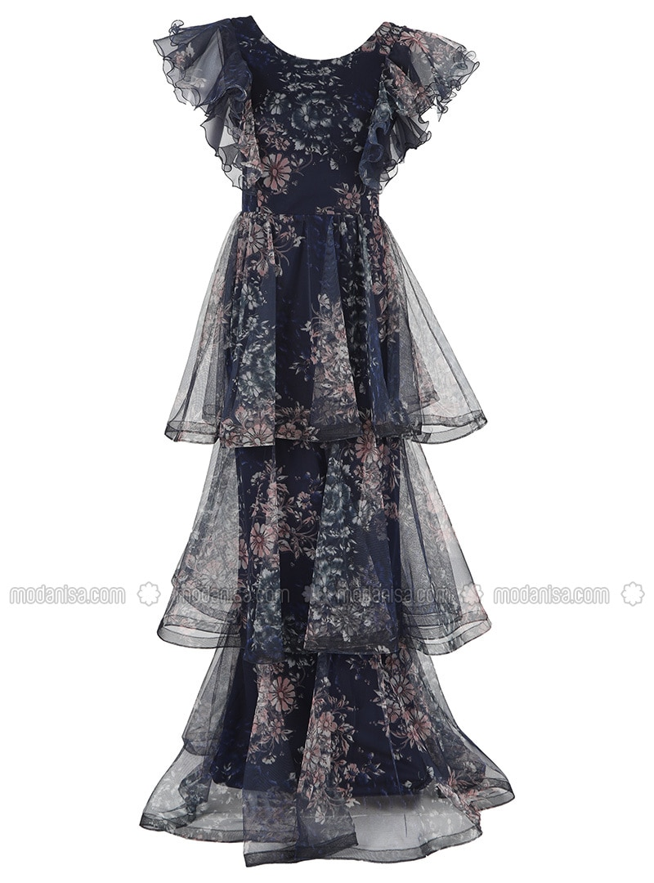
Ruffle
a sewn, ruffled or shirred ornament with sales, curtains and similar features.

Slide 49
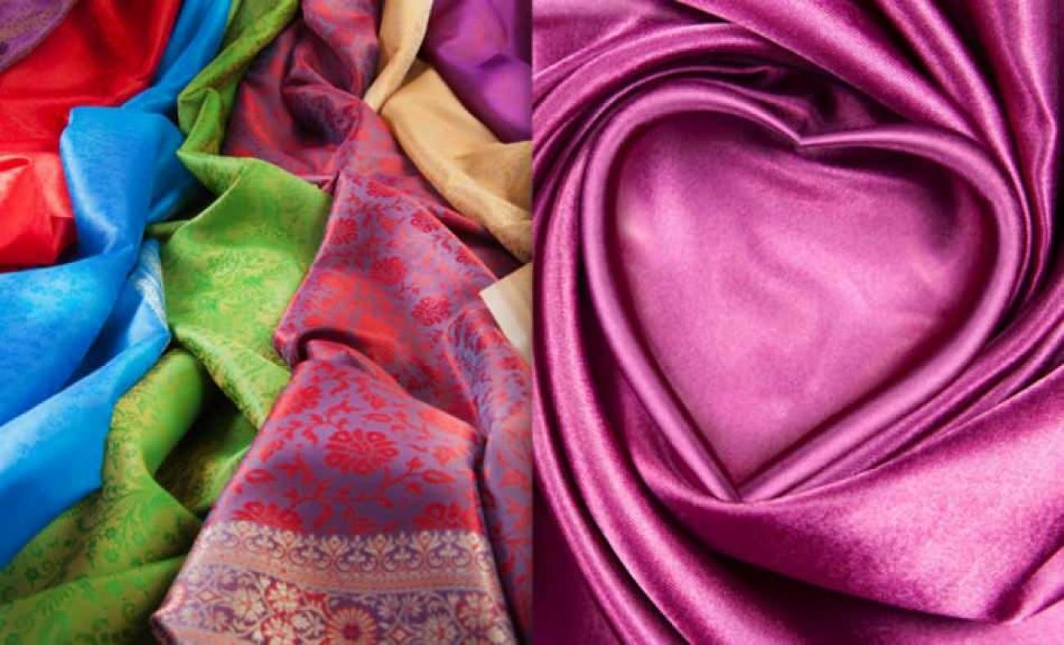
Smart
A very thin, flexible and shiny wire obtained from the cocoon woven by the silkworm and used in weaving by turning it into yarn.

Slide 50

Shopping
trading business.

Slide 51
References: 10 Student’s Book

Slide 52


