Slide 2
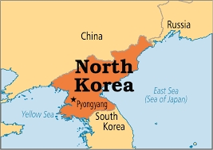
where is korea?
South Korea, officially the Republic of Korea (Korean: 대한민국 Daehan Minguk; Hanja: 大韓民國; briefly: 한국, 韓國 Hanguk) is sometimes simply Korea, a state located south of the Korean Peninsula in East Asia. neighboring states of South Korea; It is bordered by the People's Republic of China to the west, Japan to the east and North Korea to the north.

