Slide 2
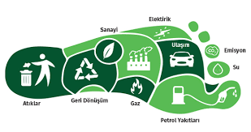
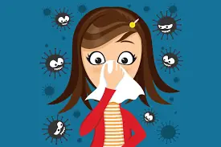
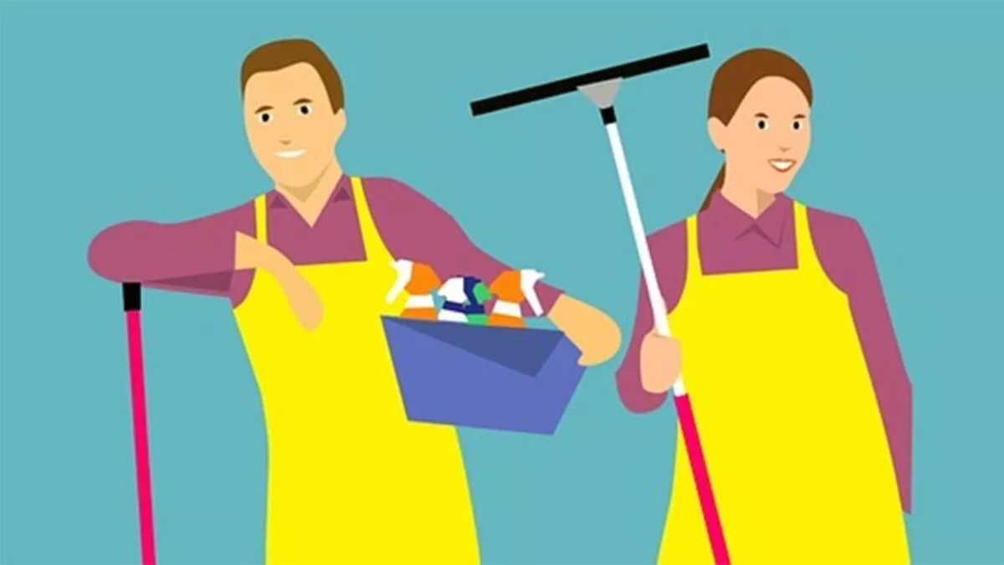
advice: tavsiye
ask for advice: tavsiye istemek
ask for permission: izin istemek
be confident: kendinden emin olmak
become extinct: soyu tükenmek
boundary: sınır
carbon footprint: karbon ayak izi
catch a cold: nezle olmak, üşütmek
check messages: mesajları kontrol etmek
choice: seçim, tercih
clean the house: evi temizlemek
clean the refrigerator: buzdolabını temizlemek
communicating with people: insanlarla iletişim kurmak
consequence: netice, sonuç
consumption: tüketim
contribute: katkıda bulunmak
cope with: başa çıkmak
cut off: kesmek
damage ecological balance: ekolojik dengeye zarar vermek

Slide 3
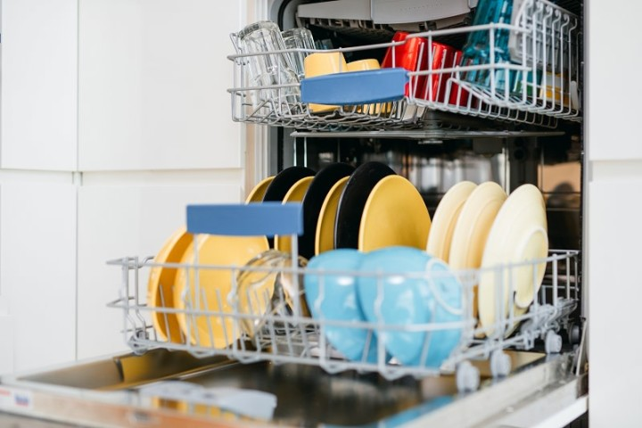
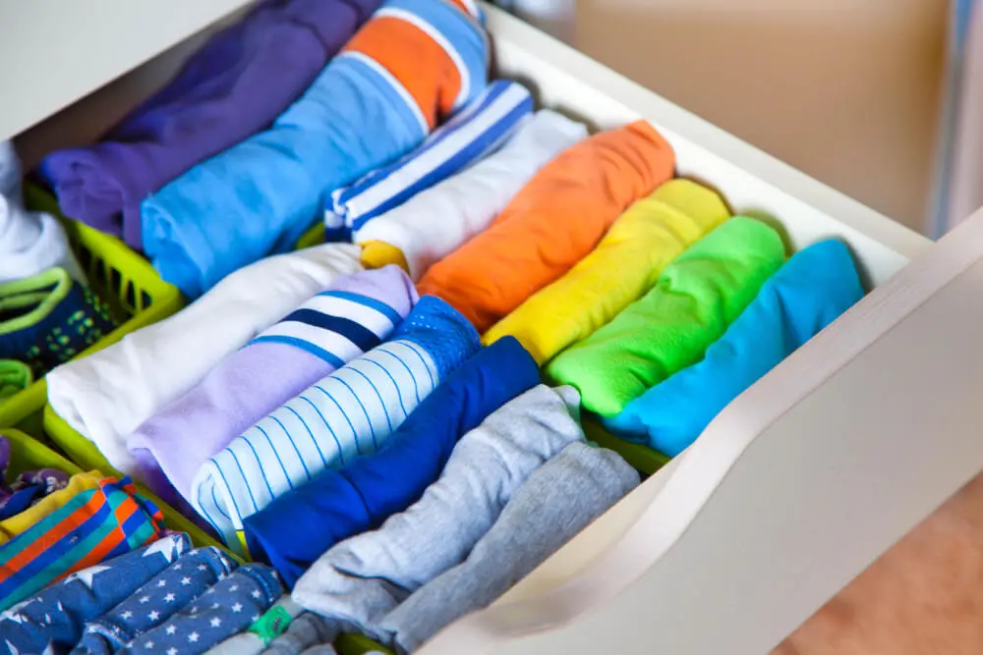
do the laundry: çamaşırları yıkamak
do the shopping: alışveriş yapmak
dust the furniture: mobilyanın tozunu almak
empty the dishwasher: bulaşık makinasını boşaltmak
energy sources: enerji kaynakları
environment-friendly: çevre dostu
fabric: kumaş
face famine: kıtlıkla karşılaşmak
fear: korku
feel annoyed: rahatsız hissetmek
fold the clothes: çamaşırları katlamak
Let me see it: bir bakayım
I see: anlıyorum
You mean: yani

Slide 4
WHAT İS IF CLAUSE?
The word 'if' carries the meaning of 'if' in English and adds a meaning similar to 'if...if you do
If we start from the meaning of the word; We can define the sentences formed for a necessary condition for an action to occur and for this condition to be fulfilled as if clauses.
There are two types of clauses in the if clause. One is the hypothetical subordinate clause that starts with 'if' and states the condition, and the other is the main sentence that indicates the situation and result that will occur if the condition is fulfilled. The subordinate clause is called if-clause, and the main clause is called the main clause.

Slide 5
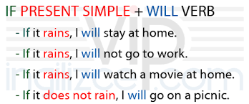
If cümlesi (şart) Temel cümle (sonuç)
If + simple present simple future
If this thing happens that thing will happen.
In Type 1 conditional sentences, 'simple present' is used in the 'if' sentence and 'simple future' is used in the main sentence.

Slide 6
IF CLAUSE MAIN CLAUSE
If + Present Simple Present Simple
The first structure we call type 0 is the structure used in general lines. In other words, it is preferred when describing certain situations and real events that everyone accepts as true. It is used for the present tense. (General Truth)

Slide 7
If Clause type 1
If ..............................to Boston, ............................ on Main Street
I move / I will live
I will move / I live
If ................................call your mother, she’ll be very happy
you call
you will
If the mechanic fixes our car on time, we................................... to Center ville
drive
will drive
If..........................today, we won’t go to the park
it rains
it will rain

Slide 8
IF CLAUSE TYPE 0
1-If you ___ happy, you ____
a)were / smile
b)are / smile
c)will / will smile
2-If you ____ the button, the radio ____.
a)press / turns on
b)are press / turn on
c)will / turns on
3-If you ____ salt to the water, it ___ later.
a)will add / will boil
b)add / boils
c)added / boiled

Slide 9
Thank you for listening

Slide 10
REFERENCES
https://ingilizcebankasi.com/if-clause-type-0-testi/
https://www.google.com/search?q=%C3%A7eviri&oq=%C3%A7e&aqs=chrome.0.69i59j69i57j0i433i512l2j0i512j0i433i512l3j46i175i199i512j0i512.1791j0j15&sourceid=chrome&ie=UTF-8
https://blog.cambly.com/tr/if-clause-kosul-cumleleri/
https://www.google.com/search?q=helpful+tips&source=lnms&tbm=isch&sa=X&ved=2ahUKEwjghYym6eb2AhU-S_EDHaQNATMQ_AUoAXoECAEQAw&biw=1680&bih=907&dpr=1#imgrc=XCpOdROAZG9ksM

