Slide 1
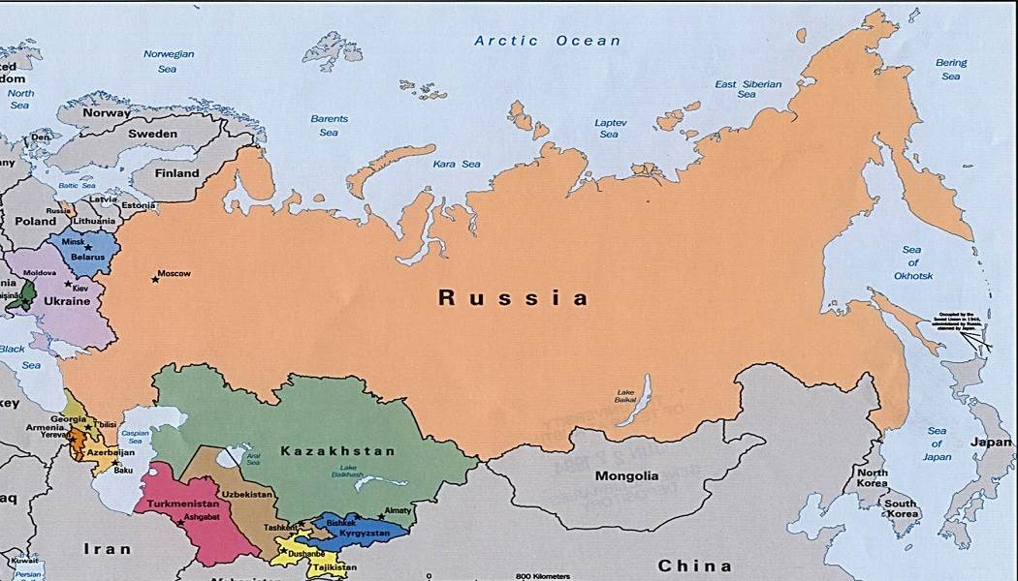
RUSSIA

Slide 2
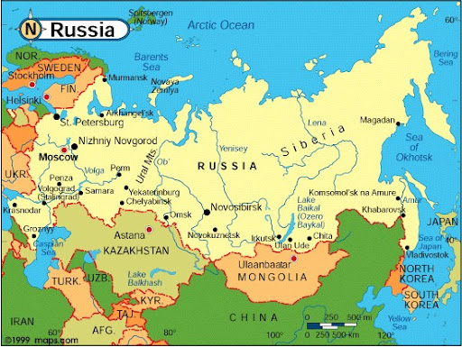
WHERE IS RUSSIA?
The Russian Federation is a country located in both Asia and Europe. On the other hand, it is a country located in the Northern Eurasian region. It is possible to say that a large part of its territory is located in the Asian Continent.

Slide 3
RUSSIA FLAG
The colors of the Russian flag consist of the Panslavism colors blue, white and red. ... White: Nobility, nobility, greatness, frankness, sincerity. Blue: Loyalty, loyalty, fidelity, honor, honesty, perfection, moral cleanliness.

Slide 4
PLACES TO VISIT

Slide 5
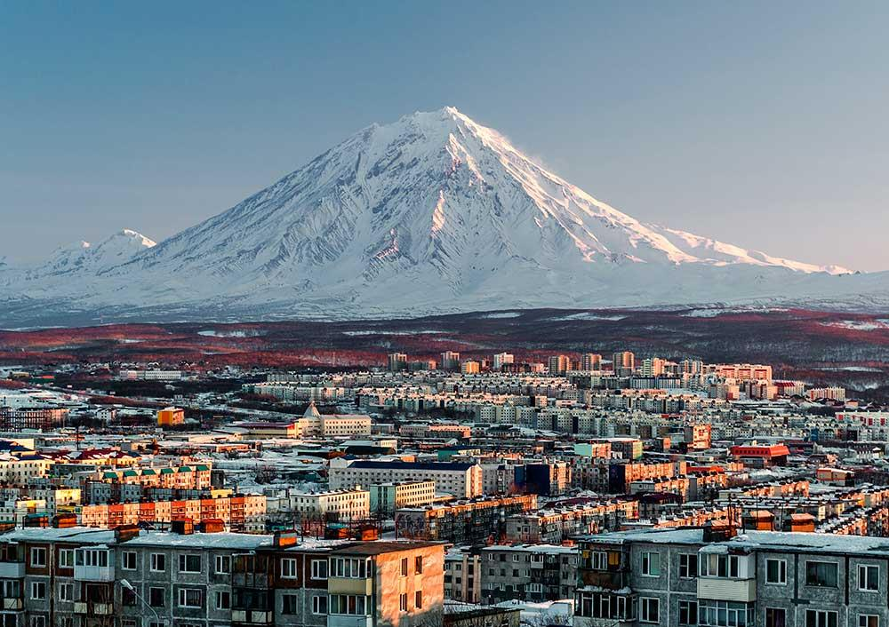
GEYSER VALLEY AND KAMCHATKA VOLCANOES
Located in the Far East of Russia, it is a large natural volcanology museum containing more than 300 active and extinct volcanoes and dozens of geysers spread over the Kamchatka peninsula. Established in 1934, there are 26 volcanoes around the Kronotsky Biosphere Reserve. It consists of (12, including active) mountain glaciers and lakes. Geyser valley is the only city in Eurasia that is a global phenomenon. The six-kilometer area contains more than 20 large geysers, dozens of thermal springs and steam gas jets.

Slide 6
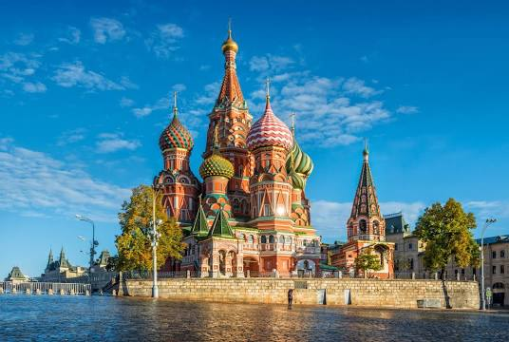
SAİNT BASİL’S CATHEDRAL
St. Basil's Cathedral is an onion-like cathedral in Moscow's Red Square, famous for its colorful, dome-like roofs. It is commonly mistaken for the Kremlin Palace. It was built by Ivan the Terrible to celebrate the victories of the Russian State against the Kazan and Astrakhan khanates between 1555 and 1561. Eight domes, designed differently, symbolize eight separate victories. The domes, which were previously solid gold, were painted in different colors after 1670. The tallest tower is about 65 meters high.

Slide 7
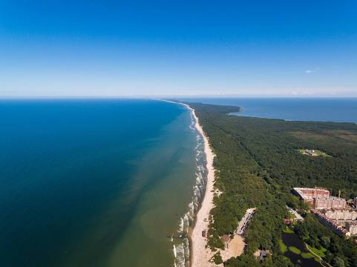
CROWN LANGUAGE
Curonian Tongue is a 98 km long thin and long dune tongue that separates the Curonian Lagoon from the Baltic Sea. Its southern end is in Russia's Kaliningrad Oblast and its northern end is in southwestern Lithuania. It is on the UNESCO World Heritage list.

Slide 8
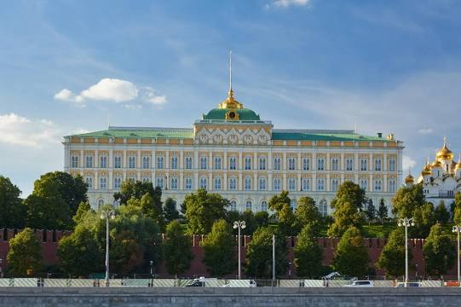
GRAND KREMLİN PALACE
The Grand Kremlin Palace was designed in the 14th century. The designer was also the architect of the Kremlin Armory and the Cathedral of Christ the Savior. The palace was also used as the place where the Russian tsars stayed in Moscow. On the other hand, there are also sources indicating that there was a church in this region in the past. It was used as the place where Supreme Soviet conferences and meetings were held during the Soviet Union era.

Slide 9
TRADITIONAL DISHES

Slide 10
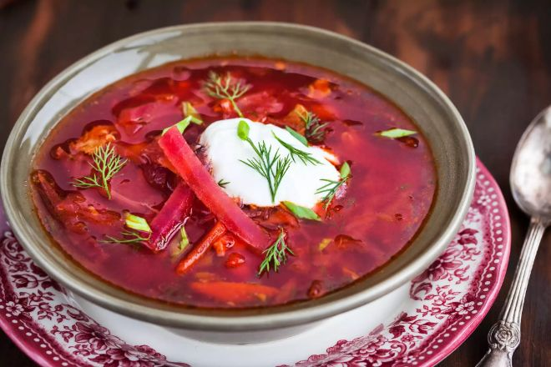
BORSCHT SOUP
Borscht is arguably the most well-known Russian dish. However, it is often mistranslated as borscht; which doesn't sound as impressive as it actually is.
Borsh, made with meat and vegetables, which usually includes potatoes, carrots, onions, cabbage, garlic and beets, is the main dish of Russian culture. There are also various versions, and a type that is extremely popular in Ukraine has entered Russian cuisine.
Borscht recipes originally included beet yeast (kvass, a fermented beverage) diluted with water and boiled. Today, some sautéed or otherwise prepared beets are added at the end of the cooking process. It is among the most popular Russian dishes.

Slide 11
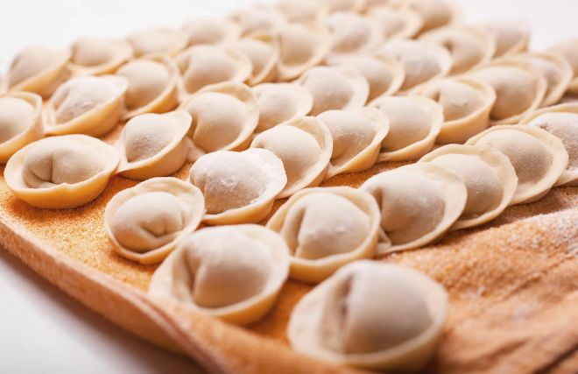
PELMENİ
A simple but delicious and satisfying dish, pelmeni is made from meat, flour, eggs and water; Sometimes spices such as garlic, salt and pepper are added. The small meatballs are then boiled for a few minutes. The simplicity of the cooking process of pelmeni and the ability to store frozen for months made it popular with hunters and travelers who carried pelmeni with them and cooked them over the campfire.

Slide 12
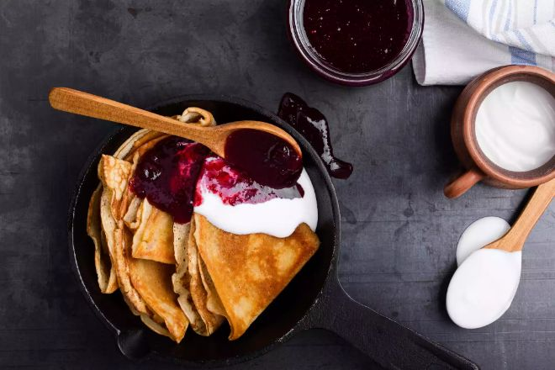
BLINI
Blini come from Slavic pagan traditions and symbolize the sun and the gods that represent it. It was originally reserved for the week of Maslenitsa (the religious public holiday before Lent) and is still one of the most favored dishes in Russia.
There are several recipes for blinis, including little drop buns, lacy paper-thin large blinis, sweet thick pancakes made with milk, and many more. It is usually wrapped in meat, vegetable and grain-based stuffing. It is a popular Russian food dessert.

Slide 13
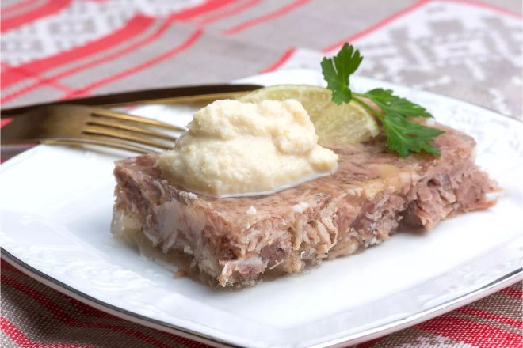
KHOLODETS AND STUDEN
This traditional Russian food is a kind of aspic in taste and preparation. Aspic, which contains meat, takes the form of jelly because it is made using pork. Known as Galantine in France, this dish was brought to Russia by French chefs working for the Russian aristocracy.
Studen already existed in Russia at that time. But it was usually given to the poor because it was made with leftovers from a great feast or dinner and was less tasty.

Slide 14
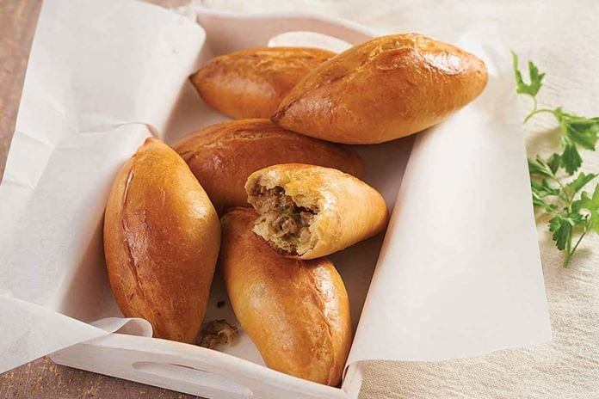
PİROZHKİ
These small puff pastries, which are prepared by baking or frying, are optionally filled with ingredients such as cabbage, cheese and olives. These prepared pastries are one of the most popular snack foods in Russia.

Slide 15
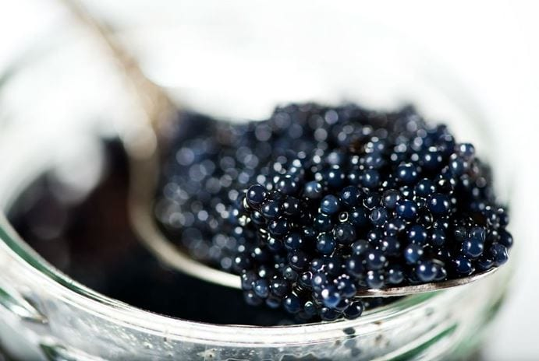
CAVIAR
When it comes to Russia, there is a fact that many people first come to mind with caviar. Caviar, which is an expensive and very tasty appetizer, is a popular and popular food served both at breakfast and with meals. People usually consume this food by spreading it on pastries such as bread or pancakes.

Slide 16
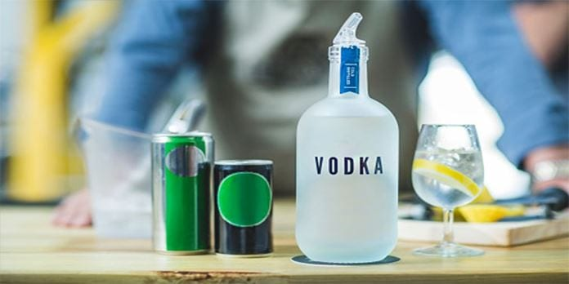
VODKA
The most famous thing about Russian cuisine is undoubtedly vodka. So if you were to ask a passer-by anywhere in the world to say three things about Russia, one of them would be vodka.

Slide 17
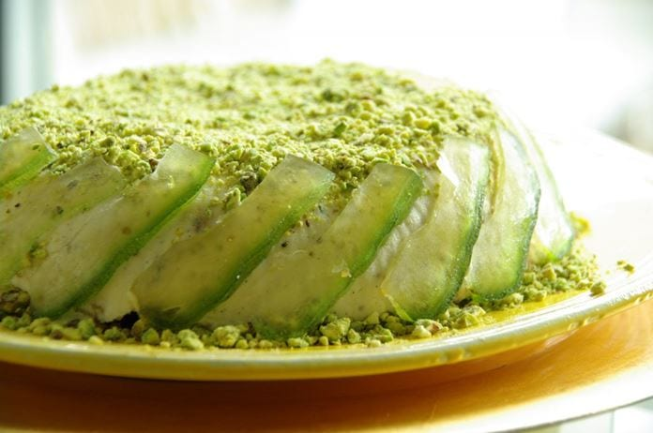
PASHA
The pashka, which has a religious meaning, is prepared to symbolize the tomb of Jesus. Cake is made in abundance throughout the country, especially during "Holy Week". Both delicious and nutritious ingredients such as Tvorog cheese, butter, almonds and currants are used in the cake.

Slide 18
FESTIVALS

Slide 19
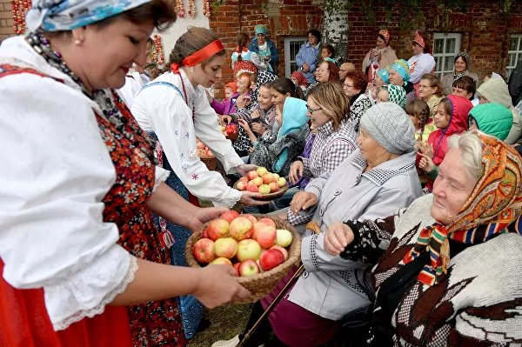
APPLE FESTIVAL
Apple Feast (Yablochny Spas), an ethnic Slavic holiday, is celebrated on August 19. On this day, apples are consecrated in the church, the people of Russia, Ukraine and Belarus cook apple tarts and consume this fruit in abundance.

Slide 20
ELECTRONIC MUSIC FESTIVAL
Alfa Future People International Electronic Music Festival, held in July, hosts 40 thousand people every year. Held on the banks of the Volga River, 420 kilometers from Moscow, the festival is one of the biggest music events in Europe. During the three-day festival, more than 100 DJs play in an area the size of 30 football fields.

Slide 21
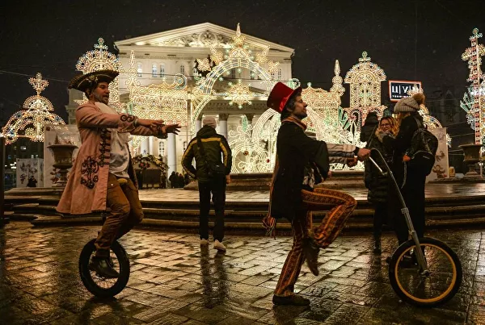
NOEL
Christmas and New Year celebrations in Moscow are undoubtedly more enthusiastic than in any other country. Dozens of concerts are held in the city as part of the celebrations, pine trees are set up in the squares. The ice skating rink and fairs created in the Red Square are flooded with visitors.

Slide 22
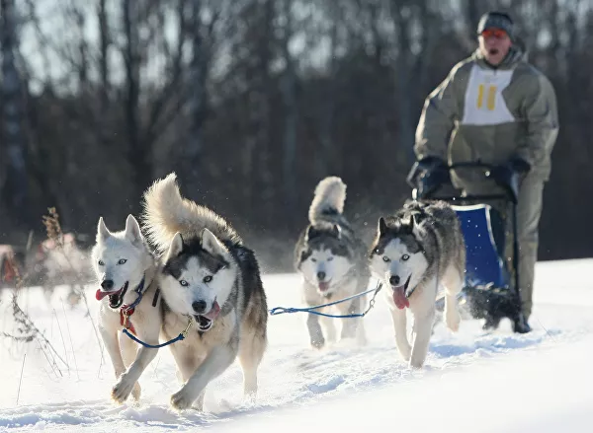
SAMPO SLIDE FESTIVAL
The Sampo sled race is held in the Republic of Karelia, 860 kilometers from Moscow. Approximately 35,000 people participate in the three-day races every year.

Slide 23
TRADITIONAL CLOTHES

Slide 24
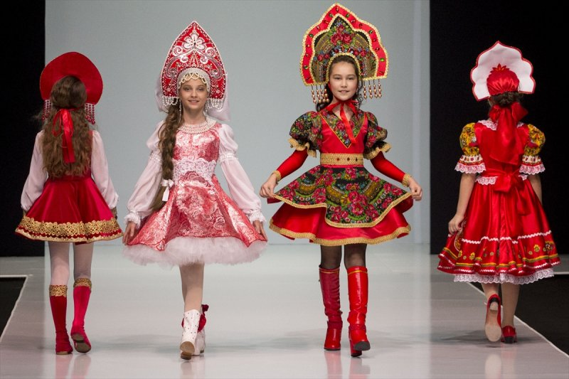

Slide 25
THANK YOU FOR LISTENING

Slide 26
REFERENCES
https://www.google.com/search?q=ceviri&oq=ceviri&aqs=chrome..69i57j0i512j0i3j0i512j0i3j0i512l2j0i433i512j0i512l2.2652j0j15&sourceid=chrome&ie=UTF-8
https://www.google.com/search?q=rusya+nerede&source=lmns&bih=907&biw=1680&hl=tr&sa=X&ved=2ahUKEwjM0tD7iNL0AhUMybsIHVkuCoEQ_AUoAHoECAEQAA
https://www.google.com/travel/things-to-do/see-all?g2lb=4645481%2C4401769%2C4644488%2C4270442%2C4640247%2C4317915%2C4679298%2C4596364%2C4258168%2C4524133%2C4597339%2C4371334%2C4624411%2C
https://tr.sputniknews.com/20151227/ilgin-etkinlik-festival-bayram-1019922087.html,
https://ungo.com.tr/2019/06/geleneksel-rus-yemekleri/

