Slide 2
YEAR OF FOUNDATION : 29 july 1958 ( 63 years ago )
PREVİOUS INSTITUTION : Naca ( 1915-1958 )
COMMITMENT : US Goverment
ADDRESSS : Washington DC
PERSONAL NUMBER : 17,786
ANNUAL BUDGET : $22,629 billion (2020)
MANAGERS : Bill Nelson
WEBSITE : nasa.gov

Slide 3
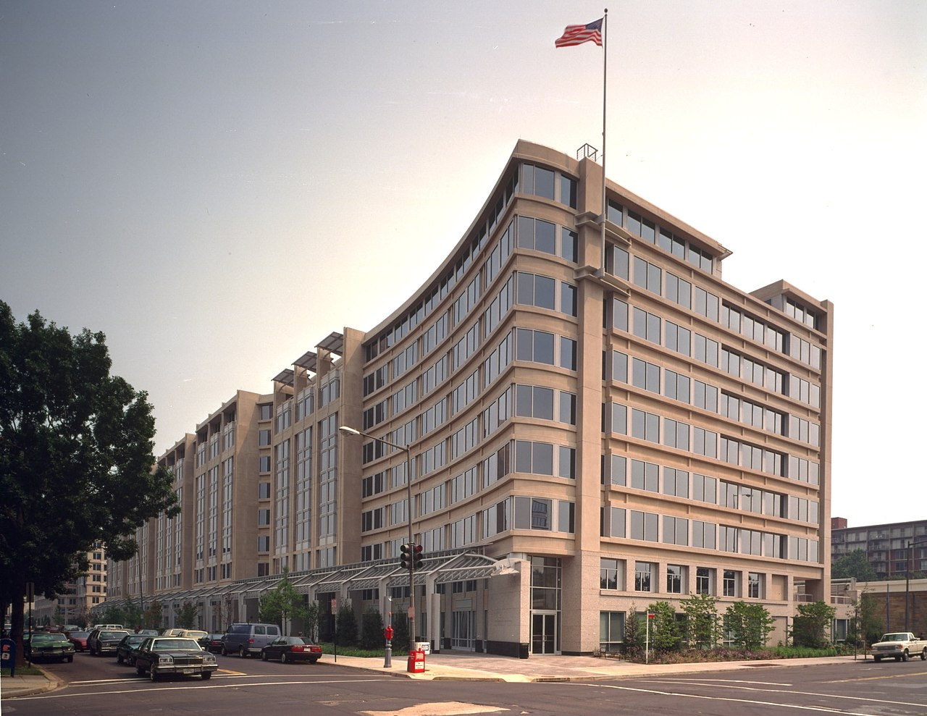

Slide 4
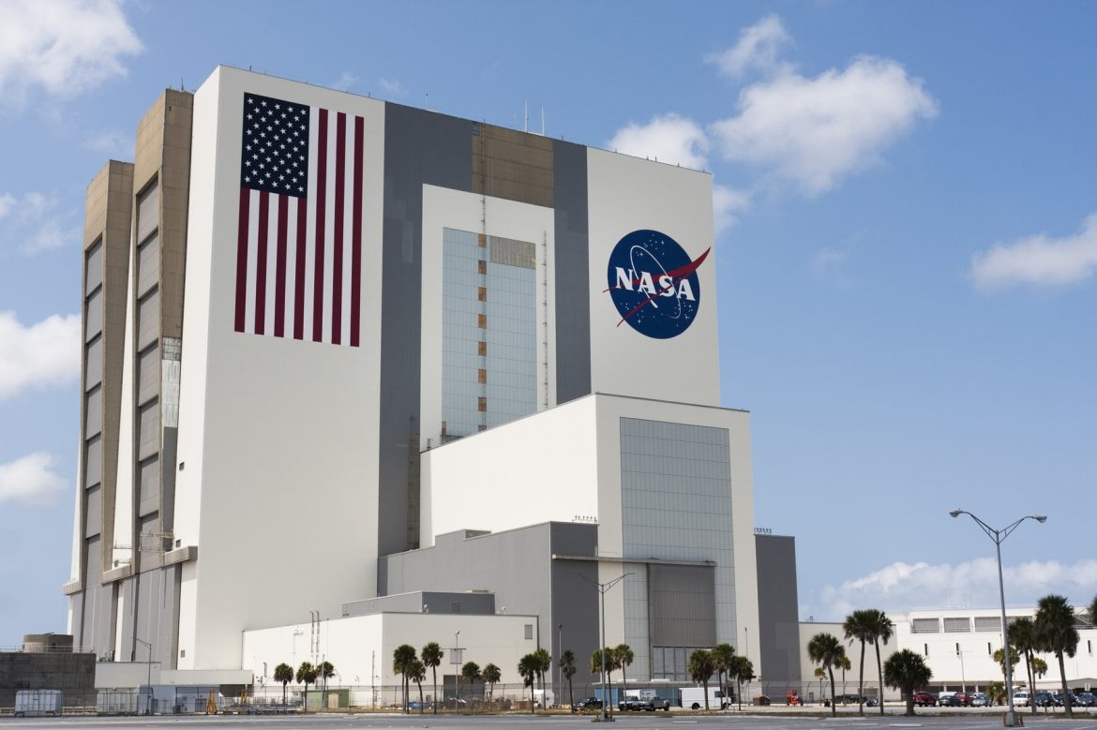

Slide 5
LOGO’ S

Slide 6
DWIGHT D. EISENHOWER

Slide 7
BORN : October 14, 1890, Denison, Texas , USA
DATE AND PLACE OF DEATH : March 28 1960, Walter Reed National Military Medical Center,Bethesda.
VİCE PRESİDENT : Richard Rixon (1952-1961)
SPOUSE : Mamie Eisenhower (d.1961-1969)
PARTY : Republican Party established
ORGANIZATIONS : NASA, DARPA, Small business, Administration, U.S. Department of Health and Human Services, Southeast Asia Treaty Orginaziton...

Slide 8
BİLL NELSON

Slide 9
Born: September 29, 1942 (age 79 years), Miami, Florida, USA
Space missions: STS-61-C
Spouse: Grace Cavet (d. 1972)
Party: Democratic Party
Mission: Head of NASA from since: 2021
Children: Nan Ellen Nelson, Bill Nelson, Jr.
Education: University of Virginia School of Law (1968), Yale University (1965), University of Florida

Slide 10
NASA's predecessor, NACA, was founded in 1915. NACA (National Advisory Committee for Aeronautics) was working on airplanes.

Slide 11
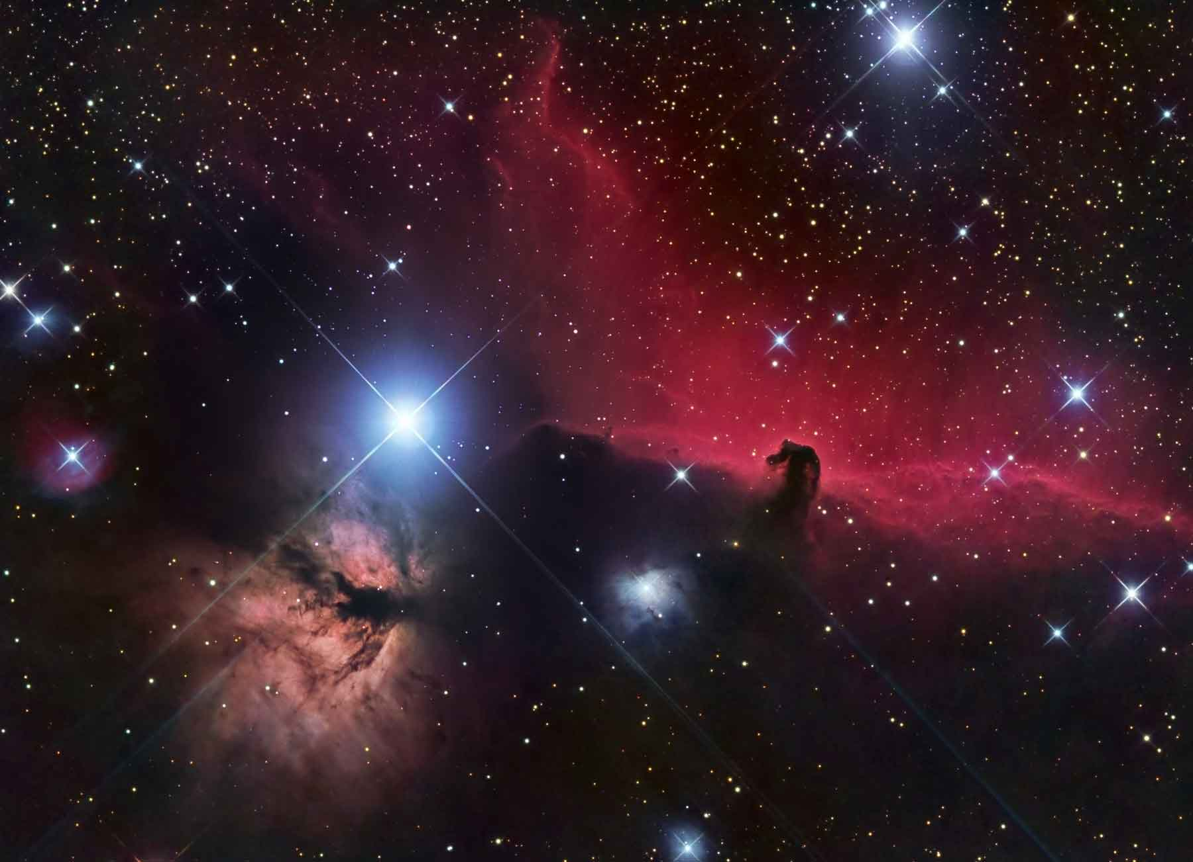
It has become the unit that directs the designs of all warplanes of the United States.He had been working on supersonic rocket planes like the Bell X-1 since 1946.

Slide 12
II. German aerodynamic experts who joined NACA after World War II make great contributions to the institution. In particular, progress has been made in the design of jet engines and supersonic aircraft. On July 29, 1958, US President Dwight D. Eisenhower passed the law that changed the name of the institution to NASA.

Slide 13
NASA's space studies so far have been largely successful, but cost the USA billions of dollars. Especially the Apollo program, Skylab, space shuttle programs that resulted in the Moon landing required huge expenditures. However, it is calculated that the previous expenditures will be very small, besides the large space stations, Moon station and Mars expedition programs that are expected to be realized towards the 21st century.

Slide 14
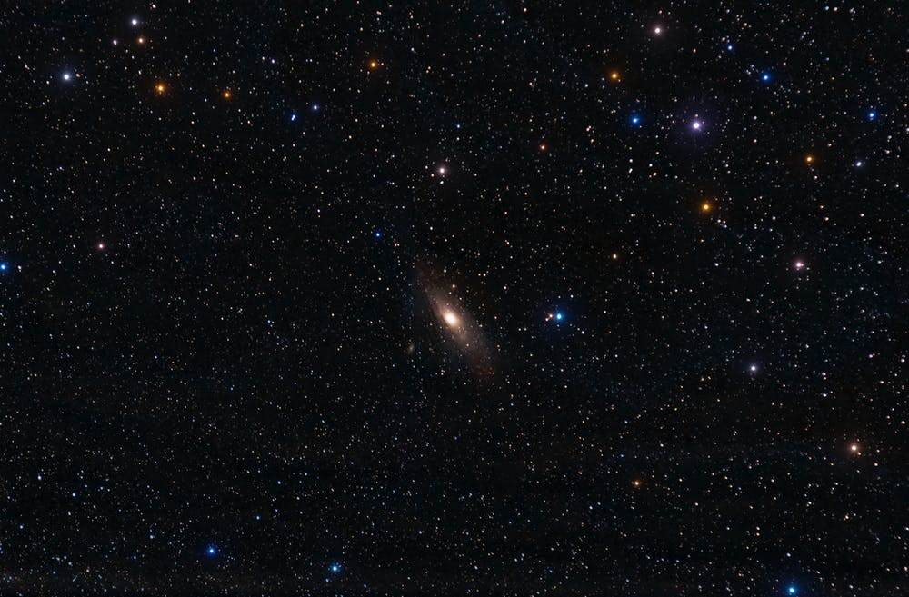
NASA
"National Aeronautics and Space Administration"

Slide 16
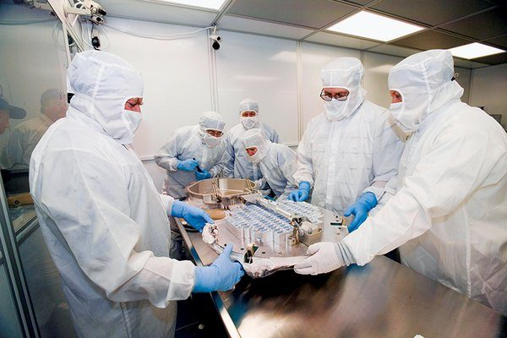
NASA has created a Planetary Protection Unit is case there is life on Other planets.

Slide 17
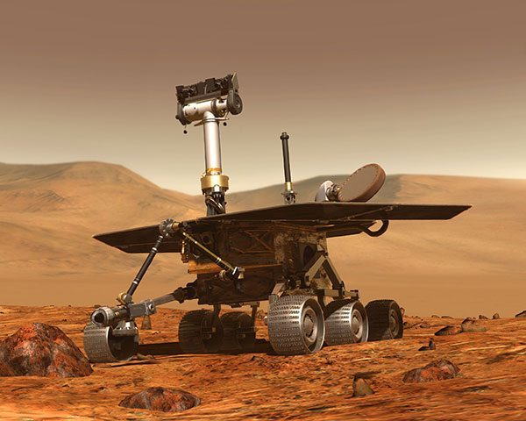
Ather NASA’s probe landed on Mars, 3 Yemenis sued NASA.

Slide 18
REFERENCES
https://tr.m.wikipedia.org/wiki/NASA#:~:text=NASA%20(%C4%B0ngilizce%3A%20National%20Aeronautics%20and,Ba%C5%9Fkan%C4%B1%20Dwight%20Eisenhower%20taraf%C4%B1ndan%20kurulmu%C5%9Ftur.
https://www.hurriyet.com.tr/haberleri/nasa
https://translate.google.com/?hl=tr

Slide 19
PREPARER
Songül MORTAŞ

