Slide 2
The word meaning of Reported Speech is "Indirect Speech". In other words, it is the indirect way of transferring a sentence established in any time period to others.

Slide 3
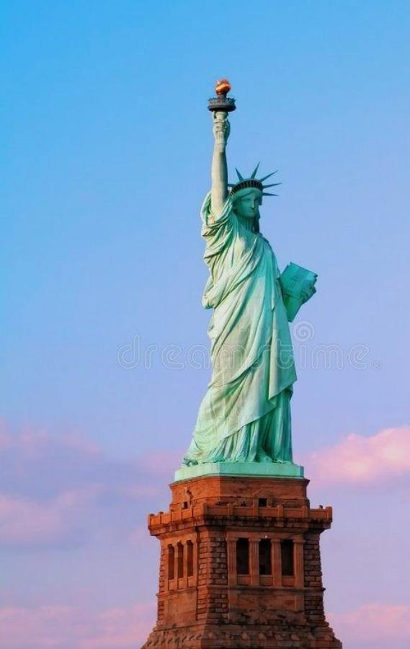
The moment of occurrence of the event can be in the past, present or future, as well as in the time interval when it was told to someone else, at the same time as the event, or after it.

Slide 4
Jane: I am going to my friend’s party. Jane said, “I am going to my friend’s party.” Jane said (that) she was going to her friend’s party.

Slide 5
Tom said “My mother bought some apple from the market.” (direct) Tom said (that) his mother bought/ had bought some apple from the market. (reported)

Slide 8
EXAMPLES
1. I’m living in London now. 2. My father isn’t very well. 3. Sharon and Paul are getting married next month. 4. Margaret has had a baby. 5. I don’t know what Fred is doing.

Slide 9
1. Eric said that he was living in London now. 2. He said that his father wasn’t very well. 3. He said that Sharon and Paul were getting married next month. 4. He said that Margaret had had a baby. 5. He said that he didn’t know what Fred was doing.

Slide 10
6. I saw Helen at a party in June and she seemed fine. 7. I haven’t seen Diane recently. 8. I’m not enjoying my job very much. 9. You can come and stay at my flat if you are ever in London. 10. My car was stolen a few weeks ago. 11. I want to go on holiday but I can’t afford it. 12. I’ll tell Ann I saw you.

Slide 11
6. He said that he had/He’d seen Helen at a party in June and she had seemed fine, or He said that he saw Helen...and she seemed fine.
7. He said that he hadn’t seen Diane recently. 8. He said that he wasn’t enjoying his job very much. 9. He said that I could come and stay at his flat if I was ever in London. 10. He said that his car had been stolen a few weeks ago. 11. He said he wanted to go on holiday but he couldn’t afford it. 12. He said he would / he’d tell Ann he had / he’d seen me.

Slide 12
THANKS FOR LISTENING TO US ☺️

