Slide 1
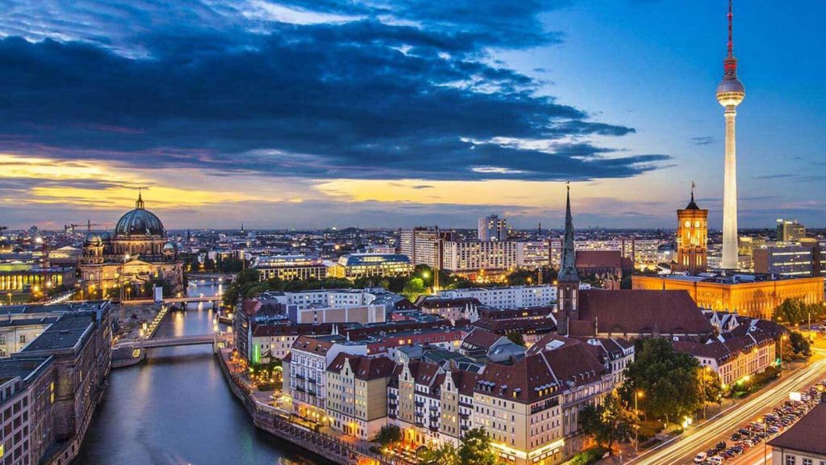
GERMANY

Slide 2
Federal Republic of GermanyIt is a country located in Centroly Europe. With a population of approximately 83 million people living on its territory, it has the largest population in the European Union and it is the world’s second largest immigration recipient after the United States, with 14.88% of this population, according to the estimate of the United Nations, immigrants. It is the second country. The capital of the country, Berlin, is also the city with the highest population, followed by Hamburg, Munich and Cologne, respectively.

Slide 3
Due to lack of money, military uniforms in various colors are painted black from head to toe, and the red cloth under the yellow buttons is considered to be the past of the colors that make up the German flag today. With the decision taken on June 7, 1950, the meaning of colors has been determined as «Drawing, Rights and Freedom.

Slide 4
Köln
Hamburg

Slide 5
Heidelberg
Honnover

Slide 6
Bremen
Berlin

Slide 7
Food Culture

Slide 8
Bratkartoffeln
Kartoffeln means «potato» in German. Germans consume potatoes in almost every meal. Bratkartoffeln is one of the most delicious dishes of this potato. Bratkartoffeln is obtained by mixing the boiled potatoes with slices, bacon and onion.

Slide 9
Kohl und Pinkel
Kohl and Pinkel, a kind of cabbage and smoked sausage, a classic taste in German cuisine, is a delicious dish made with cabbage or optionally green cabbage, porridge, lard, onions and sausage.

Slide 10
Rote Grütze
Rote Grütze is a light dessert often consumed in northern Germany. Rote Grütze has its roots in Denmark. This dessert, which combines red fruits such as raspberries, strawberries and sour cherries with cream and optionally served with ice cream, is one of the must-try flavors in Germany.

Slide 11
Flammkuchen
Flammkuchen is a type of pizza. Flammkuchen is made with various ingredients added on thinly rolled dough. If you like pizza, we definitely recommend you to try Flammkuchen.

Slide 12
Spätzle
Spätzle is one of the most consumed foods in the country. One of Germany’s rare meatless dishes, this delicious egg noodle is often served with cheese and onions. It is also consumed as a side dish with the main dish.

Slide 13
Bratwurst
One of the first dishes that come to mind when talking about Germany is sausages with a very plump appearance. Bratwurst made from pork is a delicacy that is often encountered at streetside kiosks and festivals.

Slide 14
Leipziger Allerlei
One of the most popular dishes of eastern Germany is Leipziger Allerei, that is, the “Leipzig variety”. It is prepared with a mixture of kinds, fresh peas, carrots, asparagus and lamb mushrooms. If preferred, green beans and cauliflower can be added.

Slide 15
Rouladen
Rouladen is a mixture of bacon, onions, mustard and pickles wrapped in thinly sliced ​​meat. Rouladen also has vegetable alternatives for vegetarians.

Slide 16
Maultaschen
We can call Maultaschen, a local dish of the south of Germany, German-style ravioli. It is a delicious and satisfying meal. Much more ingredients are used for the stuffing than the ravioli we are used to, and sausage, spinach and onions are placed in slightly larger dough sachets.

Slide 19
References
https://www.eagvs.com/blog/almanyaya-ozel-10-lezzet https://tr.m.wikipedia.org/wiki/Almanya

Slide 20
Şerife Nur Coşu
10/A 78

