Slide 1
lll.ALEXANDROS

Slide 2
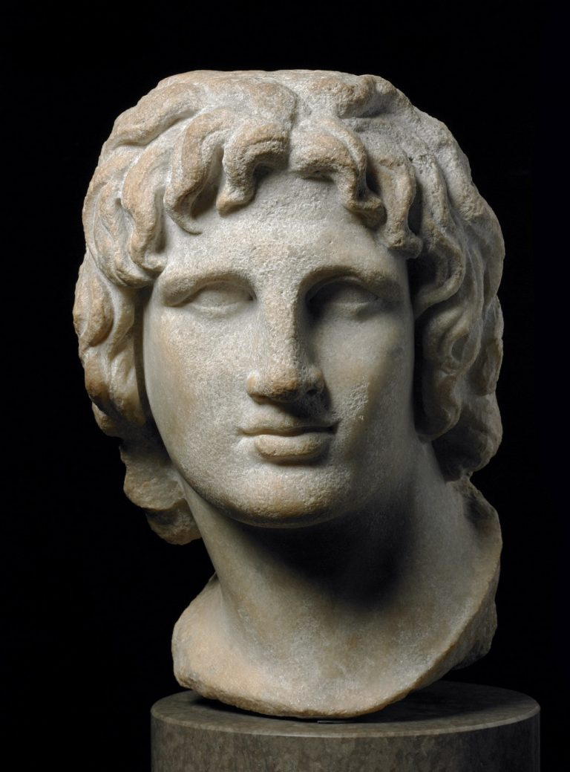
Alexandros the Great

Slide 3
BRİTH: 20 july 356 BC
Pella,Kingdom of Macedonia
DEATH: 10-11 june 323 BC (aged 32)
Babylon
SPOUSE(S): Roxana
ll. Stateira
ll.Parysats
THEİR CHİLDREN: lV. Alexandros

Slide 4
REAL NAME: lll.Alexandros
NICKNAME: Alexandros the Great
DYNAYST: House of Agead
HIS FATHER: ll. Philip
HIS MOTHER: Olympias
RELIGIOUS: Ancient greek religon

Slide 5
KING OF MACEDONIA:
Sentence: 336 BC – 323 BC
Preceding: ll.Philip
Coming arter: lV.Alexandros
lll.Philip
EGYPTIAN PHARAOH:
Sentence: 332 BC – 323 BC
Preceding: lll.Darius
Coming arter: lV.Alexandros
lll.Philip

Slide 6
ANCIENT PERSIAN KING:
Sentence: 330 BC – 323 BC
Preceding: lll.Darius
Coming arter: lV.Aleksandros
lll.Philip
KING OF ASIA:
Sentence: 331 BC – 323 BC
Preceding: Authority created
Coming arter: lV.Aleksandros
lll.Philip

Slide 8
In 336 BC, his father, II. After Philip was assassinated and died, he succeeded his father to the throne of Macedonia. Alexandros was awarded the title of Leader of Greece and used this authority to implement his father's Pan-Hellenistic plan aimed at bringing the Greeks together for the conquest of Persia.

Slide 9
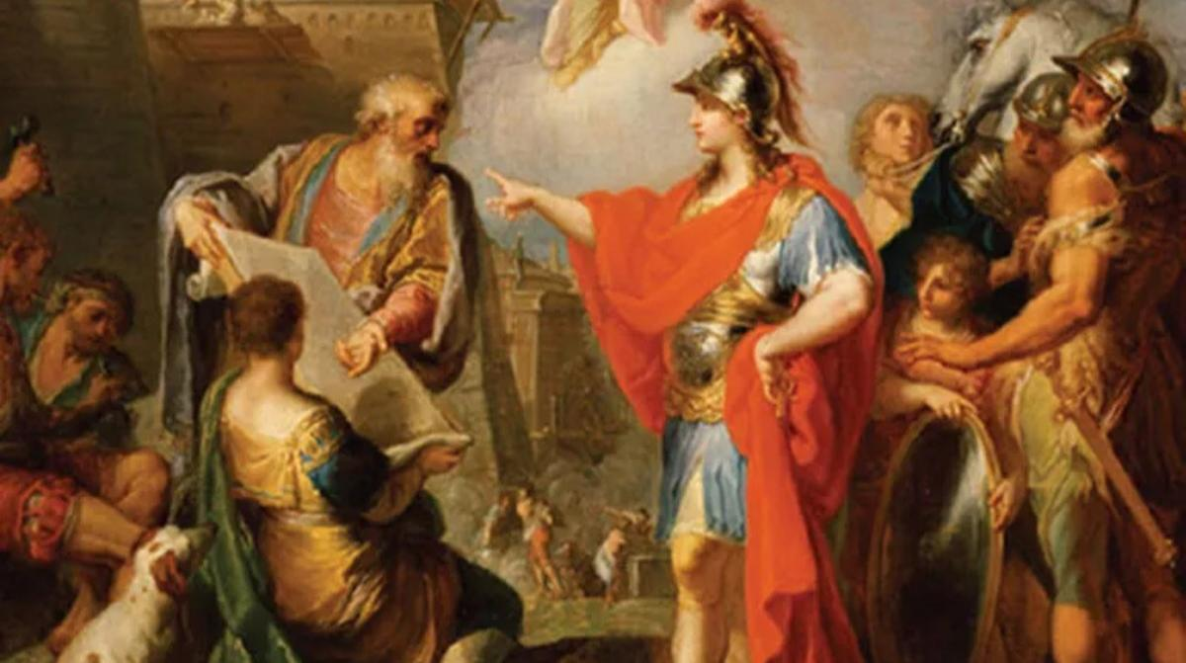

Slide 10
Saggalassos instead of Termessos Alexandros wanted to pass from Pamphylia to Phrygia, and according to Arrianos, the road to Phrygia was passing through Termessos. Indeed, it is still a matter of debate why Alexandros chose to climb the steep Yenice pass when there are lower and easier passes. It is also said that his enemies in Perge sent Alexandros the wrong way. Alexandros spent a lot of effort and time to pass the gate closed by the Termessians, and he returned with this anger and besieged Termessos. Probably because he knew he could not hold Termessos, Alexandros did not attack, but instead marched north and took his anger out on Sagalassos.

Slide 11
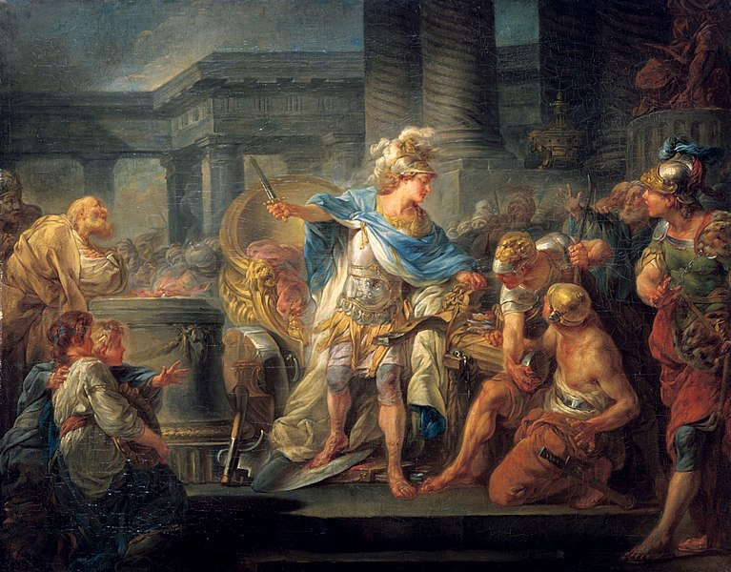

Slide 12
Alexandros the Great: Let It Stay!
The city’s appearance on the stage of history was when Alexandros the Great besieged the city in 333 BC and the people of Termessos made a strong defense and did not surrender the city. It is among the rumors that Alexandros, who could not take Termessos, said, "Let him stay, my way is longer, I cannot lose my army in front of this eagle's nest". And he calls out to his army:
“Destroy all olive trees before leaving the city.”

Slide 13
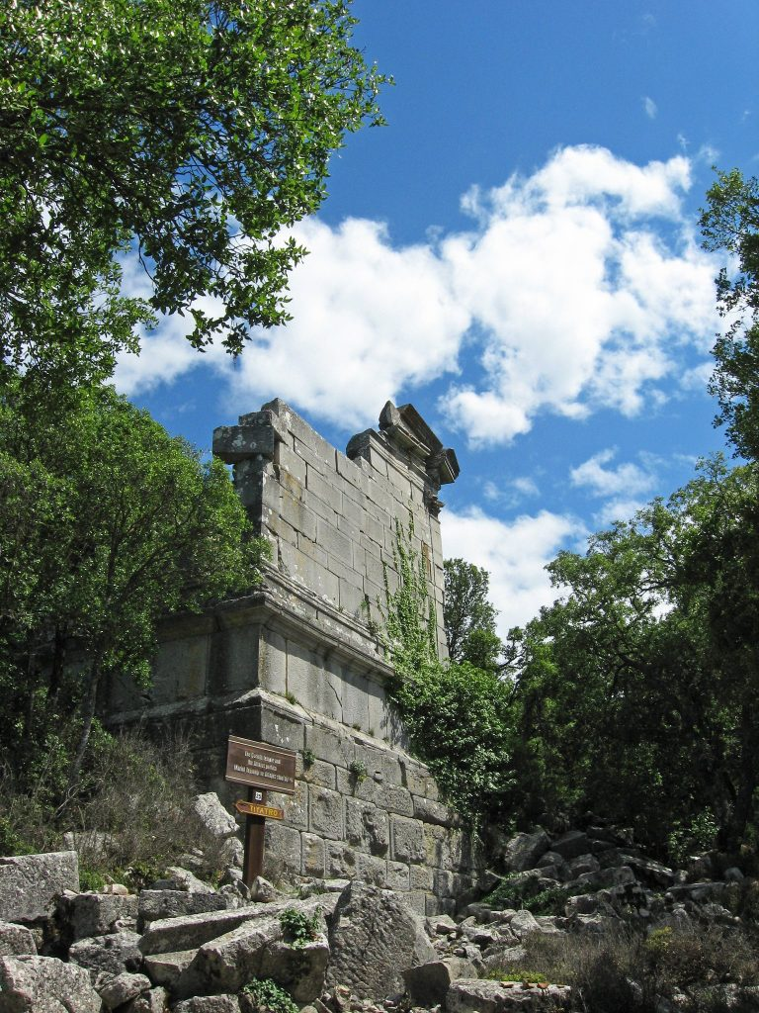
TERMESSOS

Slide 14
KNOT OF GORDIAN
The Gordian Knot is a famous legend about Alexander the Great, who is among the greatest rulers in the history of civilization. According to legend, the Phrygians, who are in search of a leader, are told by an oracle to proclaim the first man to enter the city in an ox cart as king. Then, from afar, Gordias appears, riding his oxcart with his wife and son Midas. Seeing this, the Phrygians happily accept Gordias as their king. Thinking that the kingdom is a gift from Zeus, Gordias first dedicates his oxcart to the Temple of Zeus and tied it with a knot of cranberry branches. Gordias, for this knot that carried himself to the kingdom before he died: "Whoever unties this knot, that person rules the world." speaks his word. The rumor soon spread that the person who managed to untie the knot would become the ruler of all of Asia. Years

Slide 15
Years pass and a young emperor from Macedonia, who is determined to conquer the whole world, comes to Gordion. Alexandros the Great is indeed on his way to becoming the conqueror of the Persian Empire and the ruler of Asia. Having heard the legend of the Gordian Knot, Alexandros, when he came to the city, first went to the temple, tried to untie the knot, but could not untie the knot no matter how hard he tried. Upon this, Young Alexandros, angry with impatient anger, uses his sword and cuts the knot. Thus, the prophecy comes true. However, Alexandros untimely death from a febrile illness at the age of 33 is seen by the sages as the fate of Alexandros impatient behavior rather than untying the Gordian knot.

Slide 16
REFERENCES
https://tr.m.wikipedia.org/w/index.php?title=Dosya:Map_Macedonia_336_BC-fr.svg&filetimestamp=20070114182911
https://islamansiklopedisi.org.tr/iskender-bey
https://translate.google.com/?hl=tr
https://tr.wikipedia.org/wiki/buyukiskender%27n%C4%B1n_Fethi

Slide 17
SONGÜL MORTAŞ

