Slide 1
extreme sports

Slide 2
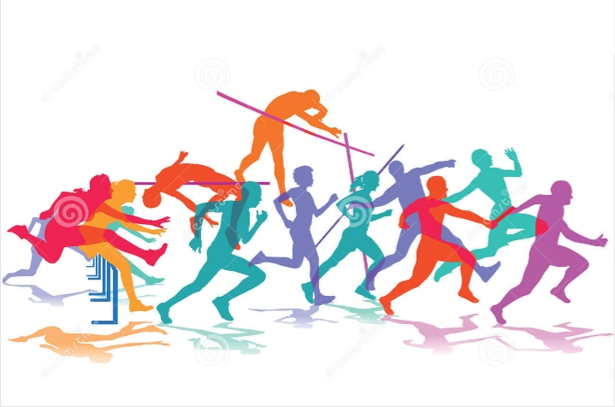
Athletics is one the oldest sports in the world, played a track or field. In these games, athletes demonstrate their running, walking, jumping and throwing abilities. First known running race was held in Egypt around 3800 BC.
Athletics:
Athletics is one the oldest sports in the world, played a track or field.

Slide 3
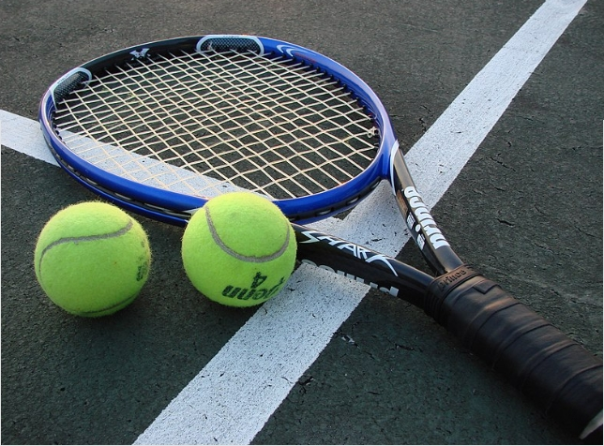
Tennis:
Tennis is a Olympic sport played between two players two teams or two with a racket and ball. Players try throw a ball over the net into their opponent's court with their rackets.

Slide 4
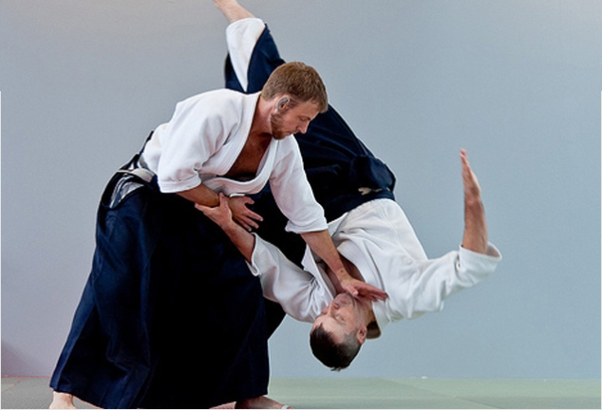
Aıkıdo:
Aikido is a "modern Japanese martial art". Like other martial arts in Japan, aikido a teaching not only for self-defense, also spiritual growth.

Slide 5
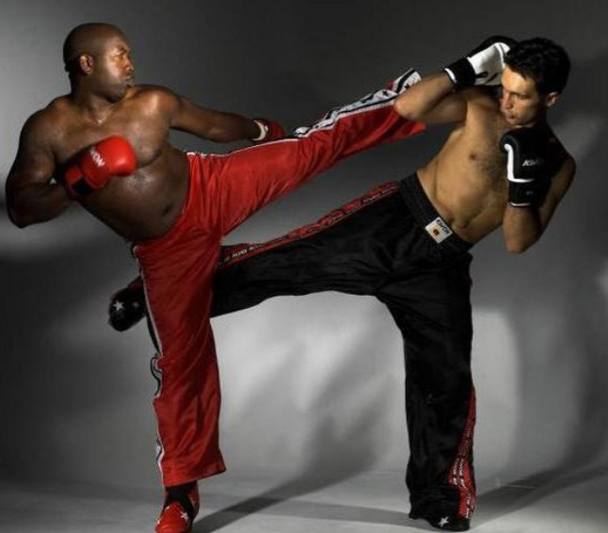
Kick boxing:
Kickboxing is eclectic combat sport that combines punches, kicks, knees and limited clinches.

Slide 6
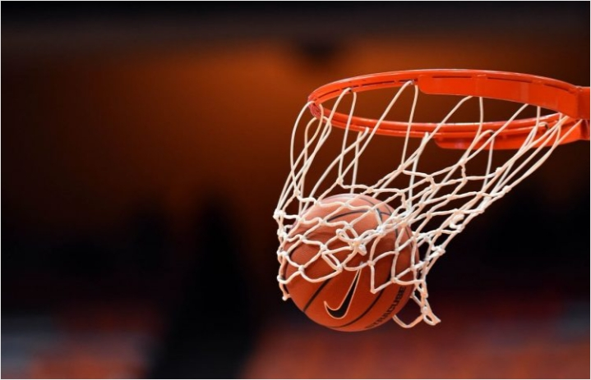
Basketball:
Basketball a popular team game and sport played with a hand-held ball.

Slide 7
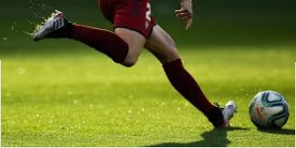
Football:
Football a team sport played with a distinctive spherical ball between two teams eleven players.

Slide 8
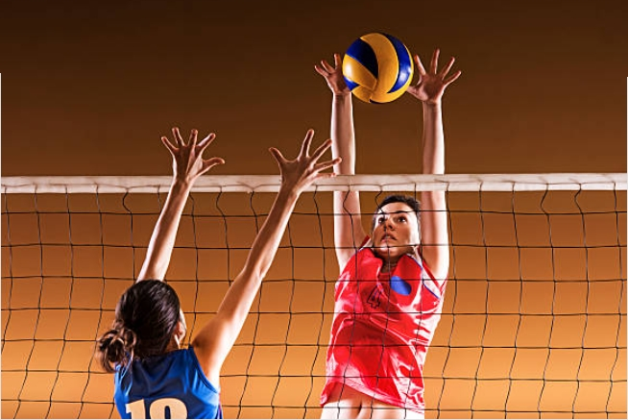
Volleyball a sport played by two teams of six a playground divided by a net. The of the game to send the ball over the net so that the ball touches the playing field of the opposing team and prevent the opposing team from reaching the same goal.
Volleyball:

Slide 9
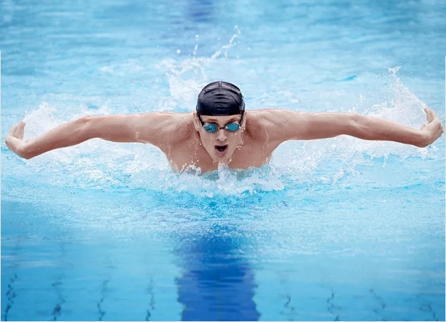
Swimming:
Swimming is a racing training sport performed at the individual or team level, which requires the individual move her whole body through water without using element other than arm and leg movements.

Slide 10
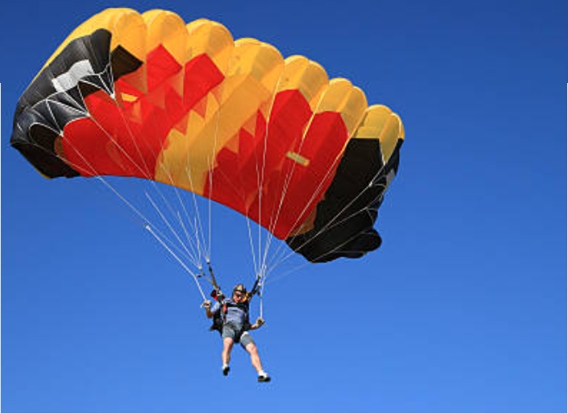
Sky diving:
Parachuting a recreational sport that occurs a result of jumping from a sufficient height, opening the fabric called parachute in order to land a safe speed.

Slide 11
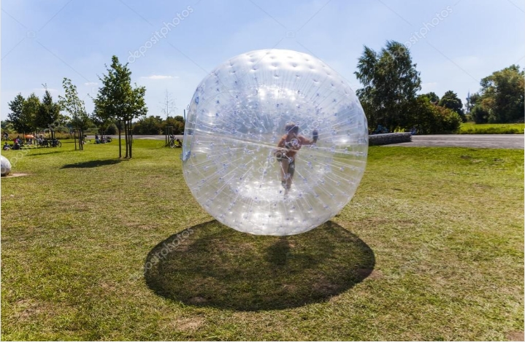
Zorbing:
Zorbing is the name given to the sport rolling down from a high point in visible, usually plastic ball.

Slide 12
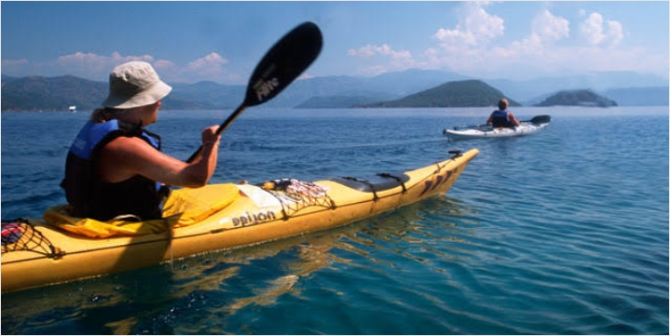
Canoeing:
A canoe is flat-type, single-paga-driven, light and portable boat. The word canoe comes from Caribbean.

Slide 13
Elif dağlar
https://tr.m.wikipedia.org/wiki/Y%C3%BCzme_(spor)#:~:text=Y%C3%BCzme%2C%20bireyin%20t%C3%BCm%20bedenini%20kol,da%20g%C3%B6l%20i%C3%A7inde)%20icra%20edilmektedir.

