Slide 1
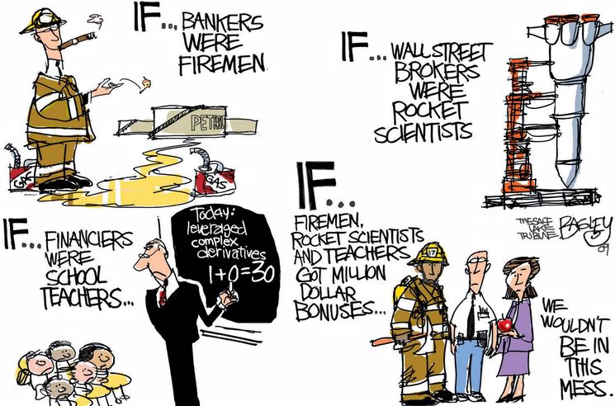
IF CLAUSE

Slide 2
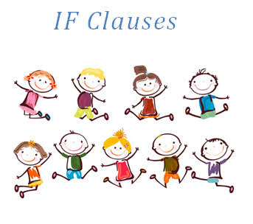
•If world means if
•Is a conditional sentence
•If Conditional sentence to the containing sentence,The sentence containing the result is called the main clause.
If at the beginning, a comma is placed between two sentences.

Slide 4
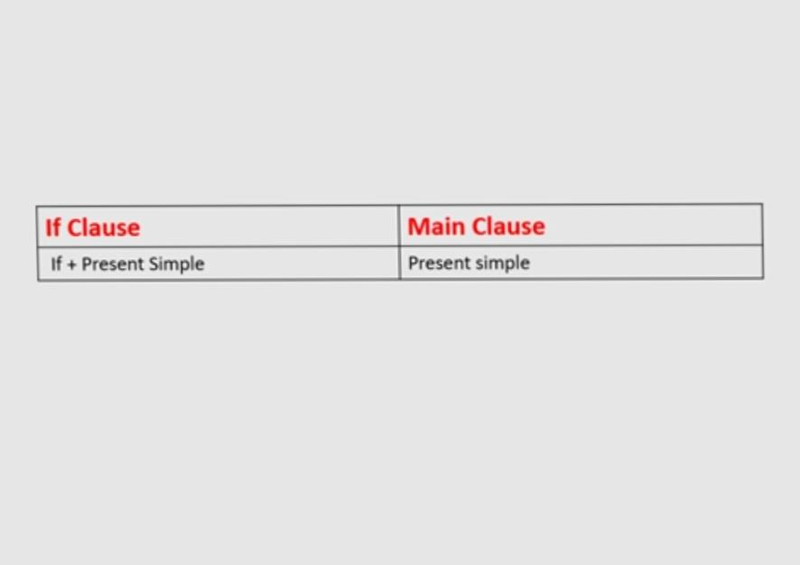
Exact situations and facts accepted by all
Use the present simple Past Tense in the sentence

Slide 8
They are sentences that are uncertain, but that are likely to happen or not.
Shows the future time

Slide 12
Has a negative meaning
Sentence is structurally positive
Type 1, type 0 are used with conditionals

Slide 21
References
Translate
https://youtu.be/1YxOQzhet5Y

Slide 22
Thank you for listening to me♡
ŞEVVAL PELVAN
10\A
98

