Slide 2
A brief history of the origins and development of English
The history of the English language is originally from MS. It started with the arrival of three Germanic tribes who invaded Britain during the 5th century. These tribes, named Anglo, Saxons and Jutes, came out of today's Denmark and the north of Germany and reached the island by crossing the North Sea. At that time, the settlers of Britain spoke the Celtic language. But most of the Celtic speakers were pushed by the invaders to the west and north of the island, primarily in present-day Wales, Scotland and Ireland. The Anglos came from England and their language was called "Englisc". The words "England" and "English" are derived from these words.

Slide 3
Old English (450-1100 AD)
Invading Germanic tribes spoke similar languages in Britain that evolved into what we now call Old English. Old English was neither sound nor style similar to English today. Native English speakers have great difficulty understanding Old English. Still, about half of the most commonly used words in Modern English are of Old English origin. For example, be, strong, and water are derived from Old English. Old English was spoken until 1100.

Slide 4
Middle English (1100-1500)
In 1066, William the Conqueror, Duke of Normandy (part of modern France), conquered and occupied England. These victorious people, called the Normans, brought with them a kind of French, which became the language of the Royal Court and its ruling and trading classes. In this process, there was a kind of language class separation in which the lower classes spoke English while the upper classes spoke French. By the 14th century, English became the dominant language in England with the addition of many French words. This language is called Middle English. This language is the language of the great poet Chaucer (1340-1400). However, it is still in a structure that is difficult for native English speakers today to understand.

Slide 5
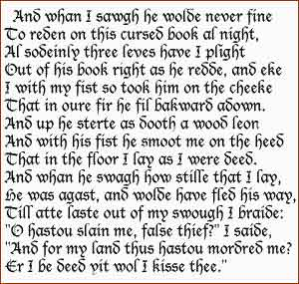
A fragment from Beowulf, a poem written in Old English
An example of Chaucer's Middle English

Slide 6
Early Modern English (1500-1800)
Towards the end of Middle English, vowels began to be pronounced much shorter, with a sudden and different change in pronunciation. From the 16th century onwards, the British communicated with many peoples from different parts of the world.
This and the classical learning of the Renaissance caused many new words and idioms to enter the language. The invention of the printing press also meant the emergence of a common language in print. Books got cheaper and more people learned to read. The printing press also brought standardization to English. Spelling and grammar were fixed, and the London dialect of many publishing houses was standardized. The first English dictionary was published in 1604.

Slide 7
Late Modern English (1800-Present)
The main difference between Early Modern English and Late Modern English is vocabulary. Late Modern English has many new words stemming from two main factors: first, the Industrial Revolution and technology created a need for many new words to be found. Second, the British Empire at its height covered a quarter of the earth, resulting in the English language incorporating foreign words from many countries.

Slide 8
REFERENCES
https://ingilizcebankasi.com/ingilizce-dilinin-tarihi/
https://tr.wikipedia.org/wiki/%C4%B0ngilizce

