Slide 1
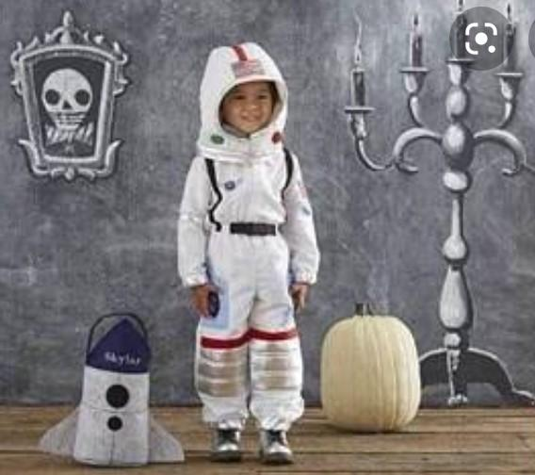
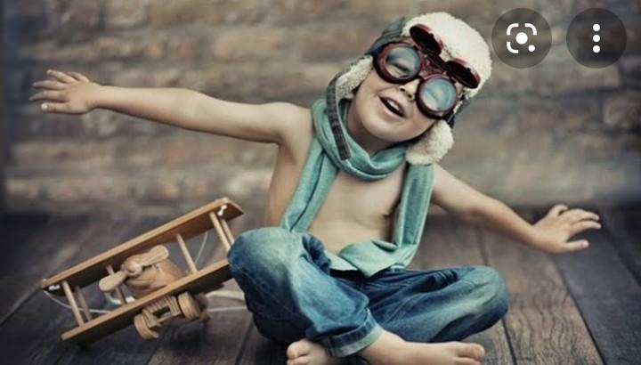
CHİLDHOOD DREAMS

Slide 2
to be famous
to fly

Slide 3
To go to space

Slide 4
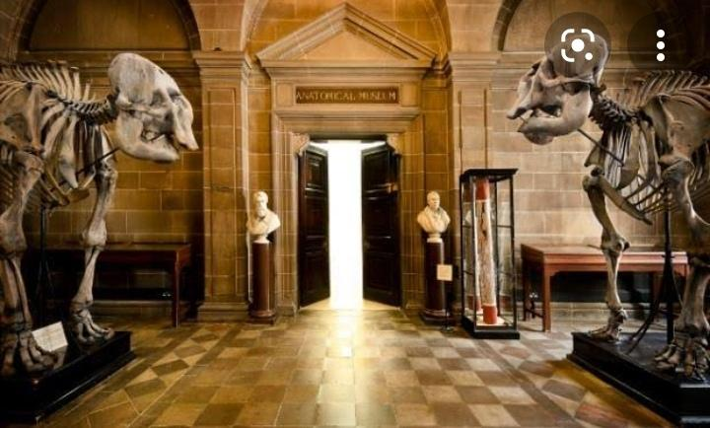
MUSEUM TYPES

Slide 5
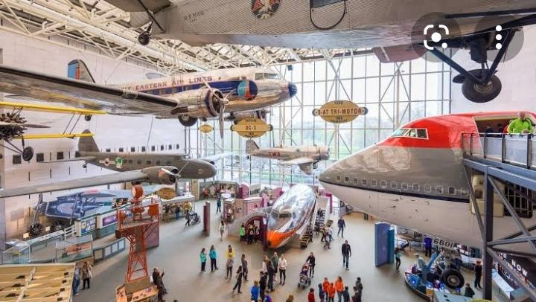
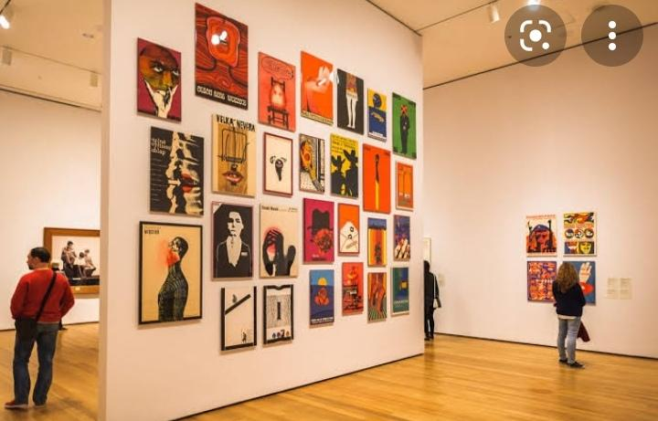
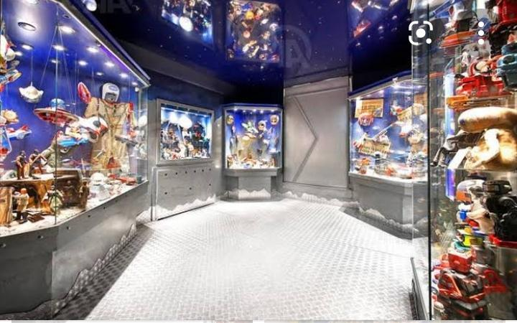
Space museum
Toy museum
Art museum

Slide 6
Opera singer
Mathematician
Archaeologist
Violinist
Architect
Specialist
Founder
Curator
Donation
Exhibition
Archives
Sculptor
Queue
Danger
Crew
Explosion
Plane
Motorbike
Survive
Braveheart
Shuttle

Slide 7
Ordinary
Diligent
Gifted
Big-hearted
Privileged
Memorable

Slide 8
MERVE AVCI
BENİ DİNLEDİĞİNİZ İÇİN TEŞEKKÜR EDERİM 🙂

