Slide 1
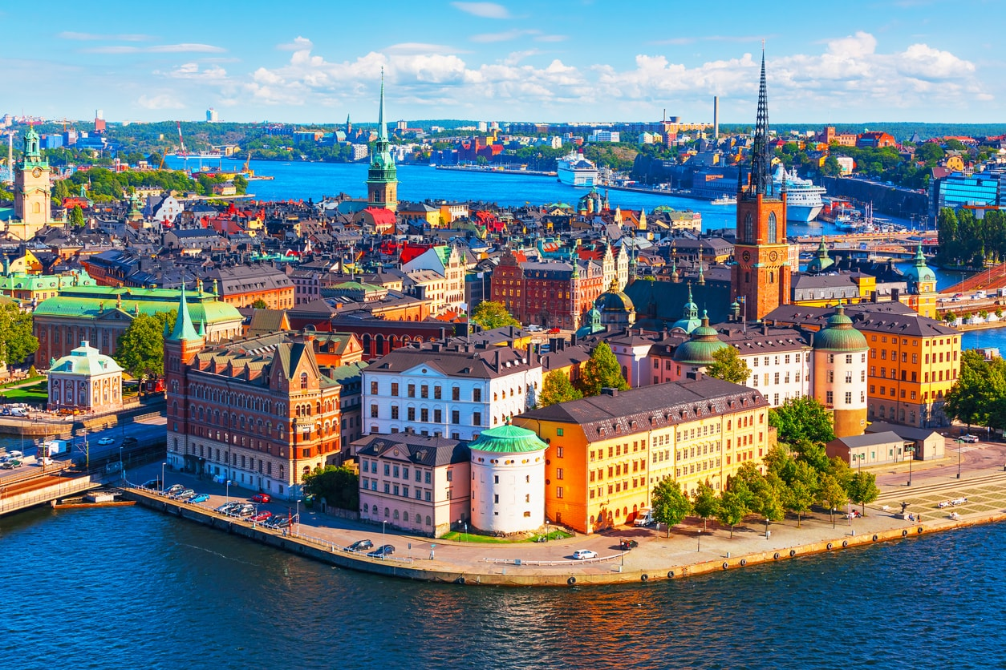
SWEDEN

Slide 2
Where is sweden?
It is a country located on the Scandinavian peninsula in Northern Europe. The country’s border neighbors are Norway to the west and north, and Finland to the east.

Slide 3
What is the meanın of the flay?

Slide 4
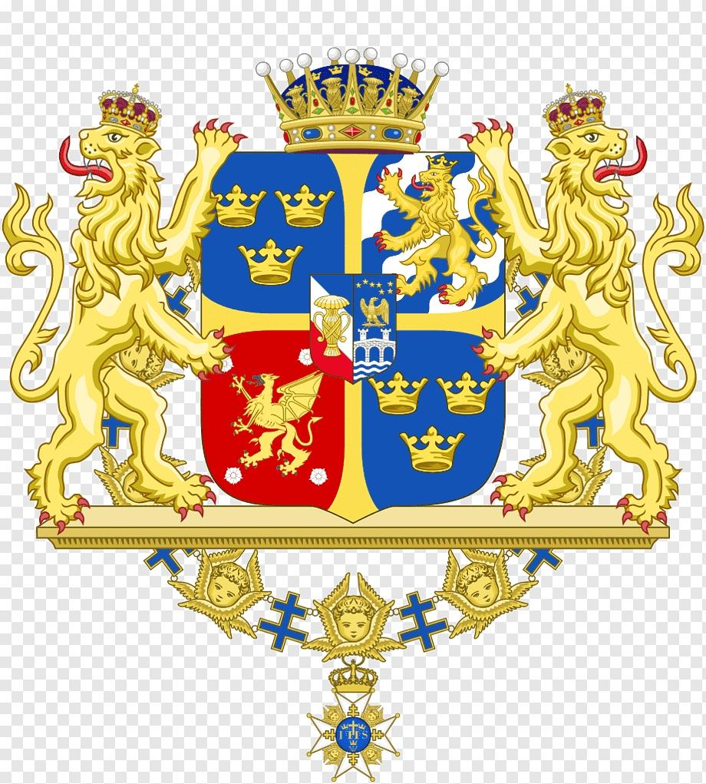
The Swedish flag consists of a yellow or golden Scandinavian cross on a blue field. The Scandinavian cross on the Swedish flag represents traditional Christianity. The design and colors of the Swedish flag are inspired by the current 1442 coat of arms of Sweden.
According to the legend in Swedish Culture, the reason why the cross on the Swedish flag is yellow is that this flag appeared in the sky during the 1157 Crusade and landed on Swedish territory.

Slide 5
10 INTERESTING THINGS YOU SHOULD KNOW ABOUT SWEDEN!!
It is the third largest music exporter in the world
Swedes love to recycle
3.Have the highest number of patents per capita in Europe

Slide 6
It is the third largest music exporter in the world
Swedes love to recycle
Have the highest number of patents per capita in Europe
The country where the Nobel Prizes are awarded
Meet the indispensable coffee’ Fika’

Slide 7
6. Sweden is one of the best places in the world to see the northern lights
7. Ice hotel tradition started with Sweden
8. Meet clean cities and air
9. Stockholm has the coolest public transport system in the world
10. The country with the most islands in the world

Slide 8
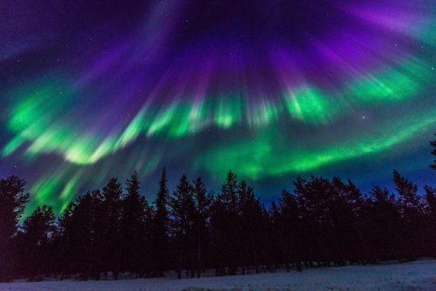

Slide 11
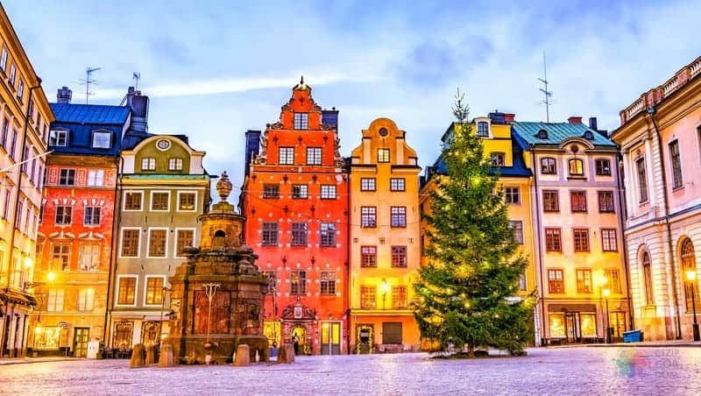
PLACES TO VISIT IN SWEDEN

Slide 12
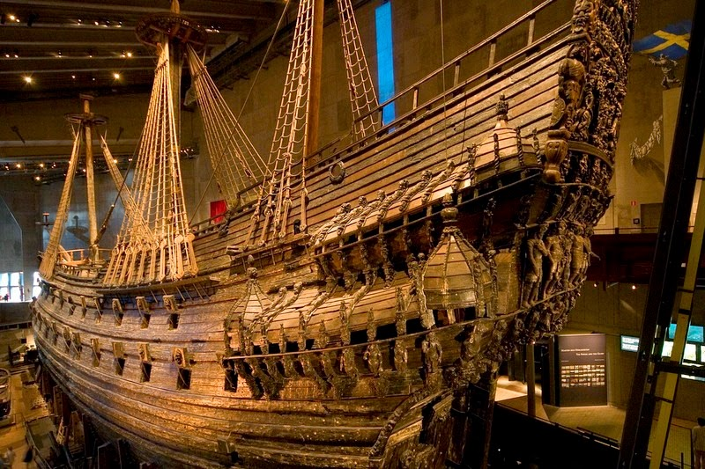
VASA MUSEUM

Slide 13
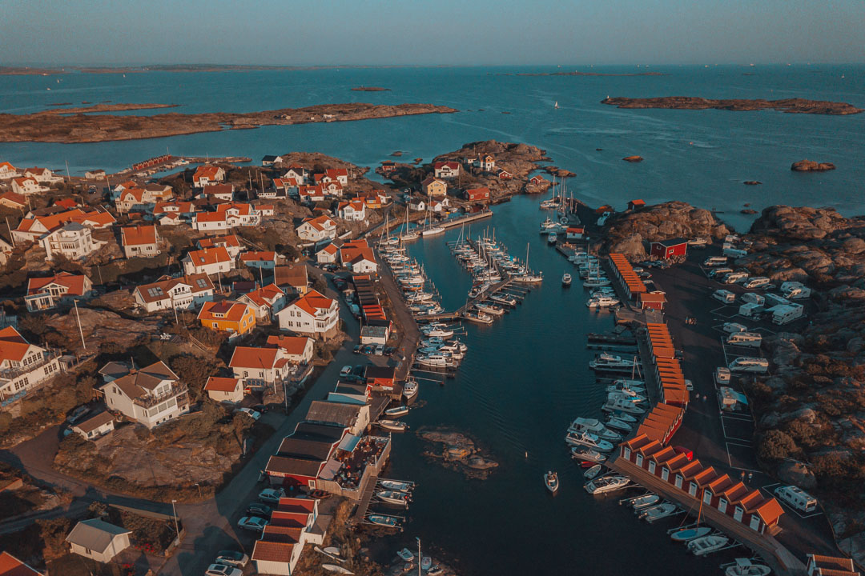
GOTHENBURG ACHIPELAGO

Slide 14
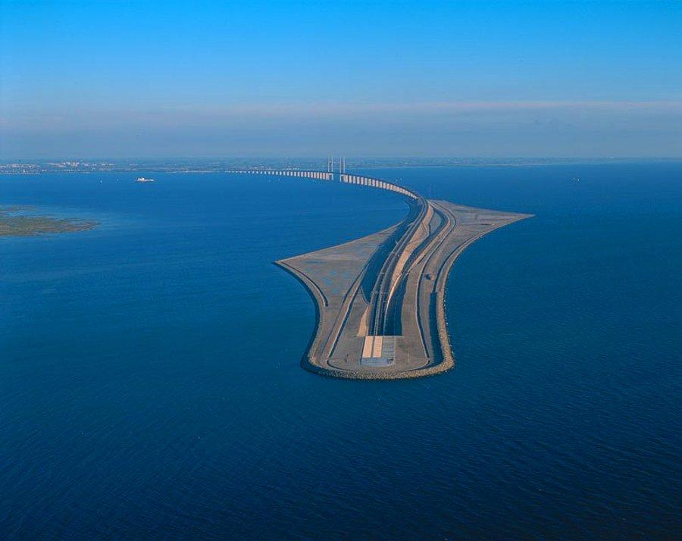
ORESUND BRIDGE

Slide 15
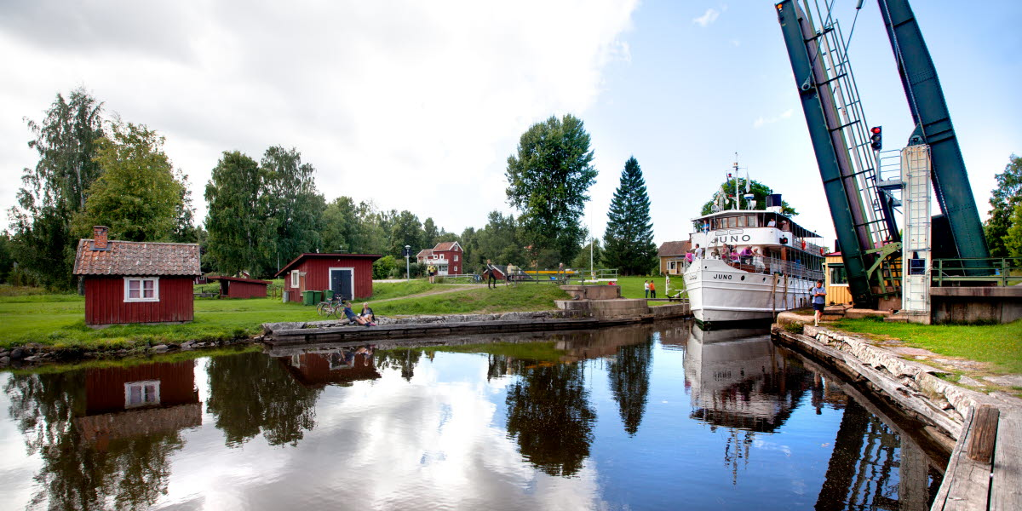
GØTA CANAL

Slide 16
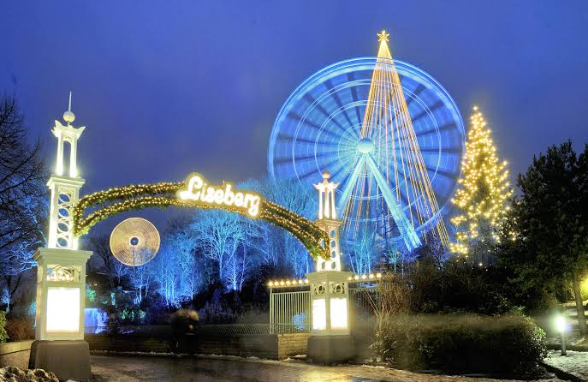
LISEBERG AMUSEMENT PARK

Slide 17
SWEDISH FOOD

Slide 18
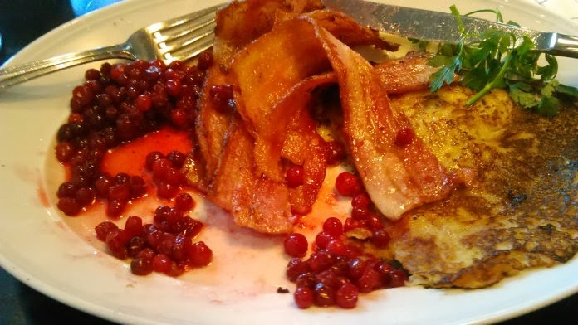
RAGGMUNK
Raggmunk is served with pancakes and bacon made from grated or ground potatoes, flour and eggs, topped with onions and garlic. It is considered one of the most popular local dishes with the flavor of the balanced mixture of salt and oil. In fact, you will encounter a kind of potato pancake.

Slide 19
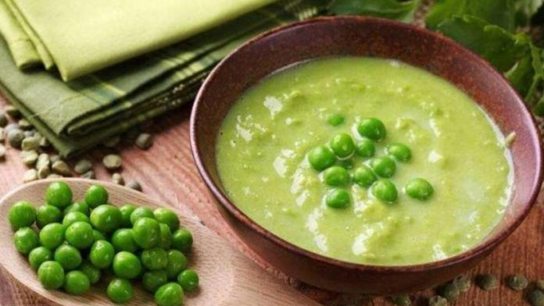
Pea Soup and Pancakes
Don’t be surprised, though, if you find that most restaurants serve pea soup on Thursdays. II. This soup, which has been a part of an ongoing tradition since World War II, is one of the unique flavors in the country and is served with such delicious pancakes on the side.

Slide 20
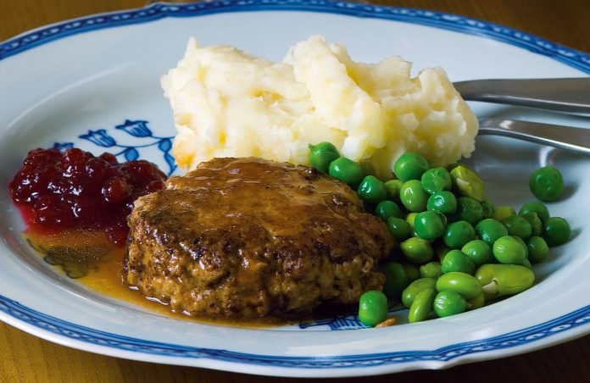
WALLENBERGARE
Wallenbergare is actually a meat pie made with ground beef and eggs covered in cream. Served with mashed potatoes and peas, Wallenbergare can be counted as one of the must-try flavors in Sweden.

Slide 21
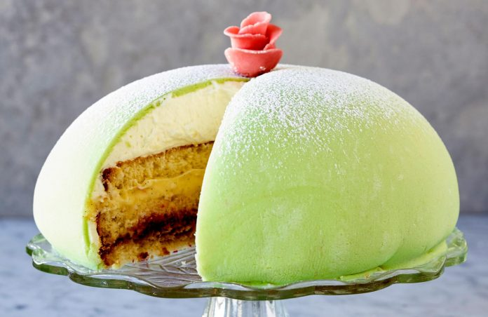
PRINSESSTARTA
These cakes are so famous throughout the country that the third week of September is considered the official princess cake week. The story behind the name of the cake comes from the daughters of Prince Carl Bernadotte .

Slide 22
CLOTHES

Slide 23
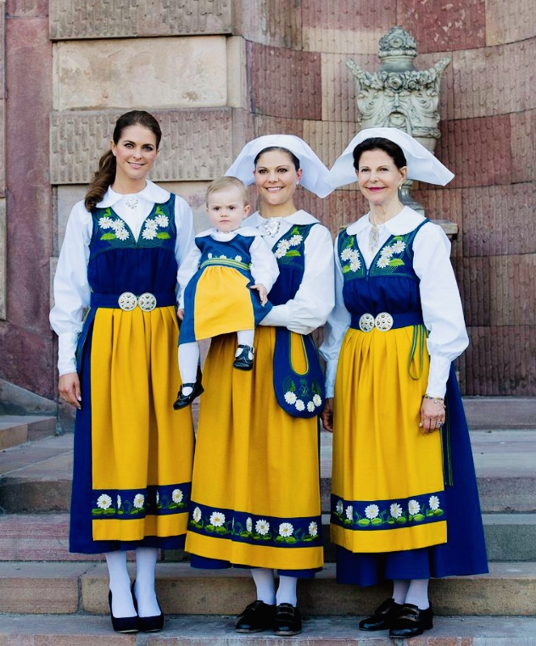

Slide 24
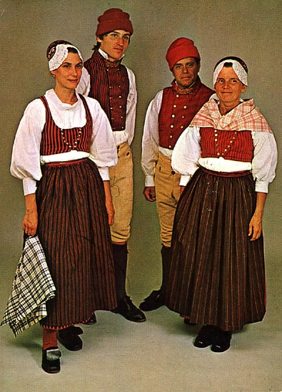

Slide 25
KAYNAKÇA:
https://blog-biletbayi-com.cdn.ampproject.org/v/s/blog.biletbayi.com/isvecte-ne-yenir.html/amp/?amp_js_v=a6&amp_gsa=1&usqp=mq331AQKKAFQArABIIACAw%3D%3D#aoh=16387117770935&referrer=https%3A%2F%2Fwww.google.com&amp_tf=%251%24s%20alan%C4%B1ndan&ampshare=https%3A%2F%2Fblog.biletbayi.com%2Fisvecte-ne-yenir.html%2F
https://www-hotcourses--turkey-com.cdn.ampproject.org/v/s/www.hotcourses-turkey.com/study-in-sweden/before-you-leave/10-facts/?amp_js_v=a6&amp_gsa=1&amp=true&usqp=mq331AQKKAFQArABIIACAw%3D%3D#aoh=16387117280290&referrer=https%3A%2F%2Fwww.google.com&amp_tf=%251%24s%20alan%C4%B1ndan&ampshare=https%3A%2F%2Fwww.hotcourses-turkey.com%2Fstudy-in-sweden%2Fbefore-you-leave%2F10-facts%2F

Slide 26
HAZIRLAYAN:
ADI:DILEK
SOYADI:PALA
SINIFI:10/A
NO:89

