Slide 1
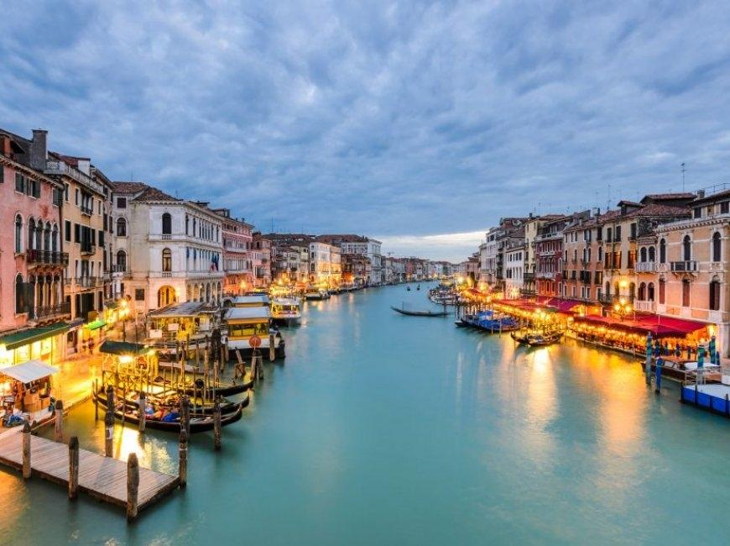
-ITALY-

Slide 2
Where is italy?
The Italian Republic is a country in Southern Europe, largely located on the Italian Peninsula. The two largest islands of the Mediterranean, Sicily and Sardinia, are also Italian territories.

Slide 3
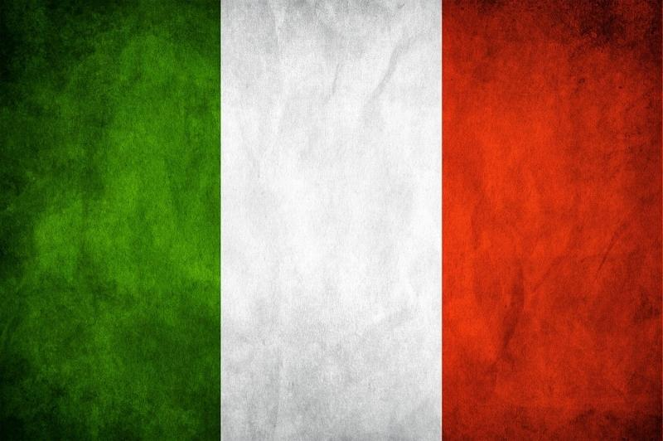
What is the meaning of the flag?
It is generally said that green represents nature, white represents snow in the Alps, and red represents the blood spilled in the Italian War of Independence. According to a more religious explanation; Green represents hope, white represents destiny, and red represents charity.

Slide 4
The city that smells of history: Rome
Rome, or the commune of Rome, is the capital of Italy, the region of Lazio, and also the province of Rome. Rome has the status of both a city and a special commune. It is between the Tiber and Aniene rivers and close to the Mediterranean Sea. Its population is 2 million people.

Slide 5
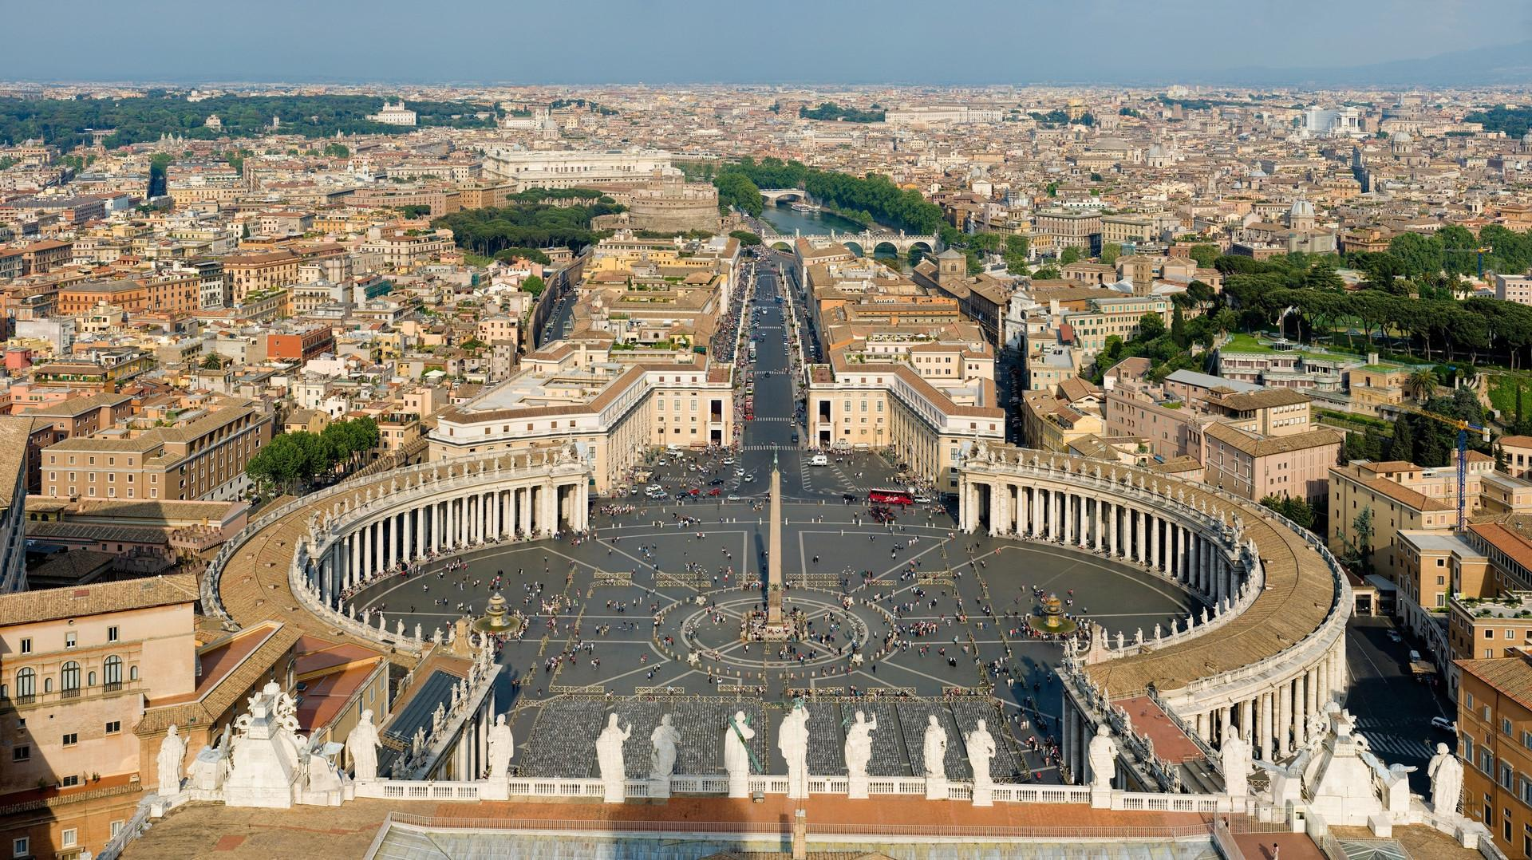
ROME

Slide 6
VENICE
Venice is built on 118 islands in northeastern Italy, separated by canals and connected by bridges. The city is located in the Venetian Lagoon, which runs along the coastline, between the deltas of the Po and Piave rivers. Venice is famous for its natural beauty, architecture and works of art. Its population is around 260 thousand.

Slide 7
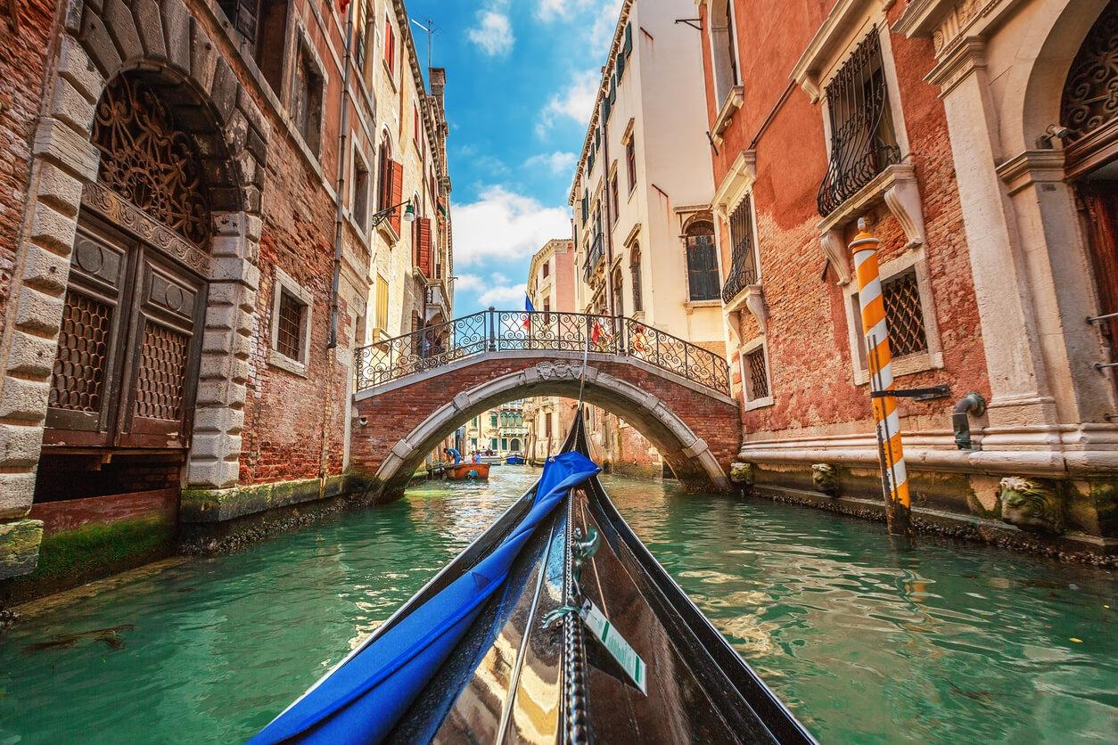
VENICE

Slide 8
MILAN
Milan is a city and comune in the eponymous province of Milan in the Lombardy region of northern Italy. Milan is the capital of the Lombardy region and the province of Milan. The commune of Milan has a population of 1,372 thousand people and is the second largest populated commune in Italy with an area of ​​2,370 km².

Slide 9
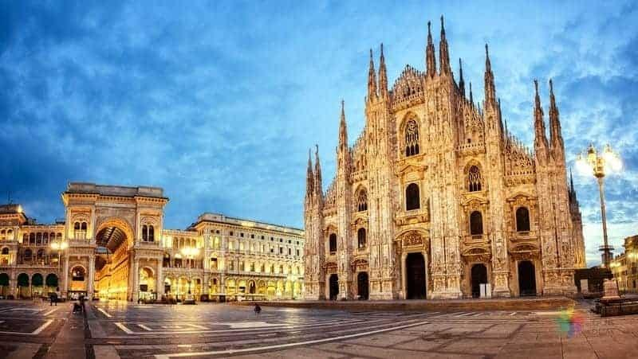
MILAN

Slide 10
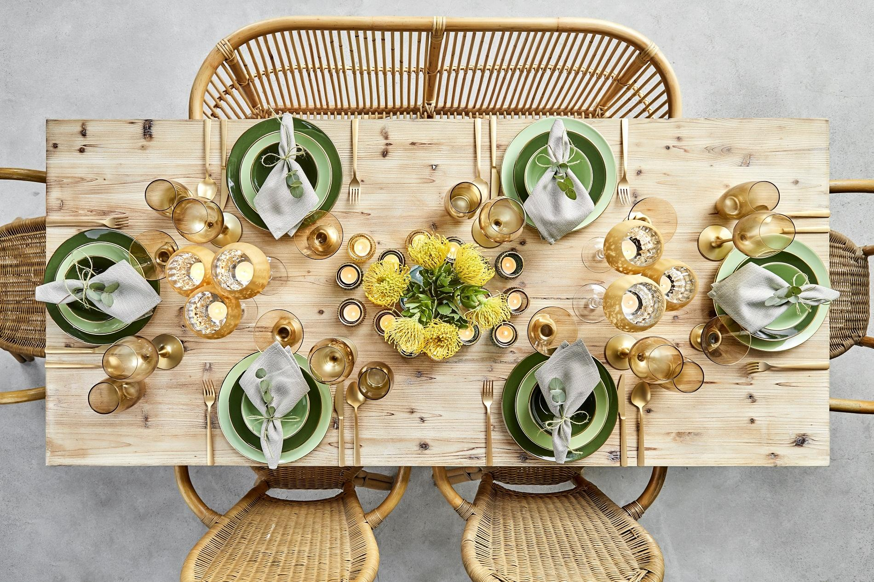
Food culture

Slide 11
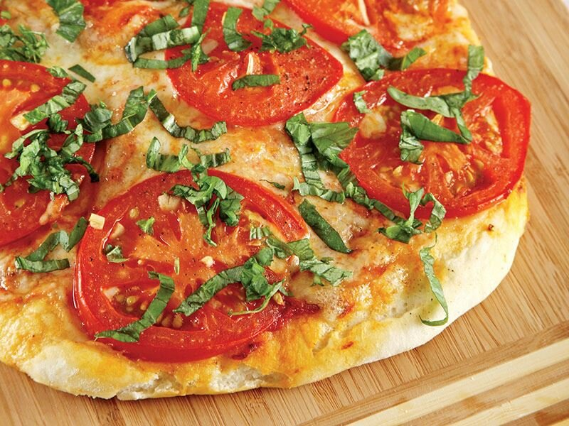
Margarita pizza
When it comes to Italian cuisine, the first flavor that comes to mind is pizza. This margarita pizza, prepared with mozzarella cheese and basil, was specially designed for the Queen of England Margarita and later spread around the world.

Slide 12
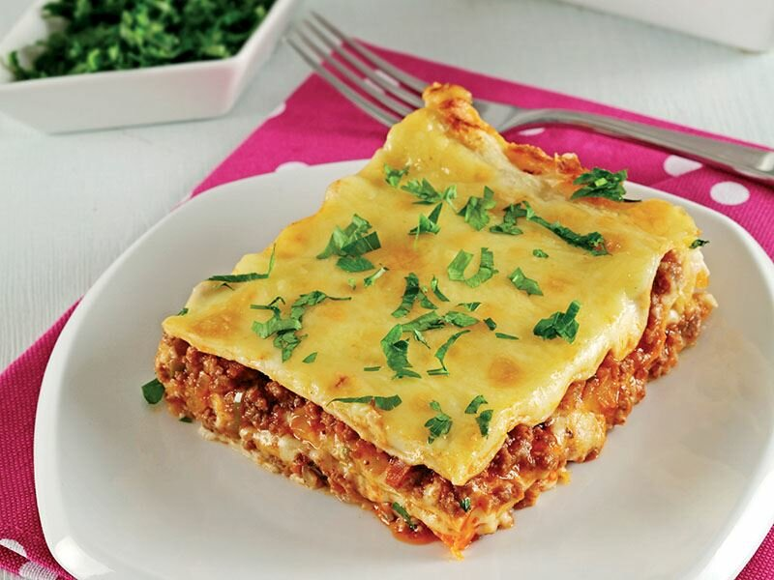
Lasagna
Lasagna, named after the container in which it is cooked, is prepared with special lasagna dough, tomato sauce and cheese. It is usually served with minced meat and plain. Lasagna takes its name from the Italian city of Bologna, famous for its beauty.

Slide 13
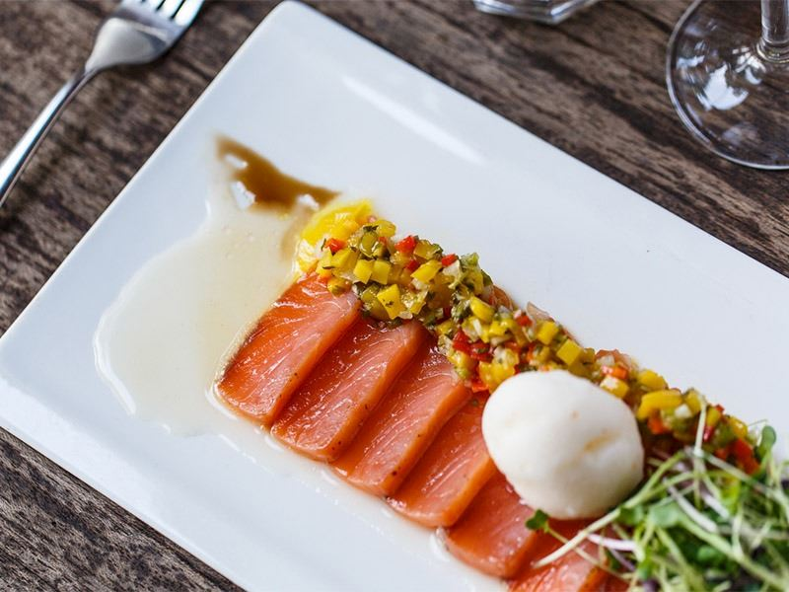
Salmon carpaccio
Carpaccio is prepared by slicing raw meat very thinly. Carpaccio, identified with Venice, can be prepared with beef, salmon and vegetables.

Slide 14
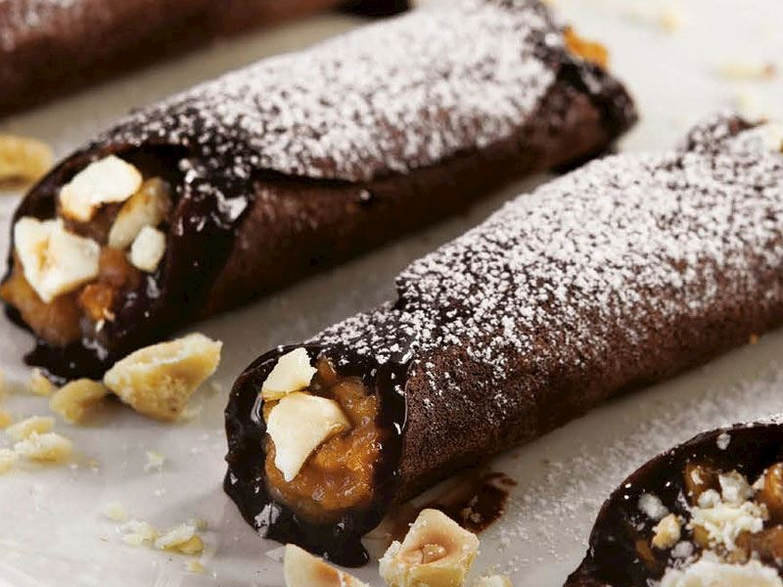
Hazelnut cannoli
Cannoli, which is among the most delicious desserts of Italy, is frequently consumed especially in Sicilian cuisine. This dessert, brought to America by Italian immigrants, has spread to many parts of the world over time. Ricotta cheese is used in dessert making.

Slide 15
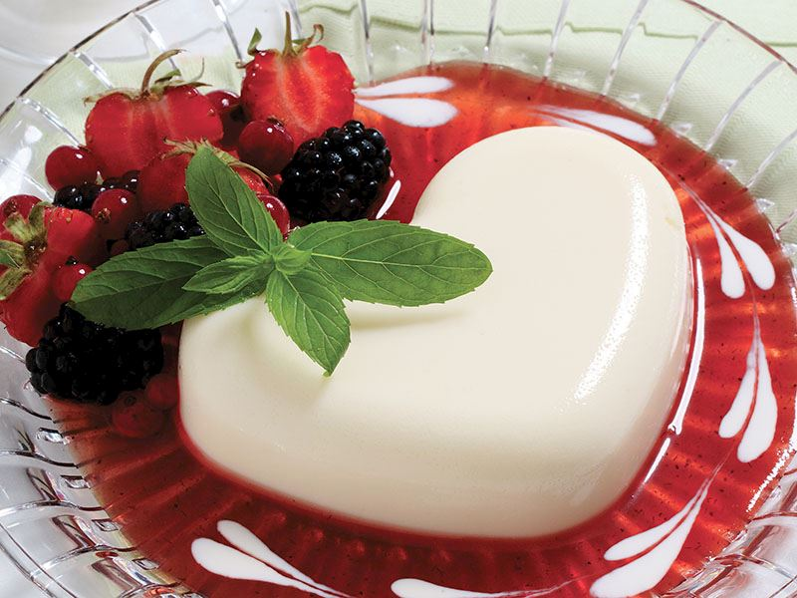
Panna Cotta
Panna cotta is also a very popular flavor thanks to its lightness and easy preparation. Prepared in 20 minutes in total, panna cotta can be enriched with fruit sauces upon request.

Slide 16
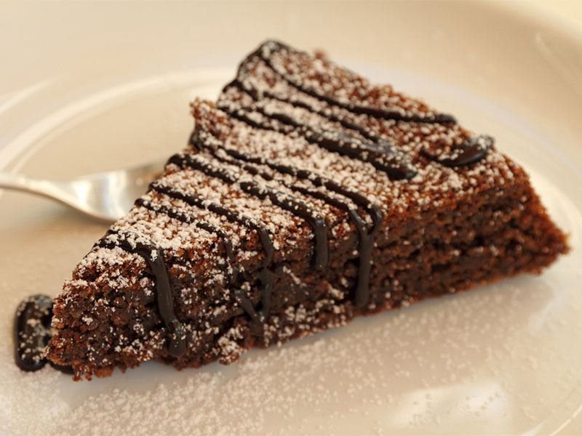
Torta Caprese
At a meeting to be held on the Island of Capri, the cook was asked to make a chocolate cake. The cook, who forgot to add flour to the cake because he was very excited, served the dessert he prepared in this way. This dessert, which is highly appreciated by the guests, is known as torta caprese.

Slide 17
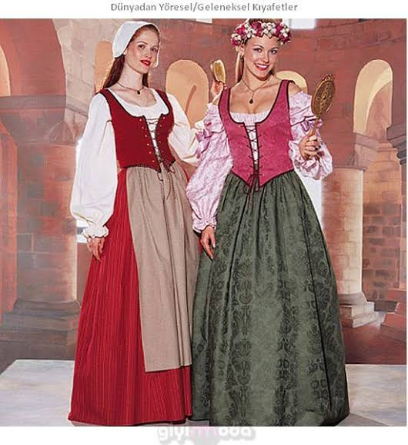
Traditional attire

Slide 18
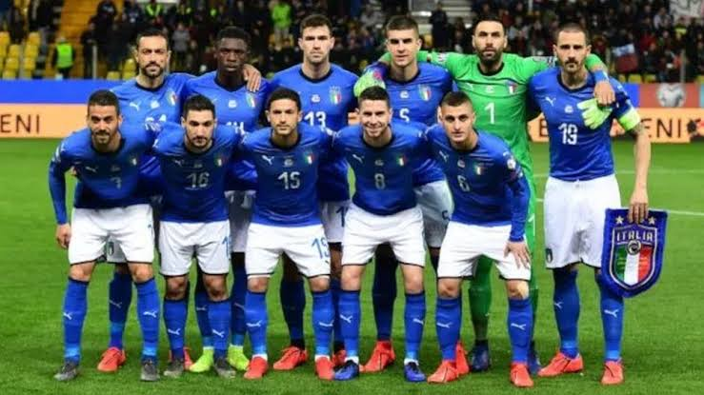
World giant Italian national football team

Slide 19
Reference
https://www.lezzet.com.tr/lezzetten-haberler/italyan-yemekleri/6
https://www.lezzet.com.tr/lezzetten-haberler/italyan-tatlilari
https://tr.m.wikipedia.org/wiki/%C4%B0talya

