Slide 1
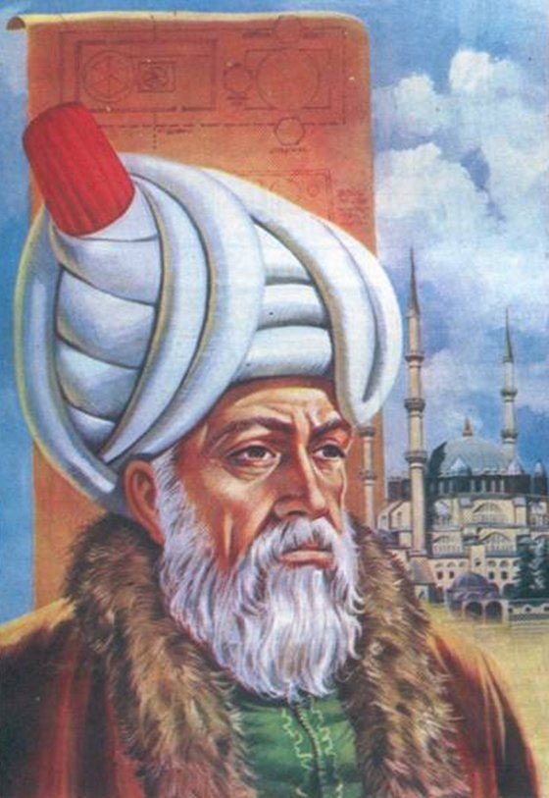
MİMAR SİNAN
Mimar Sinan was born on May 29, 1489 in the village of Ağırnas in Kayseri. At the age of 22, he was taken to the Novice Boys’ Corps, which trained soldiers for the army. Sinan, who learned carpentry here, took part in construction works. He also had the opportunity to work with the leading architects of the era during this period.

Slide 2
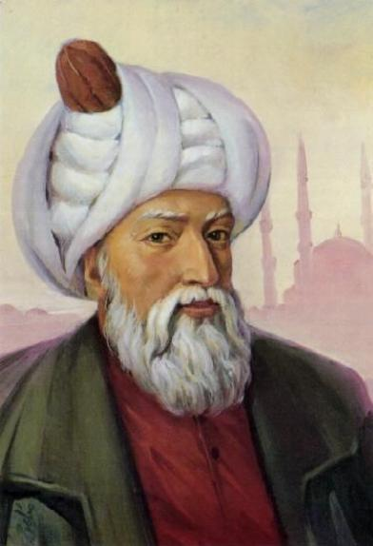
After the Battle of Çaldıran in 1514 and the Egyptian campaigns between 1516 and 1520, Sinan was taken to the Janissary Corps after his return to Istanbul.After the Mohaç expedition in 1526, she was appointed as the head of the ammunition.The successful completion of the construction of three ships that would pass over Lake Van in the Baghdad campaign earned Sinan the title of haseki. With this rank, he participated in the Corfu, Pulya and Moldavia campaigns.

Slide 3
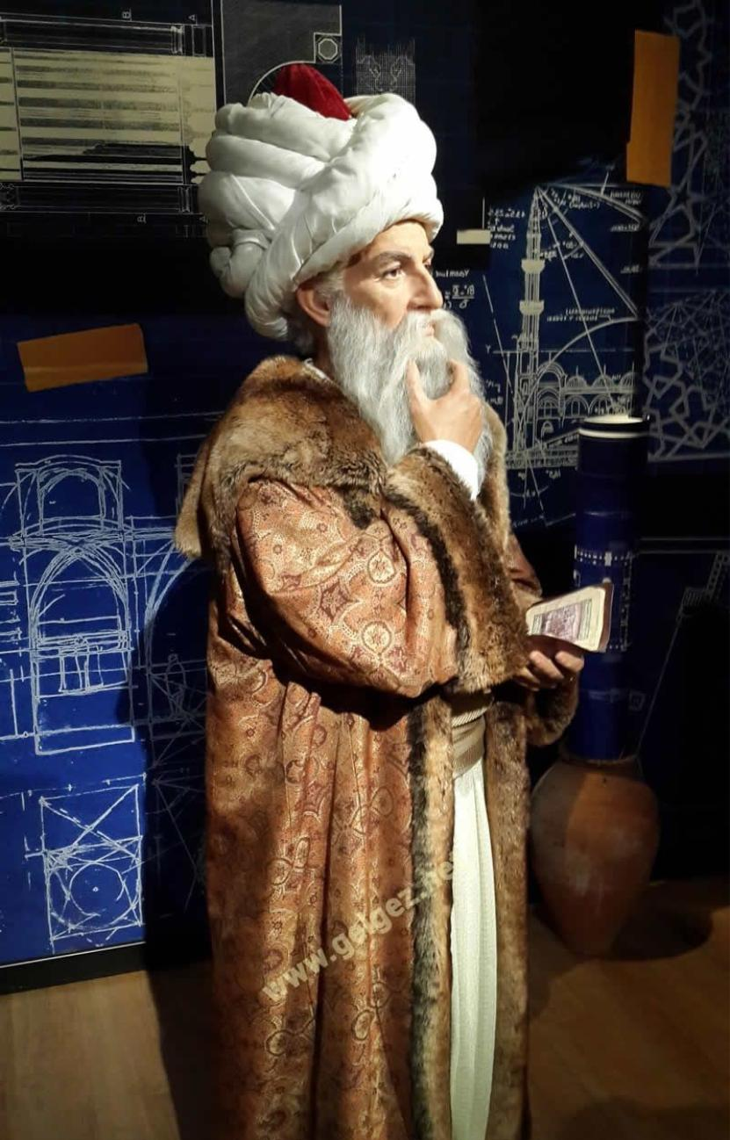
In the Karaboğdan Campaign in 1538, a bridge was needed for the army to cross the Prut River, and despite the efforts for days in the swampy area, the bridge could not be built. The task was given to Mimar Sinan by order of Damat Çelebi Lütfi Pasha, the vizier of Kanuni.
In 1539, upon the death of Architect Acem Ali, he became the Chief Architect of the Palace in his place. Later, Sinan, who took on various tasks to meet the army’s building needs, improved himself with the different architectural structures he observed in the places he went on an expedition. Sinan, who lived in the most powerful period of the Ottoman Empire, Suleiman the Magnificent, II. Selim and III. He served as chief architect to three sultans, including Murat.

Slide 4
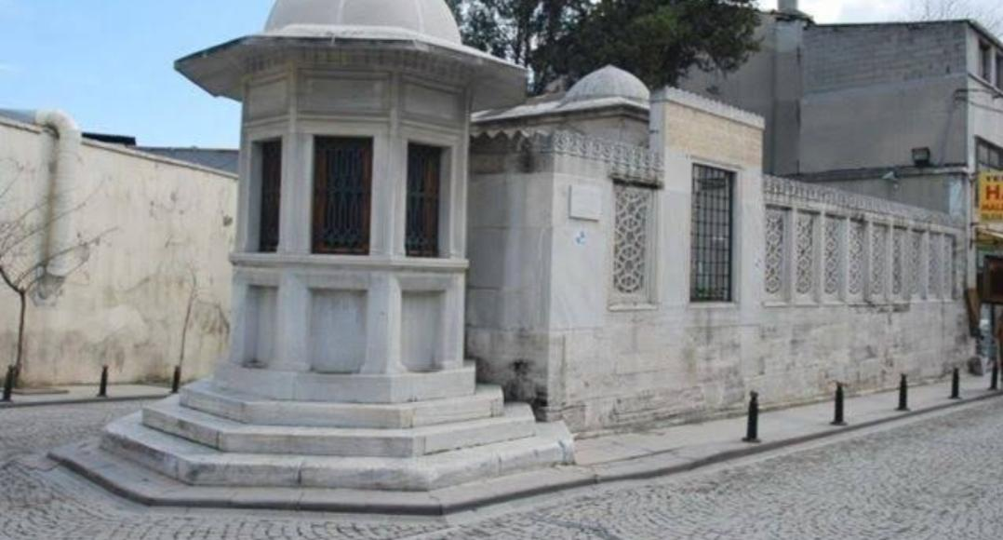
The mausoleum of Sinan, who left hundreds of architectural works behind when she passed away on July 17, 1588 in Istanbul, is a plain structure with white stone, in front of the Golden Horn wall in the Süleymaniye Complex.

Slide 5
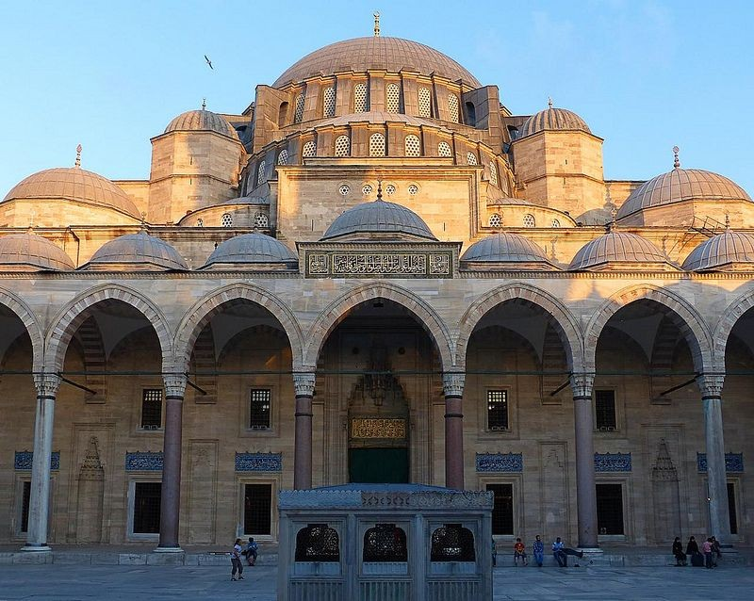
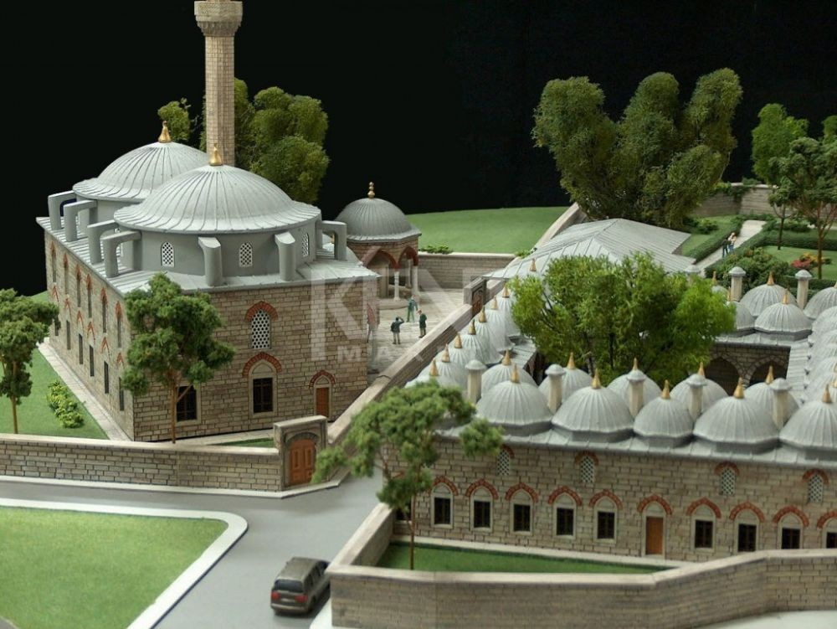
HASEKİ KULLIYE
SÜLEYMANİYE MOSQUE

Slide 6
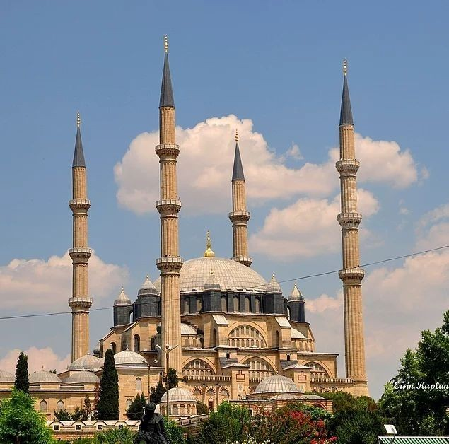
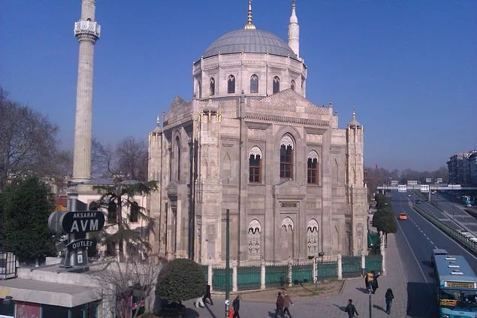
SELİMİYE MOSQUE
OLD VALIDE MOSQUE

Slide 7
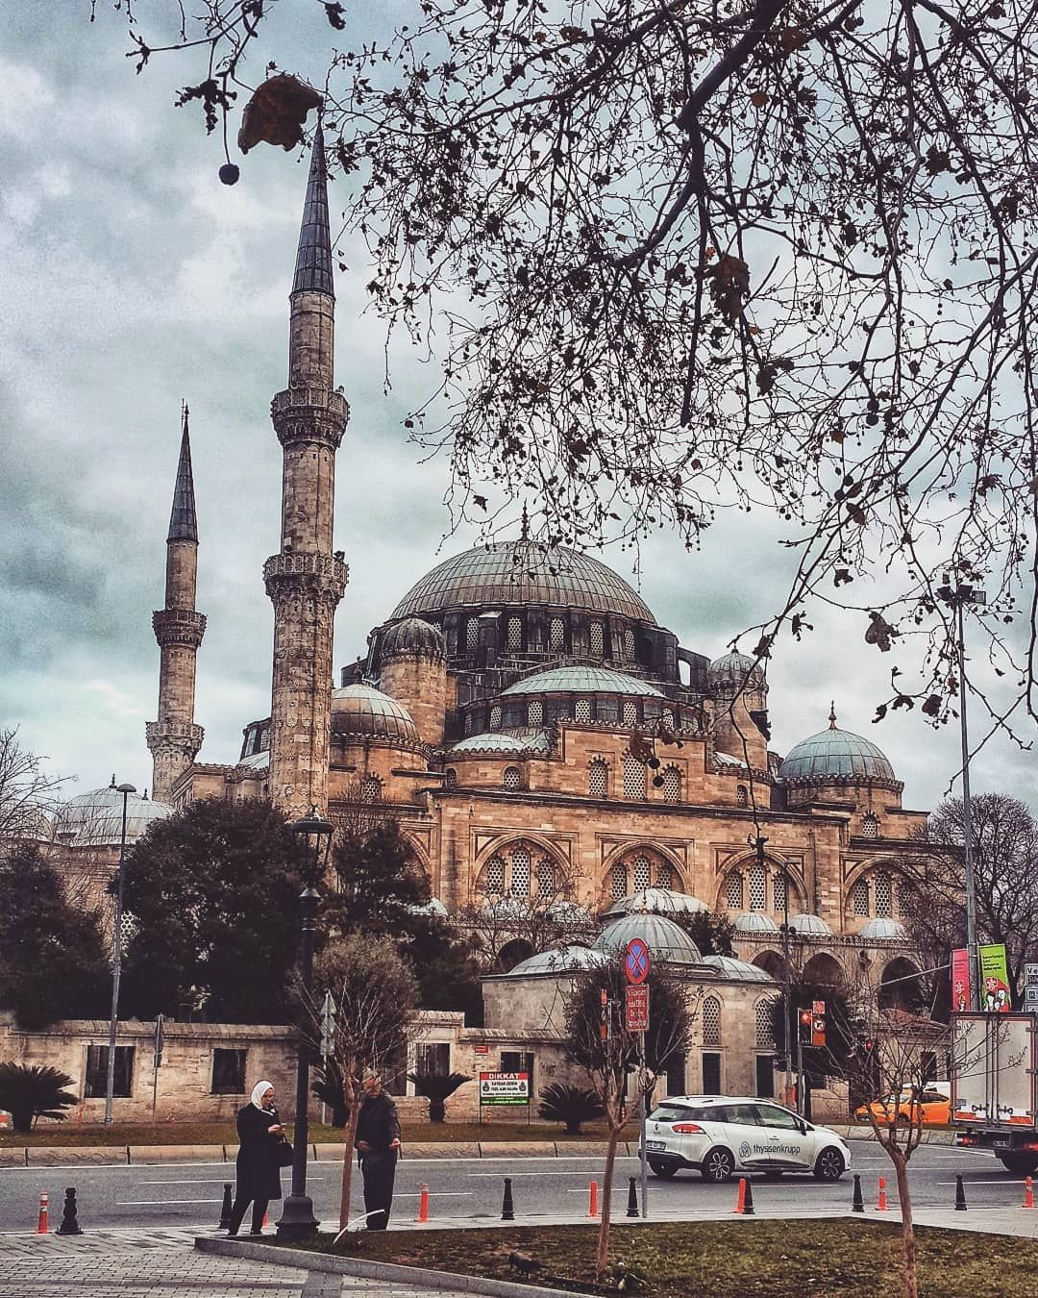
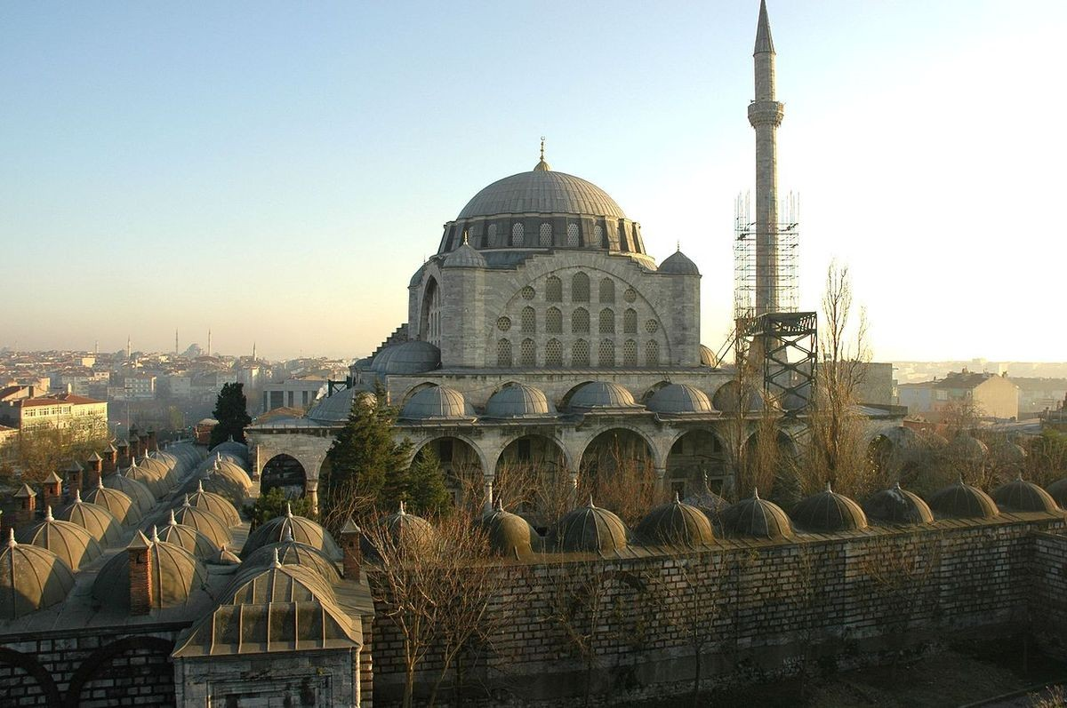
SEHZADE MOSQUE
MİHRİMAH SULTAN MOSQUE

Slide 8
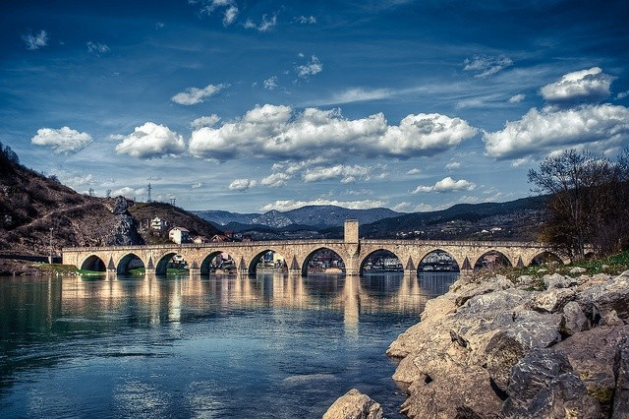
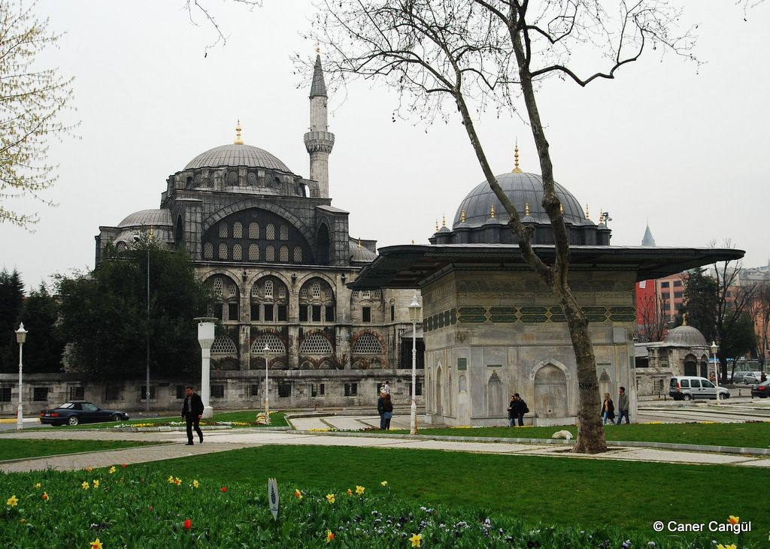
SOKULLU MEHMED PASA BRIDGE
KILIÇ ALİ PAŞA MOSQUE

Slide 9
REFERENCES
THANKS FOR LİSTENİNG TO ME 😁
https://www.star.com.tr/yasam/mimar-sinan-kimdir-mimar-sinan-eserleri-nelerdir-iste-hayati-haber-1497736/
NURULLAH SLAZALP
11/A 50

