Slide 1
FACTS ABOUT TURKEY
Rana Şen

Slide 2
THE PASSIVE
subject + to be + veby 3 + ( by)
This television was repaired by me
to be + subject+ veby 3 + (by)
Was this television repaired ?
subject + to be + not + veby3 +( by)
This television was not repaired

Slide 3
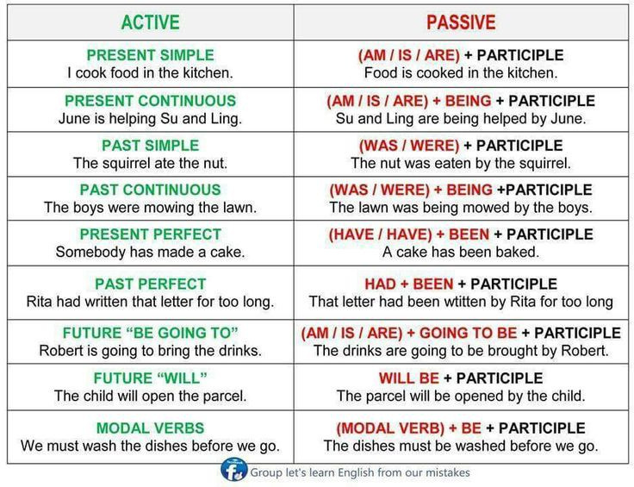
03 / 23

Slide 4
Important words
• Myths
• Facts
• Sneaky
• Imagincry
•Get in touch
• Find out
•Dug out
• Huge
•Worth in

Slide 5
LEGEND OF WILD ROSE
A gypsy girl's magical dance is told in the Legend of Wild Rose, a legend from the Aegean Region. Wild rose dances only on full moon nights. Because there is a wild beast living in the forest. Once this monster starts watching the Wild Rose dance, it won't attack people in the town. But one day, when two people from the town capture Wild Rose, the monster kills all the townspeople.

Slide 6
TURKEY'S OLD BUILDINGS

Slide 7
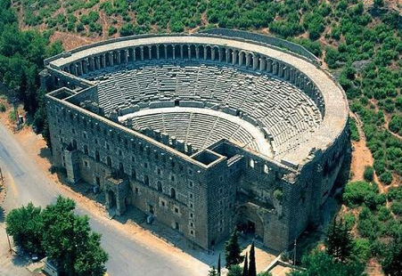
ASPENDOS
B.C. It was founded by the Achaeans in the 10th century and is one of the prosperous rich cities of the ancient period. The Theater here was built by the Romans in the 2nd century AD.

Slide 8
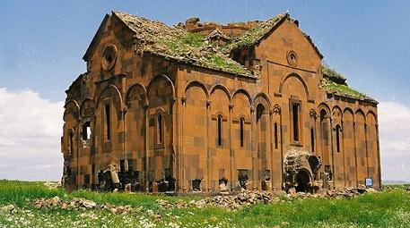
ANI RUINS
The history of Ani Ruins, 42 km from Kars, a medieval city built on a volcanic tuff layer, dates back to BC. It dates back to 5000 years. B.C. It was founded by the Achaeans in the 10th century and is one of the prosperous rich cities of the ancient period.

Slide 9
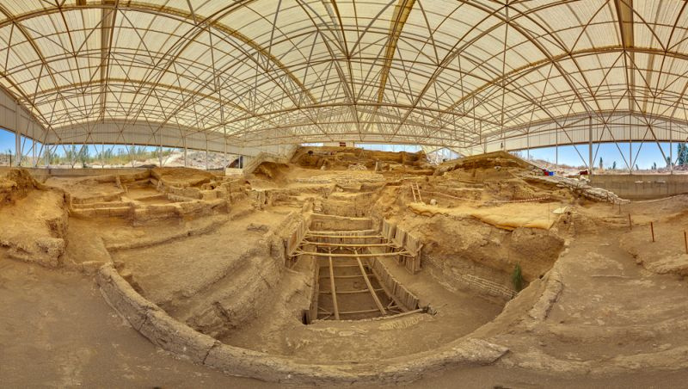
ÇATALHÖYÜK NEOLITHIC CITY
The earliest settlement level BC. The ancient city, which dates back to 5500 years, is considered to be one of the largest and most crowded settlements of the period.

Slide 10
references
https://www.webtekno.com/haber/amp/60951 https://www.milliyet.com.tr/egitim/milli-kulturumuze-ait-efsaneler-nelerdir-kisaca-bir-efsane-6491133 https://www.wse.com.tr/blog/passive-voice-etken-edilgen-cumleler-konu-anlatimi/

