Slide 1
PAST SPACE ACCIDENTS

Slide 2
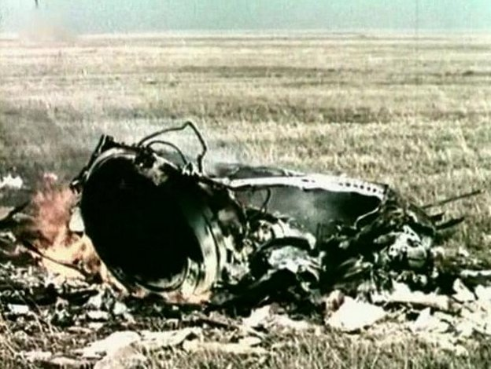
SOYUZ 1 CRASH
It is the first mortal space flight in history.
Vladimir Kamorov is chief cosmonaut.
The space shuttle crashed on April 24, 1967.
During the descent, the capsule's main parachute and auxiliary parachute did not open, so it fell to the ground.

Slide 3
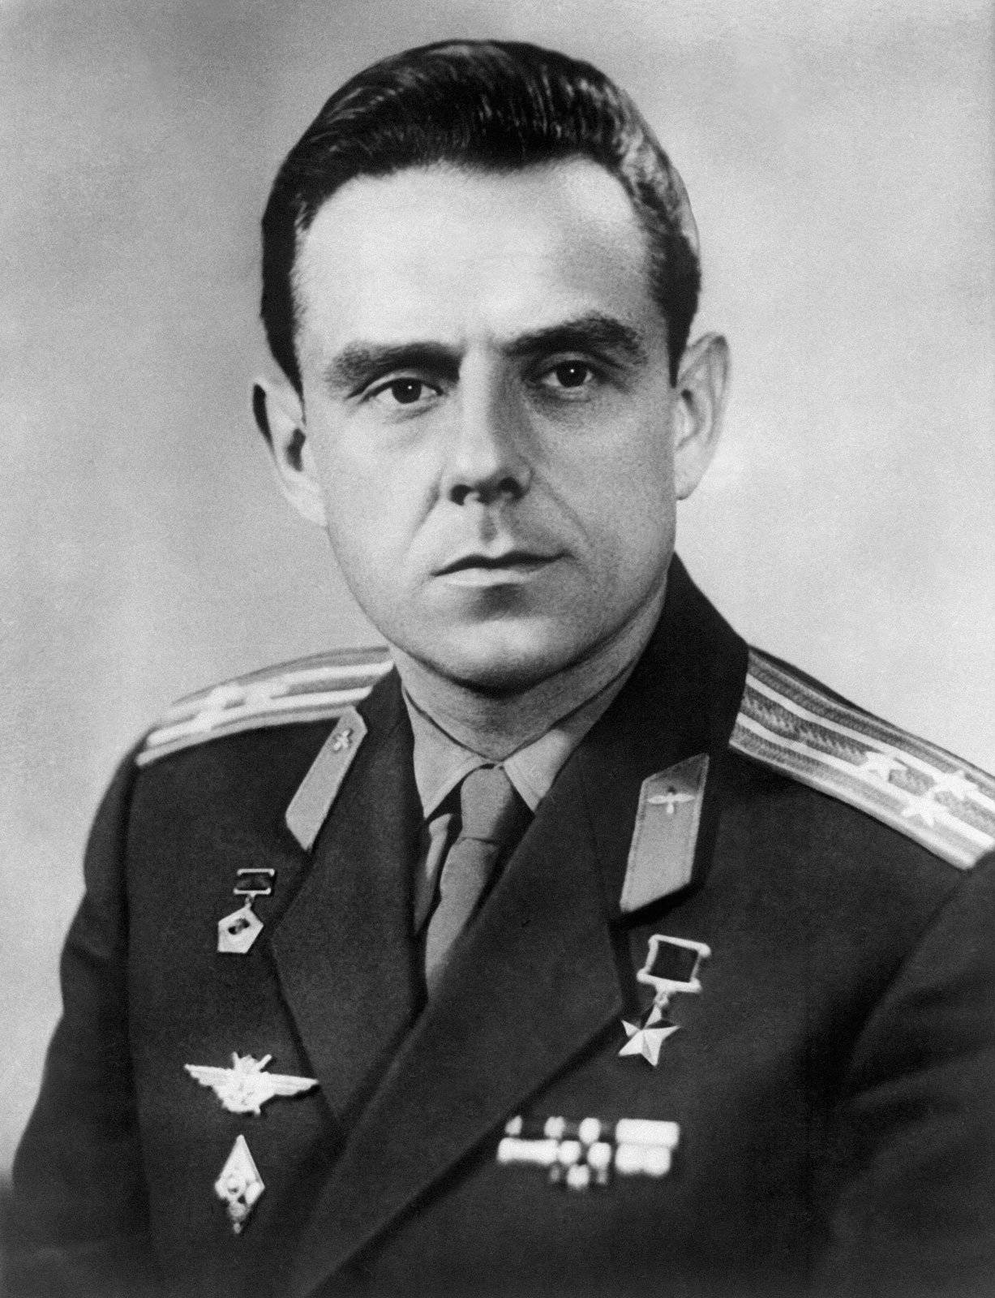
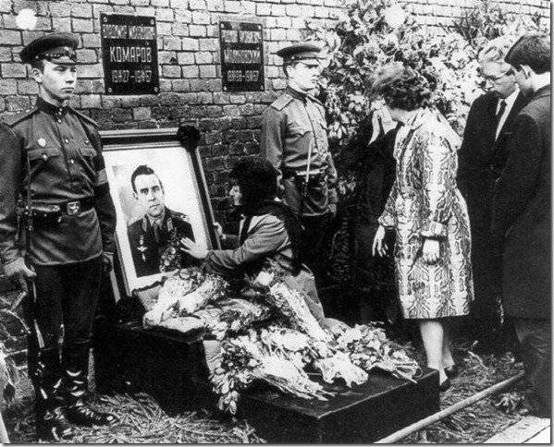
The race between the USA and the Soviet Union to be the first to reach space and the Moon is one of the most important reasons for this accident

Slide 4
Allegedly, in his last seconds, Komarov was cursing all the Soviet officials who had blatantly killed him: "You put me in this broken spacecraft, you killed me"...

Slide 5
SOYUZ 11
It was the first time a manned spacecraft had docked with a space station. There was a first in history when the Soyuz 11 spacecraft docked with the Salyut 1 space station.
Soyuz 11 was launched on June 30, 1971.
On July 7, it docked with Salyut 1 station.
Everything was fine on the way back. But when Soyuz 11 landed, everyone was in for a shock. The rescue team found the crew dead. During the descent, there was a leak in the vent and all the air inside was evacuated. Vladislav Volkov, Georgi Dobrovolski and Viktor Patsayev drowned.

Slide 6
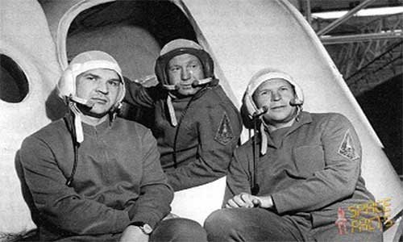

Slide 7
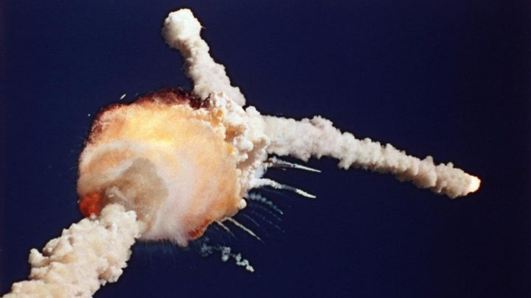
COLUMBiA SPACE SHUTTLE CRASH
It disintegrated in the atmosphere on February 1, 2003, 16 minutes before landing, during its return to Earth. This accident caused the death of 7 astronauts, including 6 Americans and 1 Israeli. It is the second accident to occur in the Space Shuttle program. The cause of the accident was shown as the damage to the left wing of the shuttle by a piece that broke off from the main fuel tank during takeoff.

Slide 8
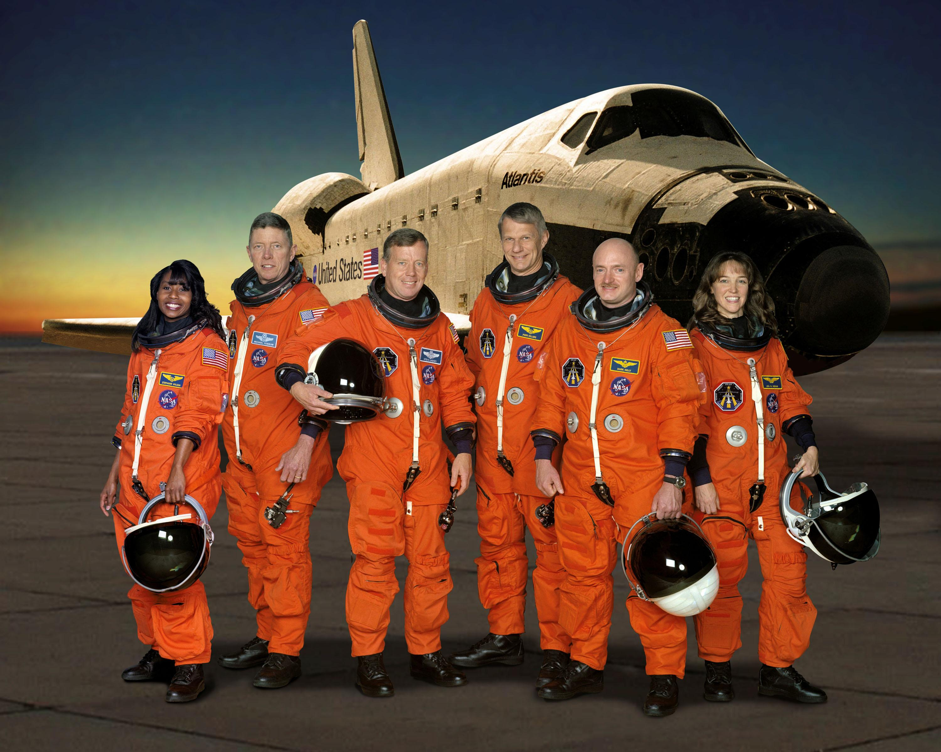

Slide 9
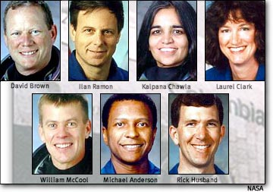

Slide 10
X-15 FLiGHT 191
Over the years NASA has conducted tests on a number of experimental aircraft designed to reach high altitudes. One of these was the X-15, a hypersonic rocket-powered aircraft that broke multiple height and speed records. The planes used by Michael J. Adams first made routine test flights. All Adams' efforts to contain the X-15 were futile, and the plane crashed 10 minutes and 35 seconds after launch. The accident caused by electrical problems resulted in the death of Michael J. Adams.

Slide 12
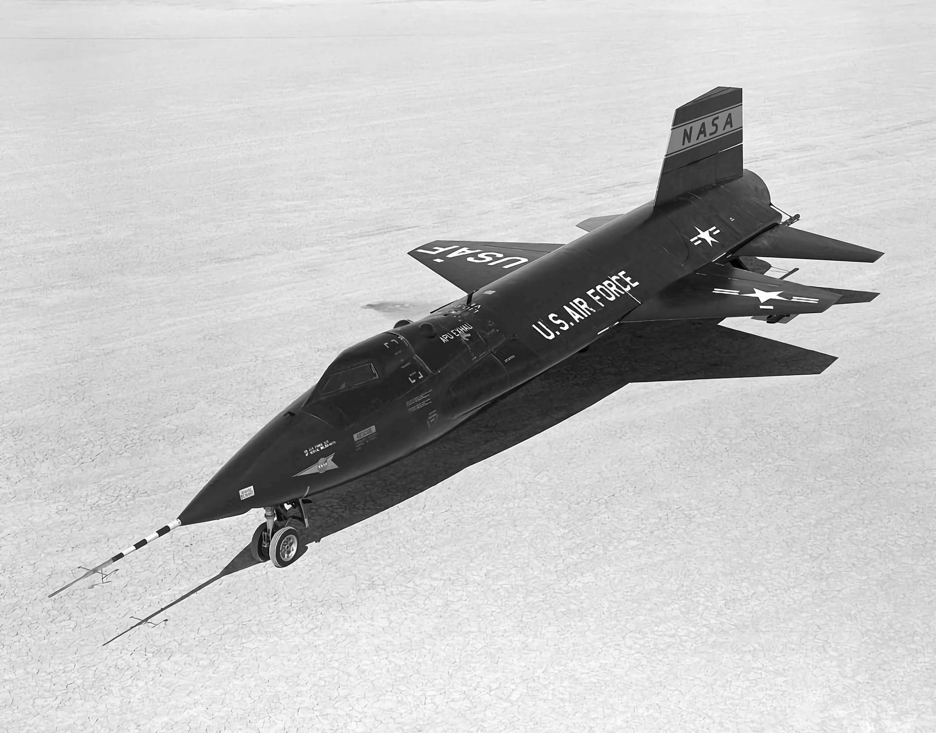

Slide 13
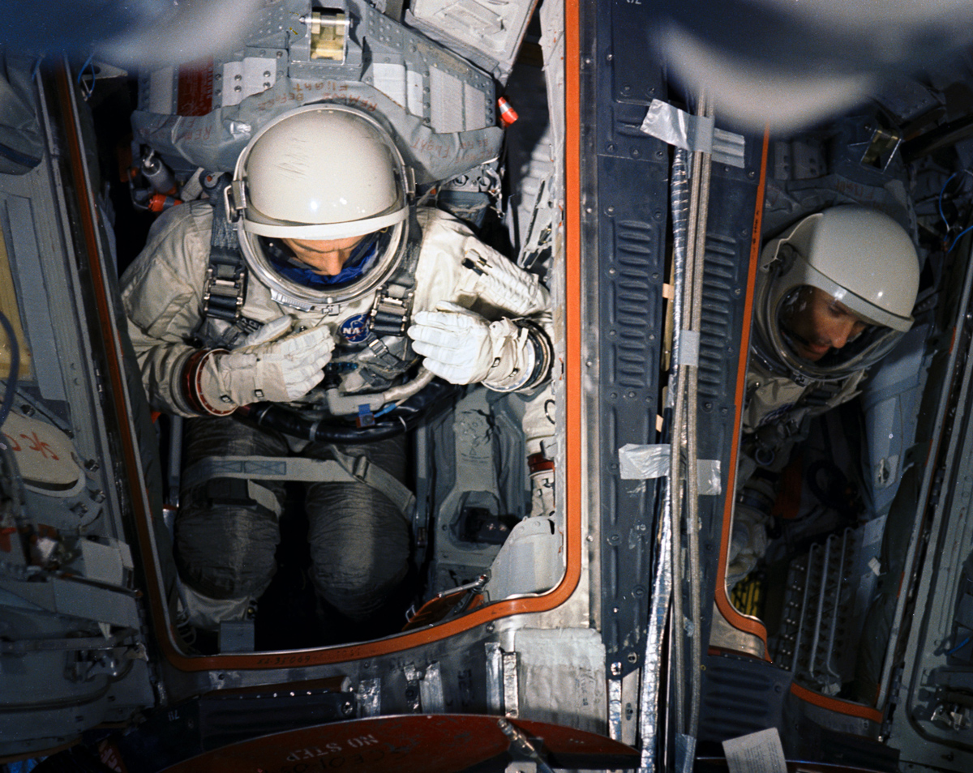
GEMİNİ 9
NASA selected command pilot Elliot See and pilot Charles Bassett as crew for manned space travel. Both pilots died in a plane crash on February 28, 1966, on their way to Missouri due to bad weather conditions. Replacement pilots Thomas P. Stafford and Eugene Cernan went to space to replace the deceased pilots and successfully completed the mission.

Slide 16
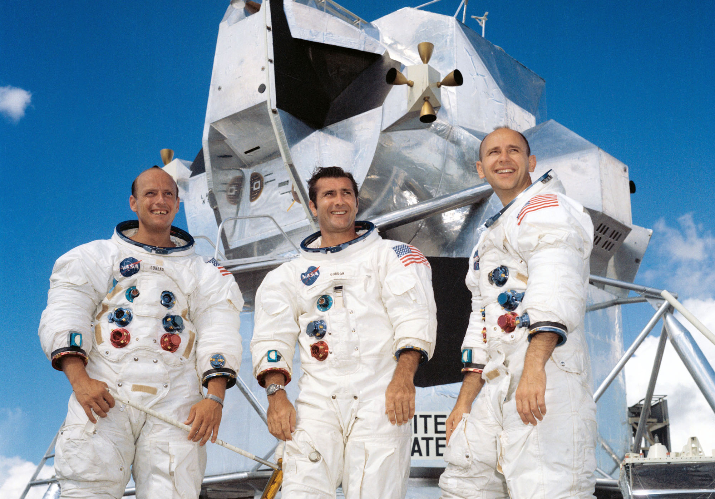
APOLLO 12
It is the spacecraft that made the second manned landing on the Moon. It was launched on 14 November 1969. The spacecraft was struck by lightning 36 seconds after launch. 52 seconds later, a second lightning struck. As a result of lightning strikes, 4 temperature sensors were broken. Luckily, fuel cell power recovered after a few minutes, and the astronauts made sure everything was working properly before heading to the Moon.

Slide 19
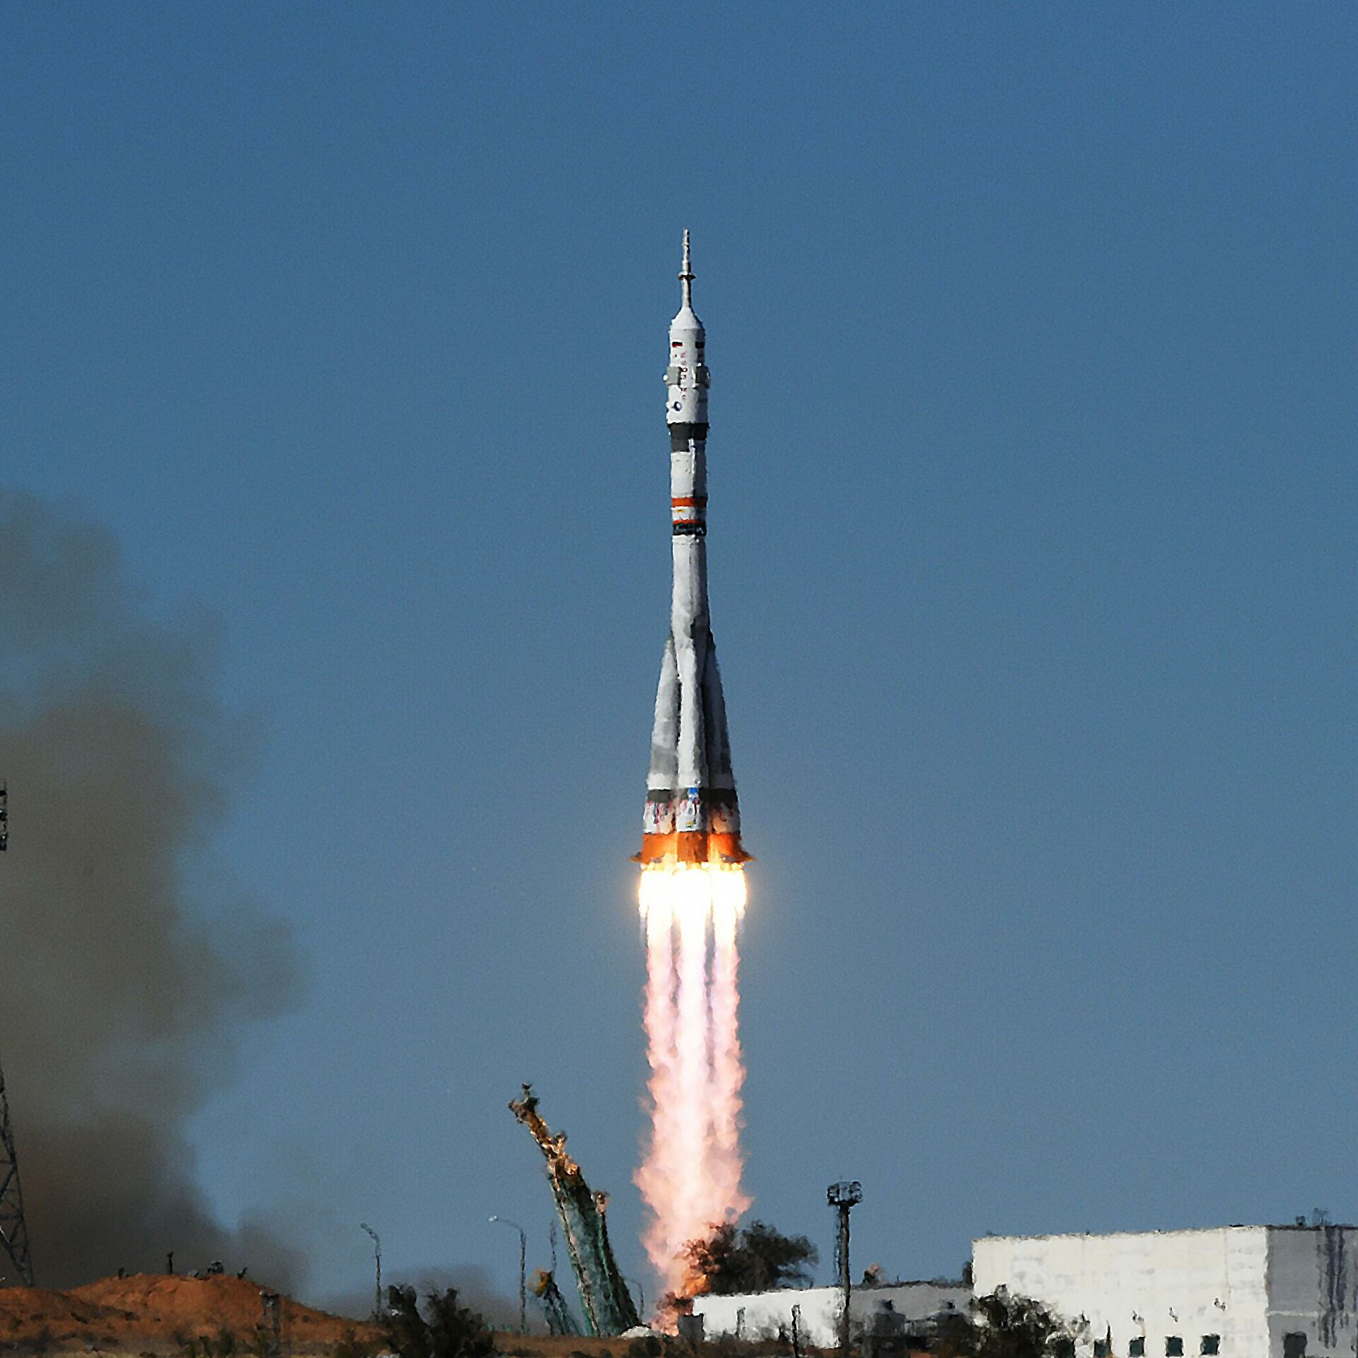
SOYUZ 18-1
It was launched into space by the Soviets on April 5, 1975. It crashed before it could reach orbit due to malfunction. Thanks to the smooth operation of the emergency landing system, cosmonauts Vasily Lazarev and Oleg Makarov escaped injury. This event was also recorded as the April 5 Anomaly.

Slide 21
REFERANCES
https://www.fakiryazar.com/yasanmis-uzay-kazalari/amp/
https://tr.m.wikipedia.org/wiki/Columbia_Uzay_Meki%C4%9Fi_Kazas%C4%B1

Slide 22
ZEYNEP ŞAHİN

